Slide 1
4102165:
Full Stack Web Development Fundamentals
Spring 2019
簡立仁 Li-Ren Chien
ccumouse@gmail.com

Slide 2
schedule
Today
Middleware and Routes
Single-page web app
More MongoDB examples
Authentication
Next
Our last lecture!
What's next: An opinionated guide

Slide 3
Final project
Final Project Proposal due today 6/11
Final Project is due Mon, June 17
You will need to create a Video Walkthrough, which will not be graded (aside from completion)
Required for every project, Diary app or original

Slide 4
Web topic requests
Post to our Piazza post:
https://piazza.com/class/j0y7gmnuoh167p?cid=184

Slide 5
Modules and Routes

Slide 6
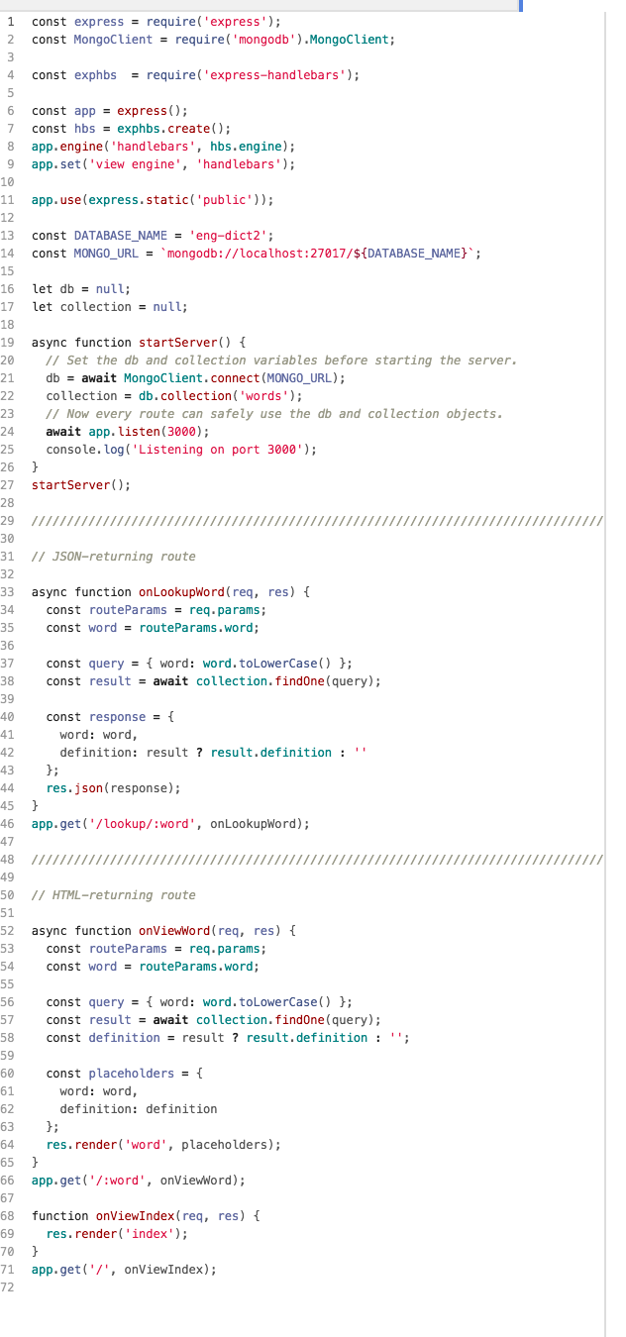
Routes
So far, our server routes have all been defined in one file.
Right now, server.js:
Starts the server
Sets the template engine
Serves the public/ directory
Defines the JSON-returning routes
Defines the HTML-returning routes
As our server grows, it'd be nice to split up server.js into separate files.

Slide 7
Recall: Modules

Slide 8
NodeJS modules
You can include it in another JavaScript file by using the require statement:
Note that you MUST specify "./", "../", "/", etc.
Otherwise NodeJS will look for it in the node_modules/ directory. See require() resolution rules

Slide 9
module.exports
module is a special object automatically defined in each NodeJS file, representing the current module.
When you call require('./fileName.js'), the require() function will return the value of module.exports as defined in fileName.js
module.exports is initialized to an empty object.

Slide 10
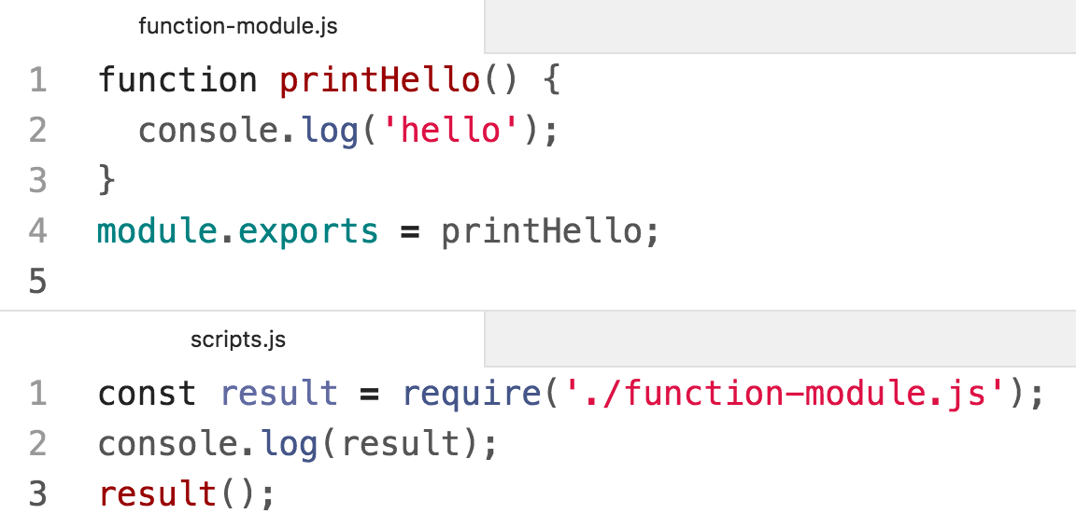
$ node scripts.js
[Function: printHello]
hello
We can export a function by setting it to module.exports

Slide 11
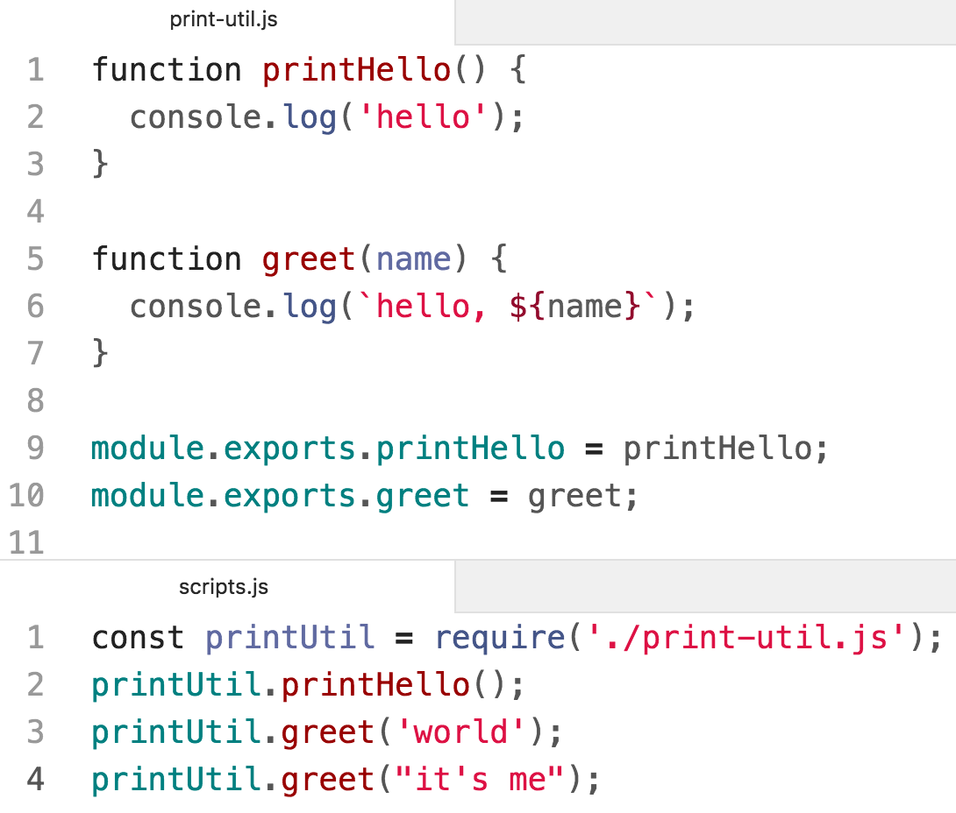
$ node scripts.js
hello
hello, world
hello, it's me
We can export multiple functions by setting fields of the module.exports object

Slide 12
Back to Routes

Slide 13
Routes
So far, our server routes have all been defined in one file.
Right now, server.js:
Starts the server
Sets the template engine
Serves the public/ directory
Defines the JSON-returning routes
Defines the HTML-returning routes
As our server grows, it'd be nice to split up server.js into separate files.

Slide 14
Goal: HTML vs JSON routes
Let's try to split server.js into 3 files.
Right now, server.js does the following:
Starts the server
Sets the template engine
Serves the public/ directory
Defines the JSON-returning routes
Defines the HTML-returning routes
→ We'll continue to use server.js for the logic in blue
→ We'll try to move JSON routes to api.js
→ We'll try to move the HTML routes to view.js

Slide 15
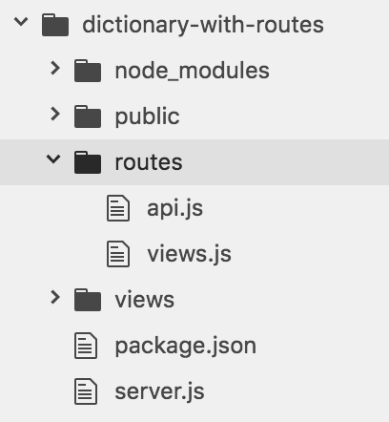
Goal: HTML vs JSON routes
→ We'll continue to use server.js for the logic in blue
→ We'll try to move JSON routes to api.js
→ We'll try to move the HTML routes to view.js
Desired directory structure:

Slide 16
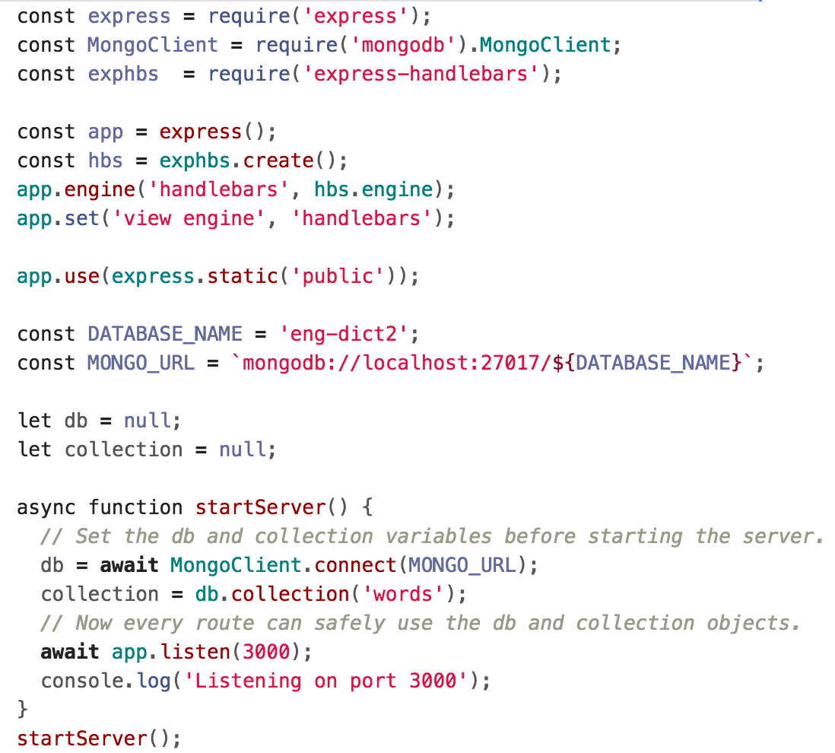
Desired: server.js
We'd like to keep all set-up stuff in server.js...

Slide 17
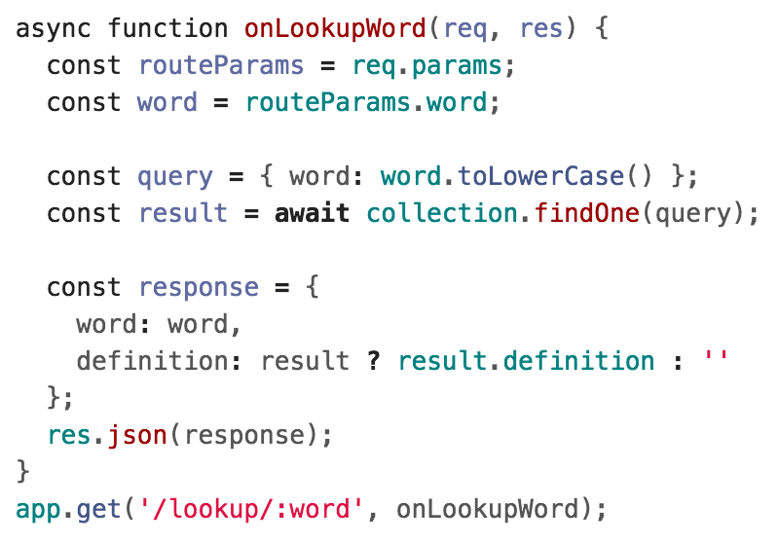
Desired api.js (DOESN'T WORK)
And we'd like to be able to define the /lookup/:word route in a different file, something like the following:
Q: How do we define routes in a different file?

Slide 18
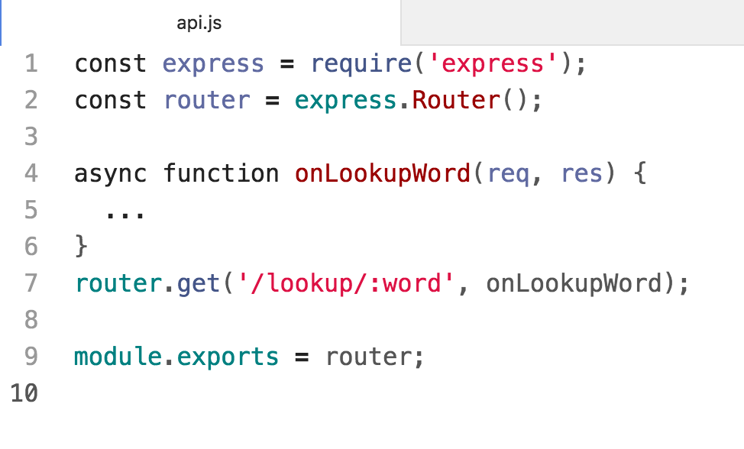
Router
Express lets you create Router objects, on which you can define modular routes:

Slide 19
Router
Create a new Router by calling express.Router()
Set routes the same way you'd set them on App
Export the router via module.exports

Slide 20
Using the Router
Now we include the router by:
Importing our router module via require()
Calling app.use(router) on the imported router
Now the app will also use the routes defined in routes/api.js!
However, we have a bug in our code...

Slide 21
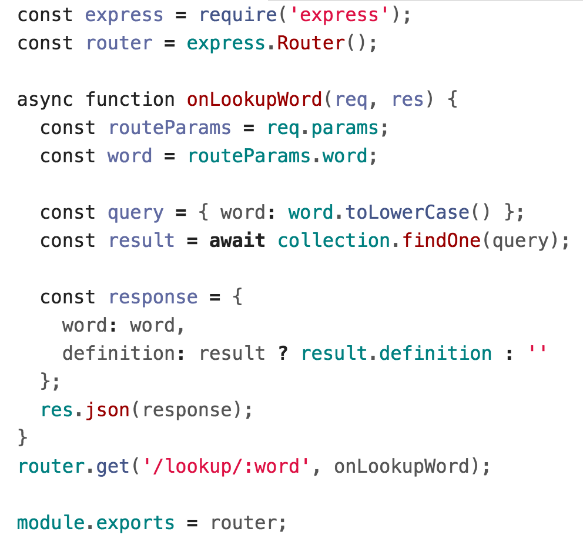
MongoDB variables
We need to access the MongoDB collection in our route...

Slide 22
MongoDB variables
...Which used to be defined as a global variable in server.js.
Q: What's the right way to access the database data?

Slide 23
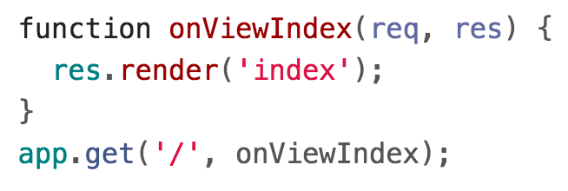
Middleware
In Express, you define middleware functions that get called certain requests, depending on how they are defined.
The app.METHOD routes we have been writing are actually middleware functions:
onViewIndex is a middleware function that gets called every time there is a GET request for the "/" path.

Slide 24
Middleware: app.use()
We can also define middleware functions using app.use():
Middleware functions receive 3 parameters:
req and res, same as in other routes
next: Function parameter. Calling this function invokes the next middleware function in the app.
If we resolve the request via res.send, res.json, etc, we don't have to call next()

Slide 25
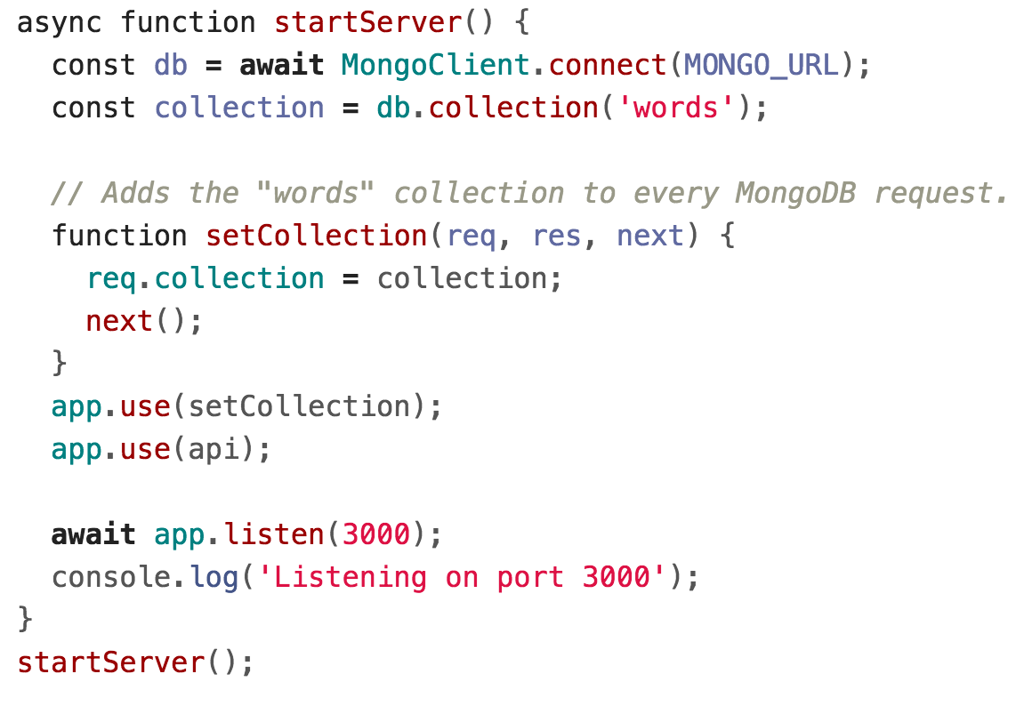
Middleware: app.use()
We can write middleware that defines new fields on each request:

Slide 26
Middleware: app.use()
Now if we load this middleware on each request:

Slide 27
Middleware: app.use()
Now if we load this middleware on each request:
Note that we need to use the api router AFTER the middleware

Slide 28
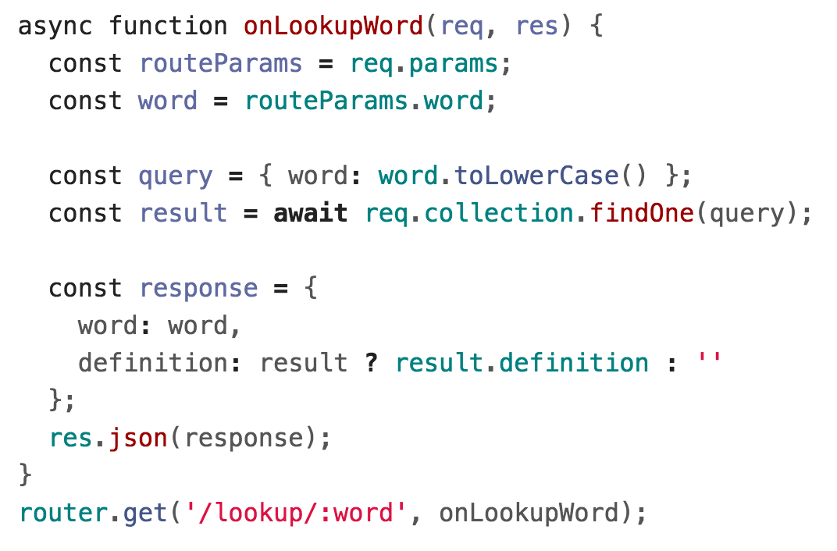
Middleware: app.use()
Then we can access the collection via req.collection:

Slide 29
Middleware: app.use()
Then we can access the collection via req.collection:

Slide 30
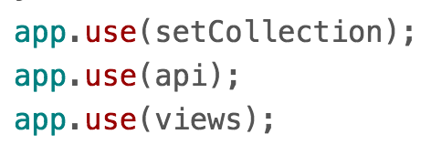
Views router
We can similarly move the HTML-serving logic to views.js and require() the module in server.js:

Slide 31
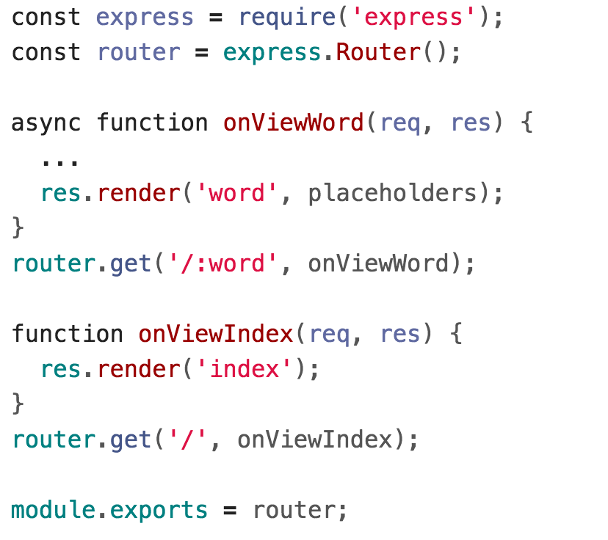
Views router

Slide 32
Routes and middleware
Simple middleware example code is here:
simple-middleware
Run instructions
Dictionary with routes example code here:
dictionary-with-routes
Run instructions
Express documentation:
Router
Writing / Using Middleware

Slide 33
Recall: Web app architectures

Slide 34
Structuring a web app
There are roughly 4 strategies for architecting a web application:
Server-side rendering:
Server sends a new HTML page for each unique path
Single-page application: Server sends the exact same web page for every unique path (and the page runs JS to change what it look like)
Combination of 1 and 2 ("Isomorphic" / "Universal")
Progressive Loading

Slide 35
Structuring a web app
There are roughly 4 strategies for architecting a web application:
Server-side rendering:
Server sends a new HTML page for each unique path
Single-page application: Server sends the exact same web page for every unique path (and the page runs JS to change what it look like)
→ Let's talk about this one now

Slide 36
Single-page web app

Slide 37
Single page web app
The server always sends the same one HTML file for all requests to the web server.
The server is configured so that requests to /<word> would still return e.g. index.html.
The client JavaScript parses the URL to get the route parameters and initialize the app.
GET localhost:3000/
index.html

Slide 38
Single page web app
The server always sends the same one HTML file for all requests to the web server.
The server is configured so that requests to /<word> would still return e.g. index.html.
The client JavaScript parses the URL to get the route parameters and initialize the app.
GET localhost:3000/dog
index.html

Slide 39
Single page web app
Another way to think of it:
You embed all your views into index.html
You use JavaScript to switch between the views
You configure JSON routes for your server to handle sending and retrieving data
GET localhost:3000/dog
index.html

Slide 40
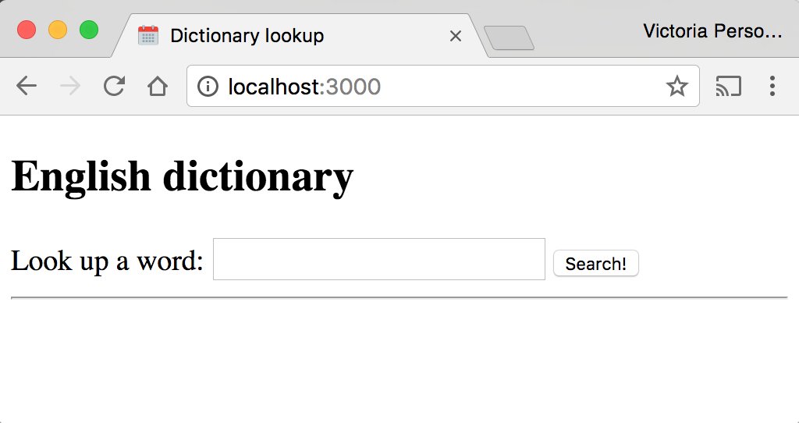
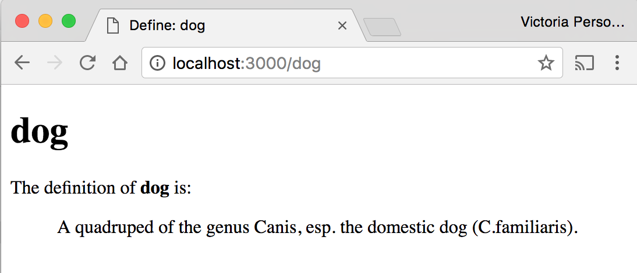
Dictionary example
Let's write our dictionary example as a single-page web app.

Slide 41
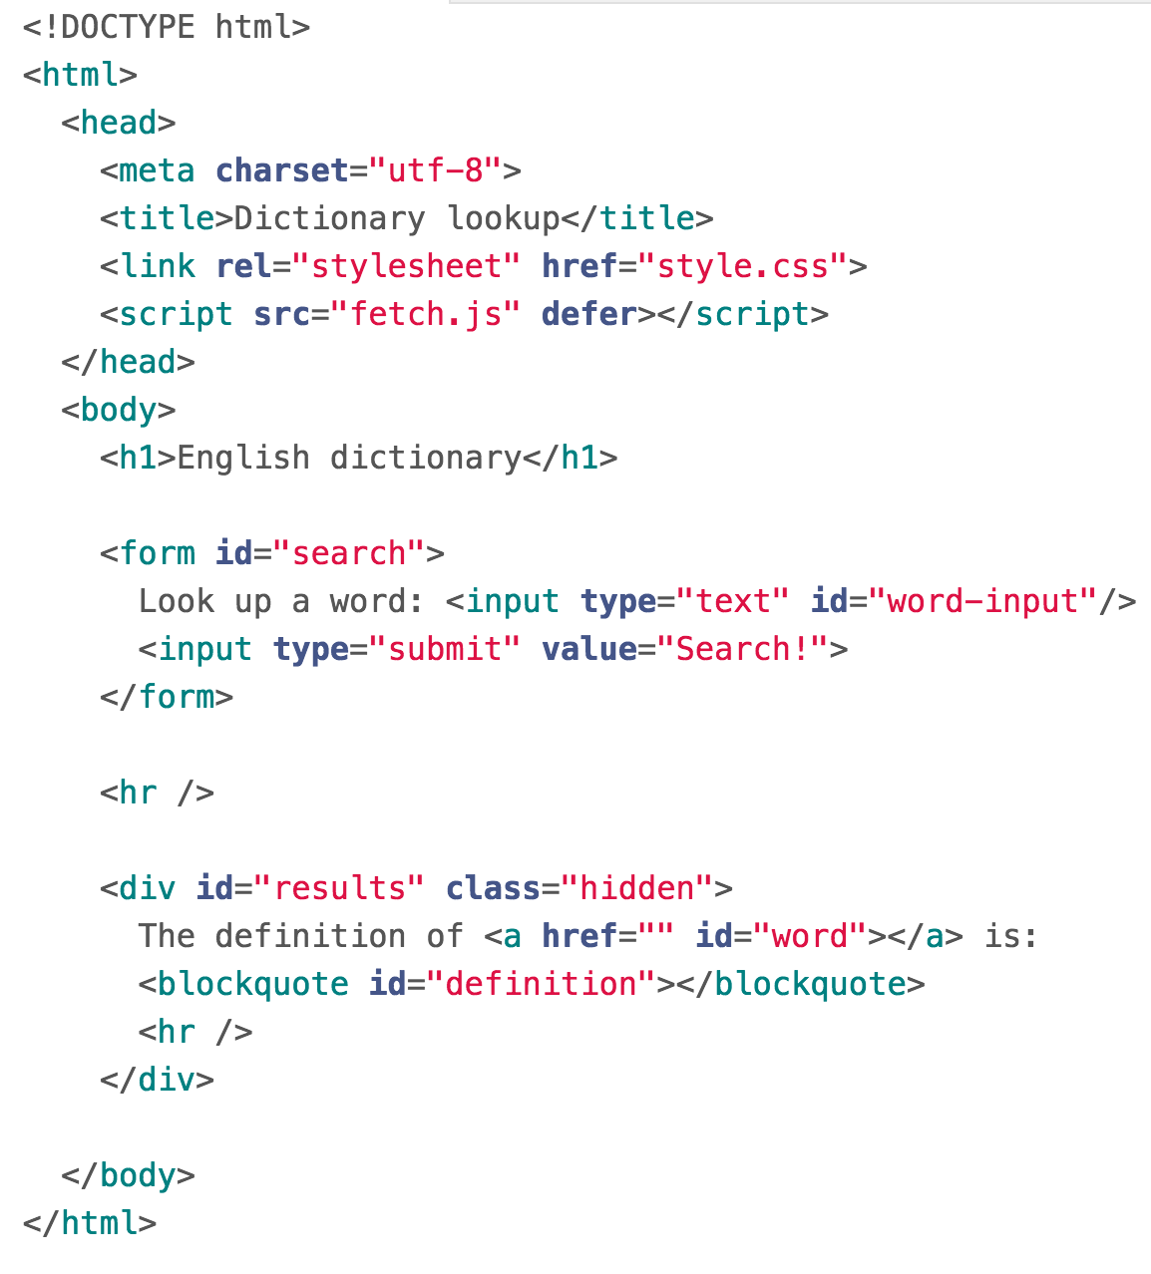
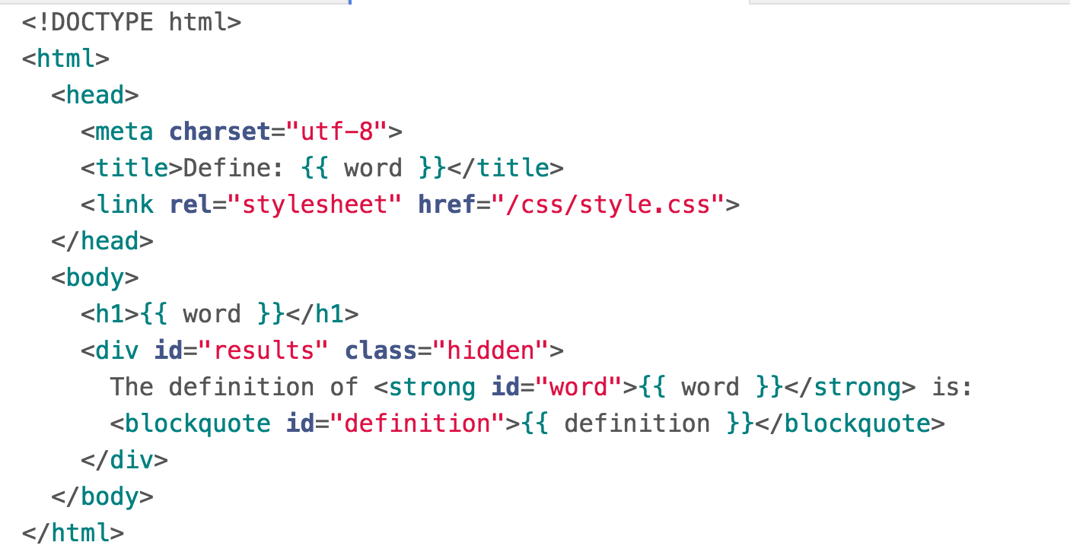
Recall: Handlebars
For our multi-page dictionary app, we had two handlebars files: index.handlebars and word.handlebars
word.handlebars
index.handlebars

Slide 42
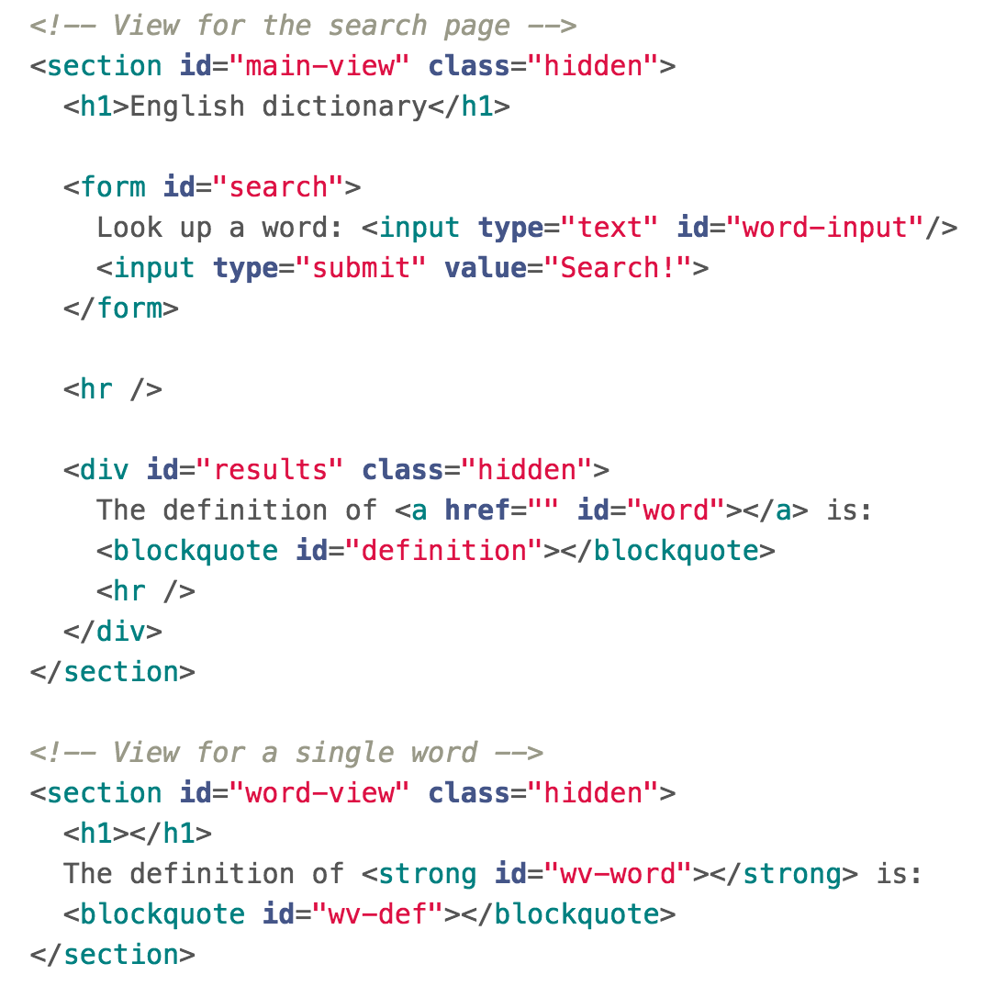
SPA
In a single-page web app, the HTML for both the Search page and the Word page are in index.html:

Slide 43
Server-side routing
For all requests that are not JSON requests, we return "index.html"

Slide 44
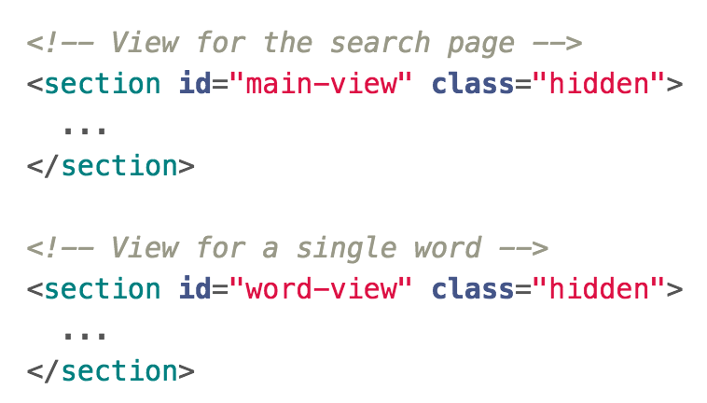
Client-side parameters
All views are hidden at first by the client.

Slide 45
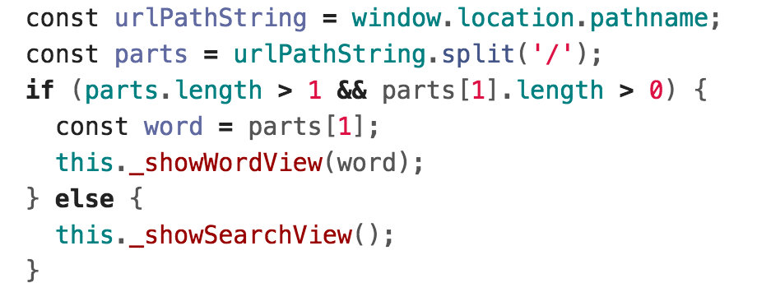
Client-side parameters
When the page loads, the client looks at the URL to decide what page it should display.

Slide 46
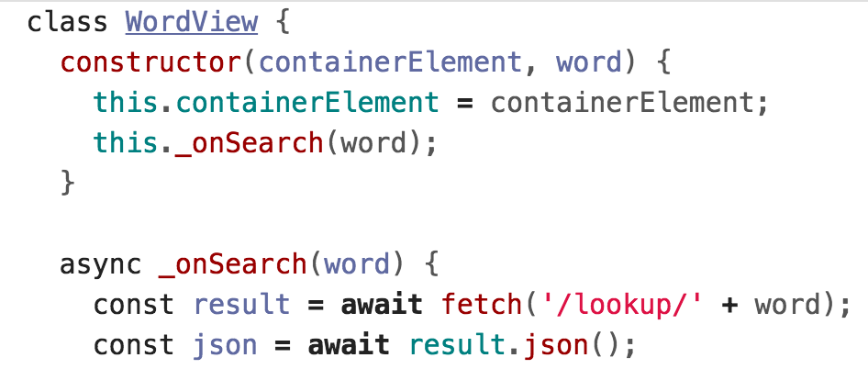
Client-side parameters
To display the word view, the client makes a fetch() requests for the definition.

Slide 47
Completed example
Completed example code:
dictionary-server-side
See run instructions

Slide 48
More MongoDB examples

Slide 49
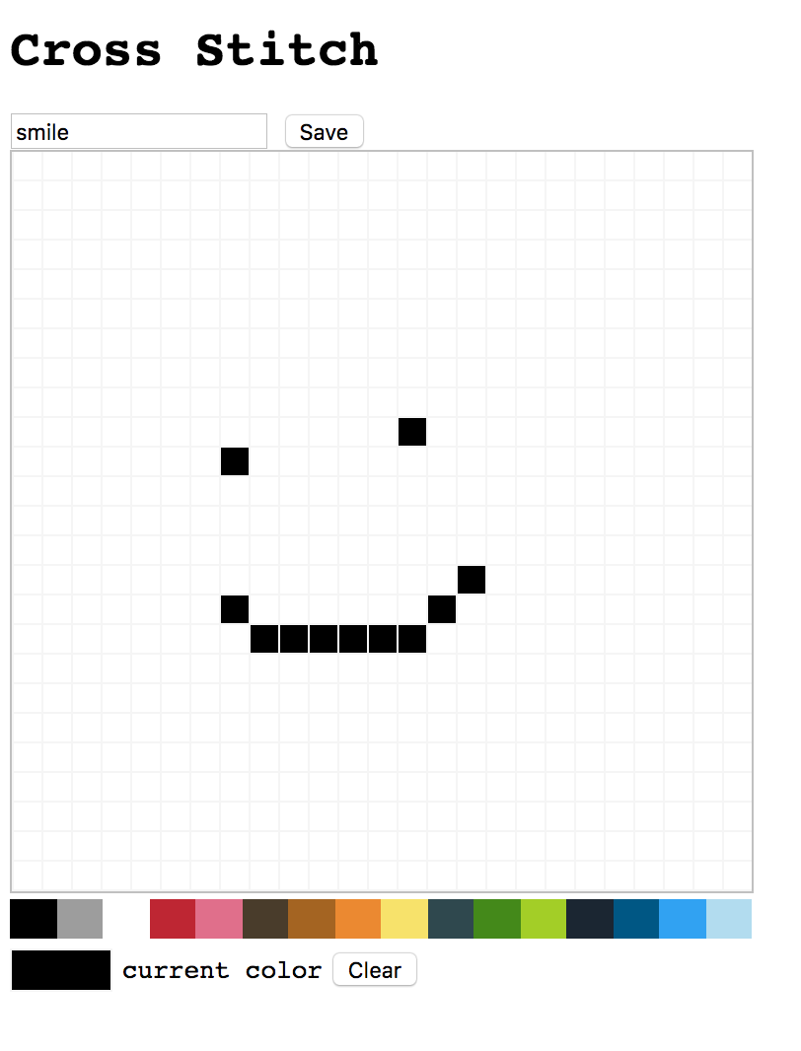
Example: Cross-stitch
Let's say that we want to write a Cross-stitch App, that lets us create and save a cross-stitch drawing (called a "hoop").
→ Simplest version: 1 global drawing

Slide 50
Implementation
There are 625 (25x25) small divs that make up each square of the drawing.
Q: How do we save the drawing to a database?

Slide 51
Data representation
You need to figure out a way to represent your data, in a way that lets us load the drawing later.
For each colored square, need to know:
Color
Position
For the hoop, need to know:
Name of the hoop

Slide 52
Data representation options
One option: Give every pixel a number, 0-625, and assign each number a color
hoopData = {
title: "smile",
pixelData: [
'white',
'white',
…
]
}

Slide 53
Data representation options
One option: Give every pixel a number, 0-625, and assign each number a color
Drawbacks:
Would be hard to support grids of different sizes
You don't need to store Information for every pixel, only the changed pixels

Slide 54
Data representation options
Another option: Give every non-empty pixel a row number, column number, and a color
hoopData = {
title: "smile",
pixelData: [
{ row: 12, col: 8, color: 'black' },
{ row: 11, col: 15, color: 'black' },
...
]
}

Slide 55
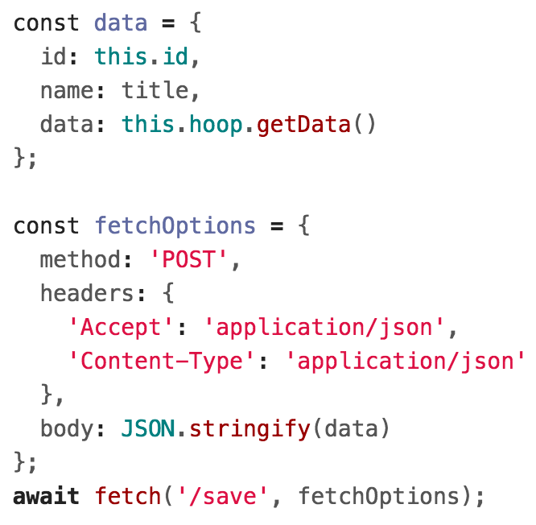
Saving data
Since there is only one hoop, saving and retrieving the data is pretty easy:
On the client side, make a fetch POST request:
(The first time we save, we won't have an id value.)

Slide 56
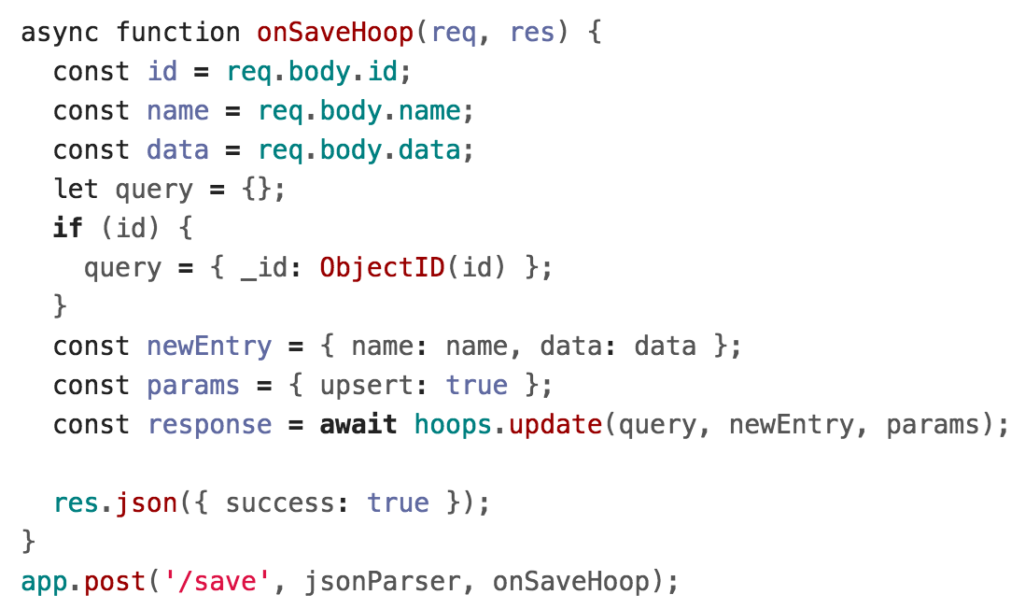
Saving data
Since there is only one hoop, saving and retrieving the data is pretty easy:
On the server side, upsert the entry to the database:

Slide 57
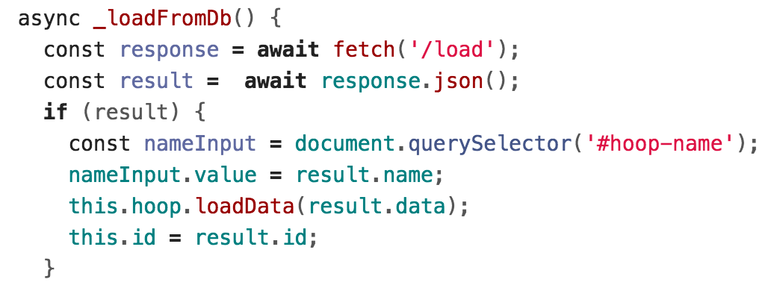
Loading data
On the client side, make a fetch GET request when the page first loads:

Slide 58
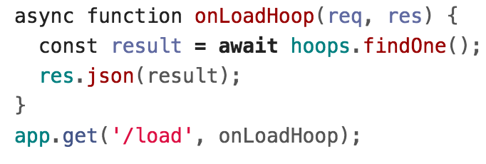
Loading data
On the server side, retrieving the data is *really* easy, since there is only one hoop:

Slide 59
Completed example
One global cross-stitch hoop:
cross-stitch-one-hoop
See run instructions

Slide 60
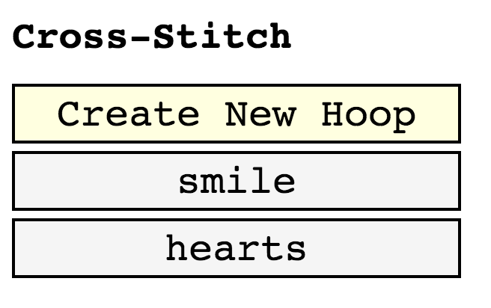
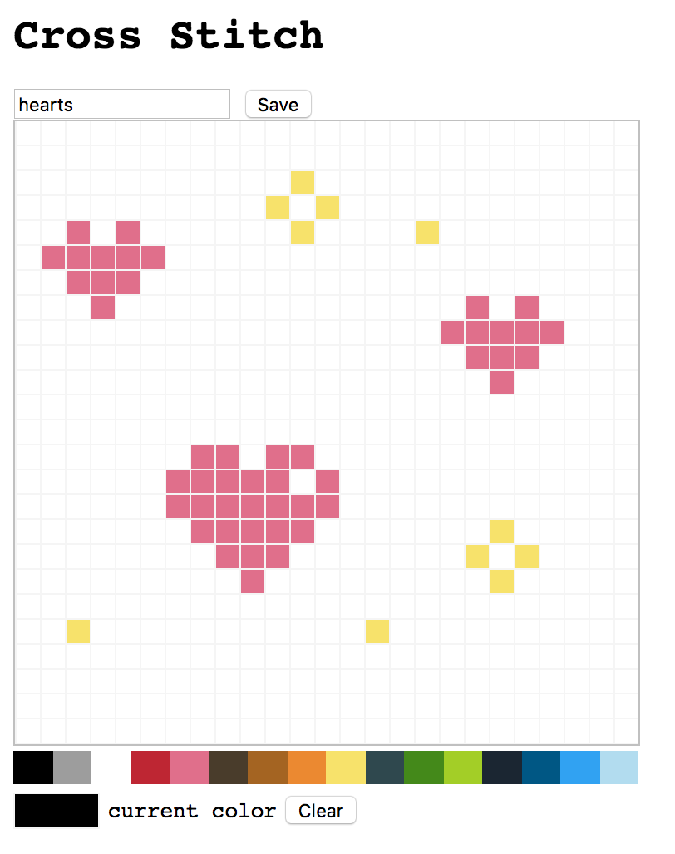
Example: Cross-stitch
Let's extend the cross-stitch App to create and save multiple cross-stitch drawings.
Each drawing is loaded at localhost:3000/id/<id>

Slide 61
Data representation
We can use the same data representation for each drawing; we're just going to have more than one:

Slide 62
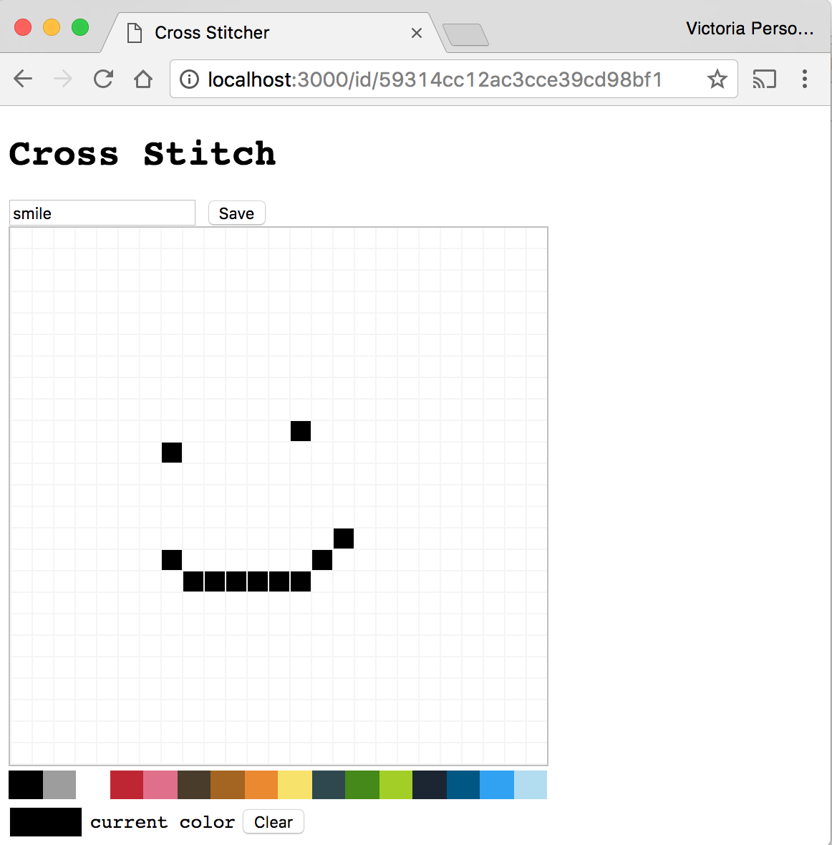
Two screens
A trickier decision is figuring out how to design the two screens, including a unique URL for each image:

Slide 63
Loading data
Let's say that you have a URL at id/59314cc12ac3cce39cd98bf1.
Q: How do we load the URL for this id?

Slide 64
Loading data
One solution: Look at the URL on the client and get the ID
(Some other solutions:
Build the page completely in Handlebars template (icky)
Inject a global JavaScript variable into the Handlebars template (icky and tricky))

Slide 65
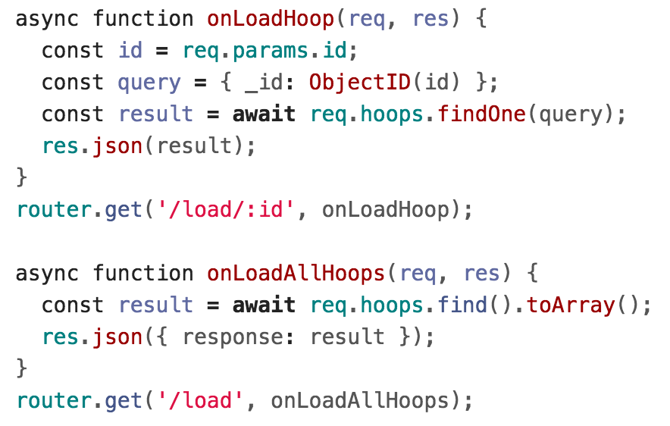
Loading data
The server-side lookups are easy:

Slide 66
Aside: HashIds
In the cross-stitch app and the e-cards app, we used the raw MongoDB ids in the URL.
That's not great:
Can be pretty guessable, since they don't change much between objects
Very long
Exposes database internals (the id) to the user
→ Try using the HashIds library

Slide 67
Completed example
Multiple cross-stitch hoops
cross-stitch-one-user
See run instructions

Slide 68
Authentication

Slide 69
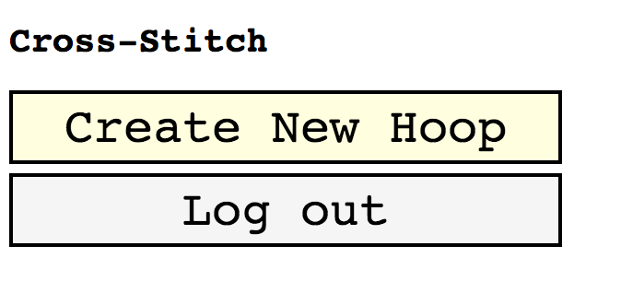
Adding user login
What if you want to add user login to your web page?
For example, what if we extended the Cross-stitch app so that you had to log in before you could create a new cross-stitch drawing?

Slide 70
Authentication is hard
Trying to write your own login system is difficult:
How are you going to save passwords securely?
How do you help with forgotten passwords?
How do you make sure users set a good password?
Etc.
Luckily, you don't have to build your own login.

Slide 71
OAuth2
OAuth2 is a standard for user authentication
For users:
It allows a user to log into a website like AirBnB via some other service, like Gmail or Facebook
For developers:
It lets you authenticate a user without having to implement log in
Examples: "Log in with Facebook"

Slide 72
OAuth2 APIs
Companies like Google, Facebook, Twitter, and GitHub have OAuth2 APIs:
Google Sign-in API
Facebook Login API
Twitter Login API
GitHub Apps/Integrations
OAuth2 is standardized, but the libraries that these companies provide are all different.
You must read the documentation to understand how to connect via their API.

Slide 73
Using OAuth2
All OAuth2 libraries are going to be different, but they work like the following:
Get an API key
Whitelist the domains that can call your API key
Insert a <script> tag containing <company>'s API
In the frontend code:
Use <company>'s API to create a login button
When the user clicks the login button, you will get information like:
Name, email, etc
Some sort of Identity Token

Slide 74
Aside: API keys
Generally you're not supposed to store API keys in your GitHub repo, even though we did in HW5 and in some lecture examples.
→ How are you supposed to store API keys?

Slide 75
API keys: Store in Env Vars
Generally you're not supposed to store API keys in your GitHub repo, even though we did in HW5 and in some lecture examples.
→ How are you supposed to store API keys?
→ Best practice: Use Environment Variables
Set the environment variable on your host, such as Heroku
Can access the environment variable's value in NodeJS via process.env.VAR_NAME

Slide 76
Using OAuth2
You need to authenticate the identity of the client on the backend as well:
In the backend code:
Use <company>'s libraries to verify the token from the client is a valid token

Slide 77
Using OAuth2: Frontend
Load the Google API by calling Google's library functions with the client id
Add a button that, when clicked, prompts the user to log into Google

Slide 78
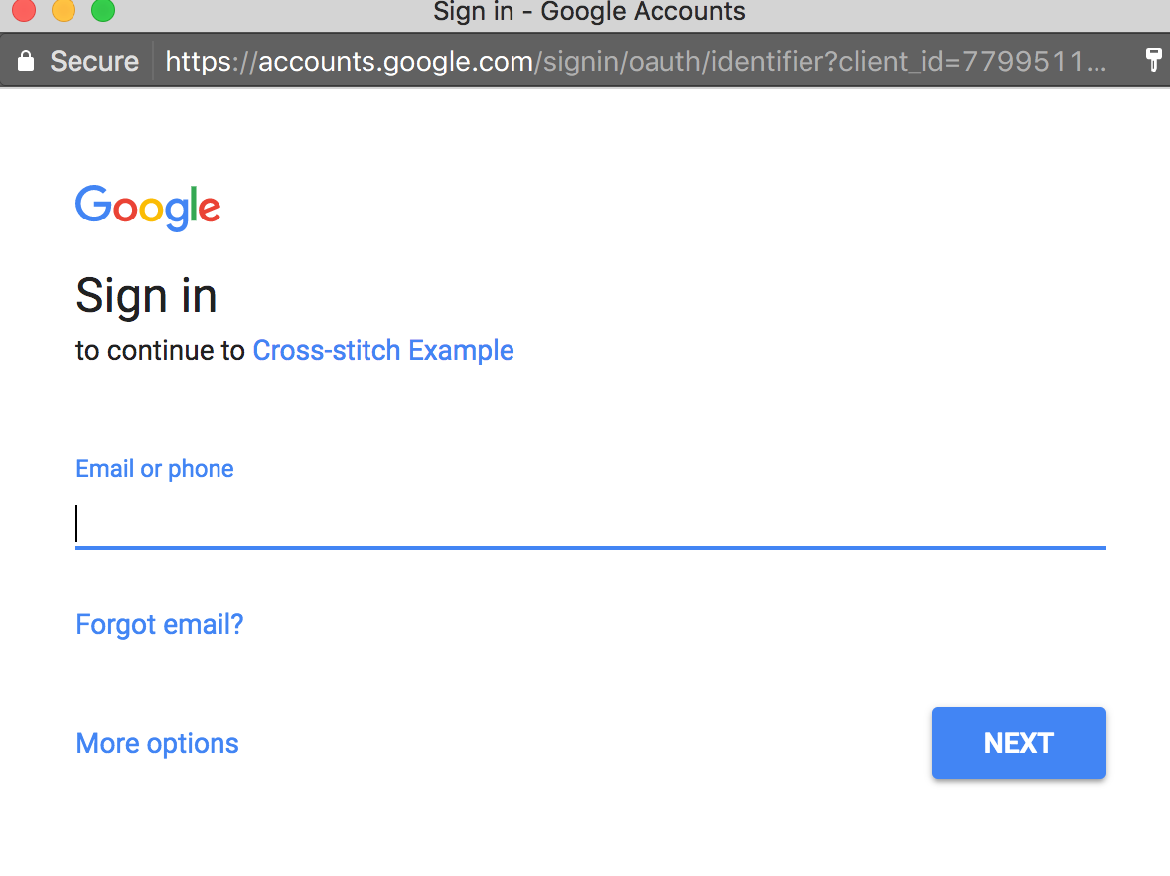
Using OAuth2: Frontend

Slide 79
Using OAuth2: Frontend
When the user logs in, the login callback will fire with information about the user
Name, email, etc
Will also include an IdentityToken, which will expire after a certain amount of time

Slide 80
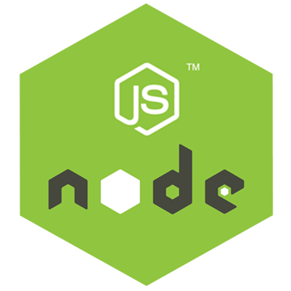
Using OAuth2: Backend
When we want to save information to the client, we should send along the IdentityToken
POST /create

Slide 81
Using OAuth2: Backend
NodeJS can then call into Google's Login endpoint to verify the IdentityToken is valid and to get the user's email, name, etc.
POST /create

Slide 82
Adding user login
Adding user login to Cross-stitch:
Now we have two collections: Users and Hoops

Slide 83
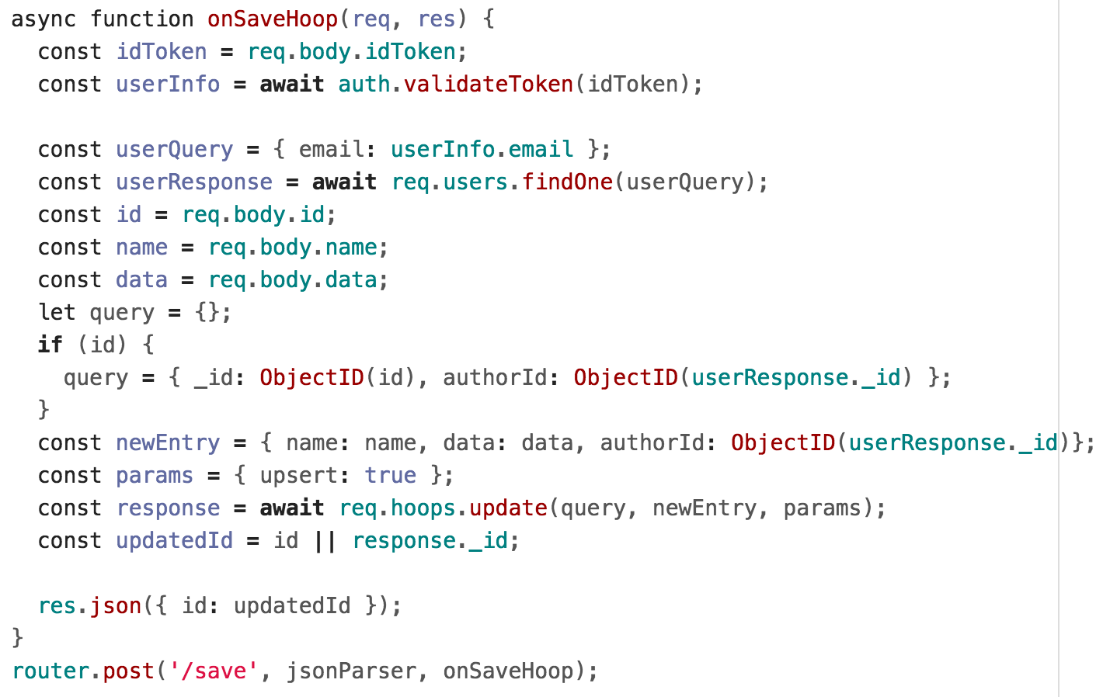
Saving hoops
Every Hoop now has an author associated with it:

Slide 84
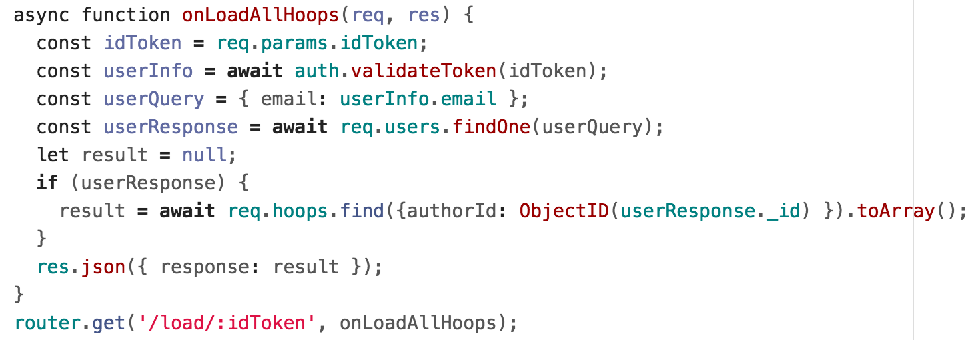
Loading hoops
You also need to load hoops by author:
This is also called an "application-level join"

Slide 85
Completed example
User login for cross-stitch:
cross-stitch-user-login
See run instructions

Slide 86
MongoDB database design
For more on MongoDB database design, MongoDB wrote a short, helpful blog series:
6 Rules of Thumb for MongoDB Schema Design:
Part 1: Basic modeling techniques
Part 2: Referencing
Part 3: Design recommendations
For *a lot* more on database design, take a database class!

