Slide 1
4102165:
Full Stack Web Development Fundamentals
Spring 2019
簡立仁 Li-Ren Chien
ccumouse@gmail.com

Slide 2
Schedule
Today
Web application architecture
Server-side rendering with Handlebars
Modules, Middleware, Routes
Web application architecture
Single-page web app
NXET
Authentication
Accessibility
Testing

Slide 3
Final project
Final Project is due Mon, June 17
No late cutoff! Must turn in on time.

Slide 4
NodeJS and MongoDB

Slide 5
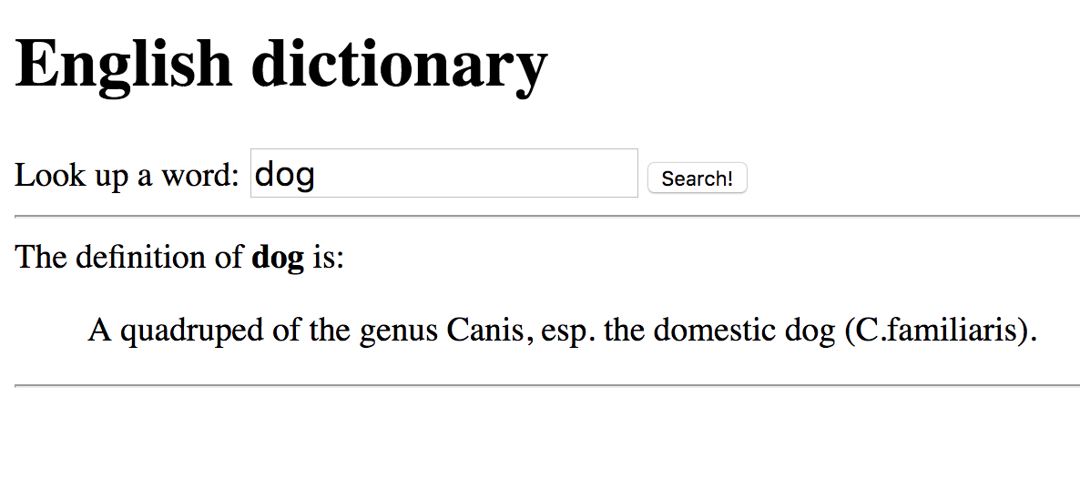
Dictionary example
Let's go back to our dictionary example that let us look up the definition of words (GitHub):

Slide 6
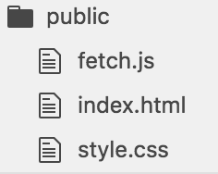
Current code: Static routes
We've defined our server to:
Statically serve index.html / style.css / fetch.js

Slide 7
Current code: Static routes
We've defined our server to:
Statically serve index.html / style.css / fetch.js
localhost:3000/
So when there's a request to localhost:3000/ ...

Slide 8
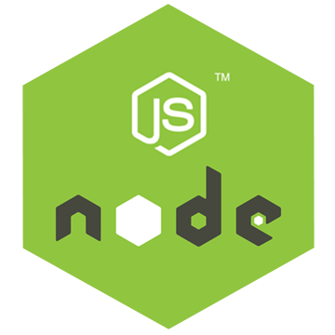
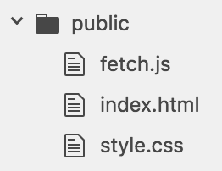
Current code: Static routes
We've defined our server to:
Statically serve index.html / style.css / fetch.js
"Does the 'public' folder have an 'index.html' file?
Our NodeJS server.js program checks the public directory to see if "index.html" exists, which is does, so it replies with that file.
It similarly provides fetch.js and style.css, embedded in index.html.

Slide 9
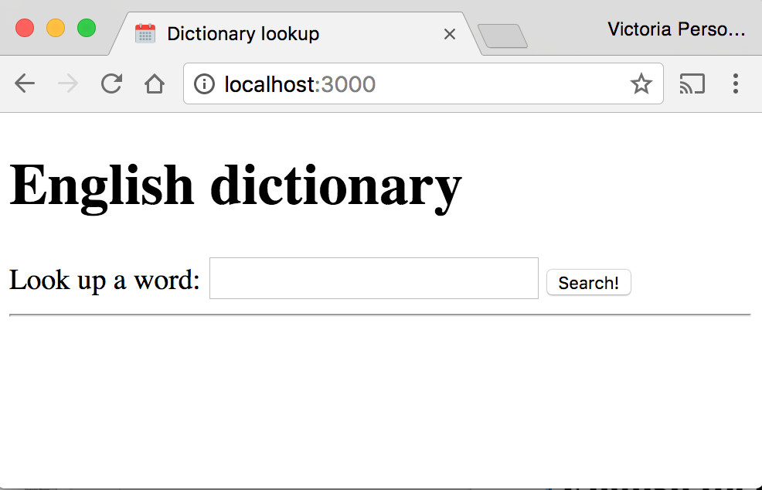
Current code: Static routes
We've defined our server to:
Statically serve index.html / style.css / fetch.js

Slide 10
Current code: JSON route
We've also defined our server to:
2. Return JSON in response to request to lookup/<word>

Slide 11
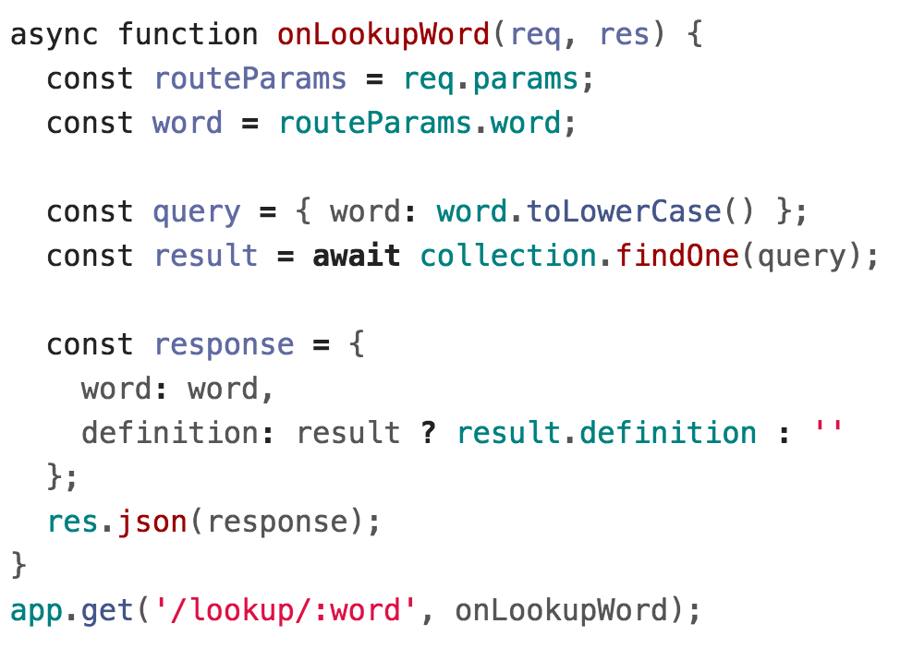
Current code: JSON route
We've also defined our server to:
2. Return JSON in response to request to lookup/<word>

Slide 12
Current code: JSON route
We've also defined our server to:
2. Return JSON in response to request to lookup/<word>
If we navigate to http://localhost:3000/lookup/dog, we see the raw JSON response.

Slide 13
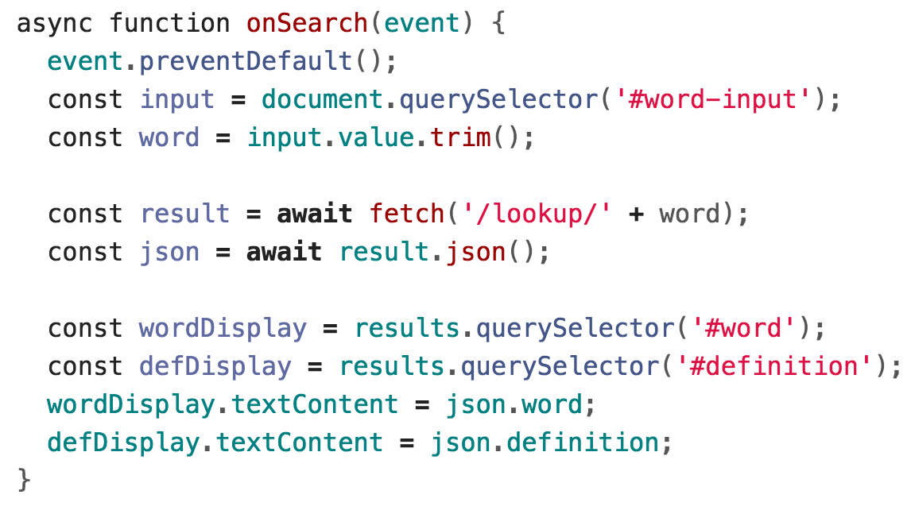
Current code: JSON route
We've also defined our server to:
2. Return JSON in response to request to lookup/<word>
But how we actually query our JSON route is through fetch().

Slide 14
Dynamically generated web pages

Slide 15
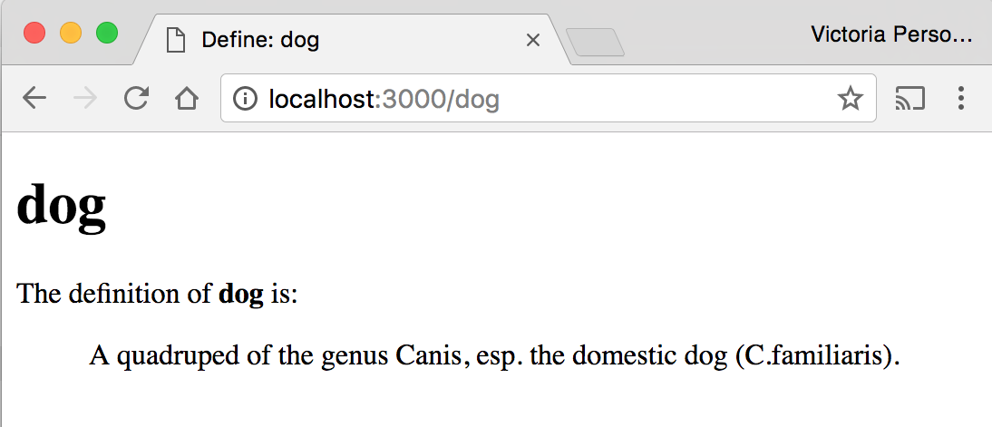
Dictionary example
What if we wanted each definition to also have its own page: http://localhost:3000/dog should show a web page with the definition of "dog:"

Slide 16
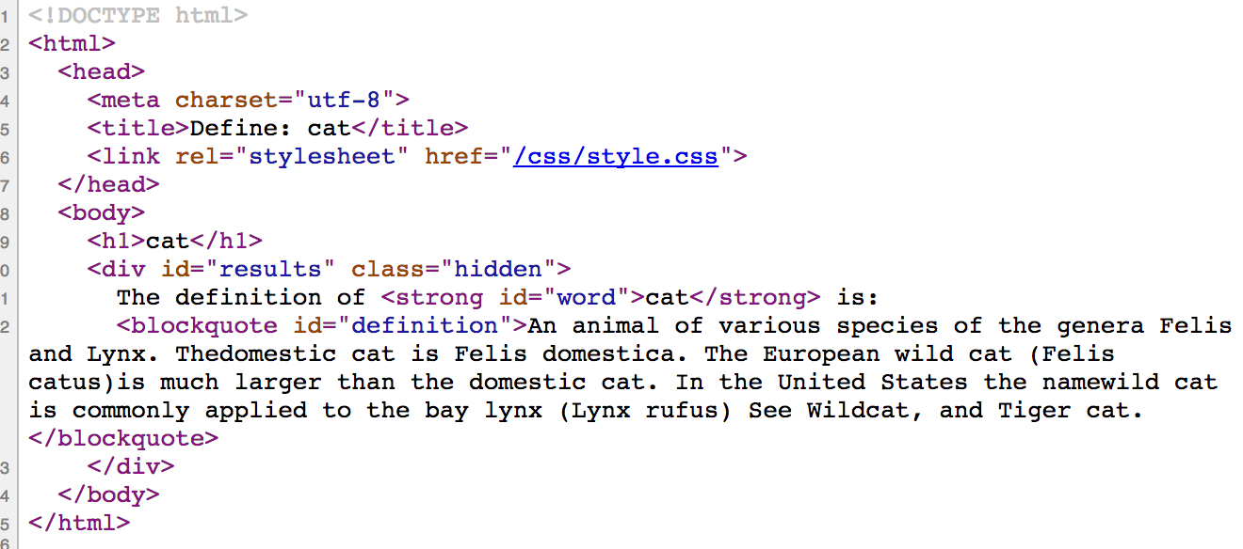
Naive solution: static files
One solution would be to create 1000s of very similar web pages:
cat/index.html

Slide 17
Naive solution: static files
One solution would be to create 1000s of very similar web pages:
category/index.html

Slide 18
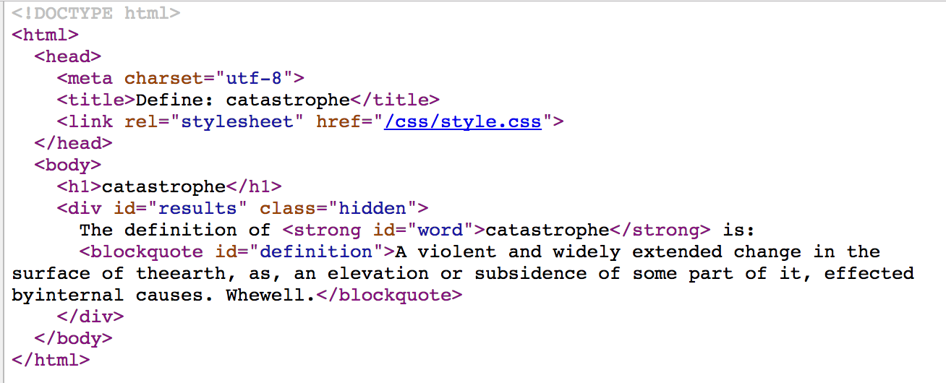
Naive solution: static files
One solution would be to create 1000s of very similar web pages:
catastrophe/index.html

Slide 19
Naive solution: static files
We could put each of these files under public/ and have a unique HTML file for each word of the dictionary.
...
...

Slide 20
Naive solution: static files
However, that would be a pain:
Very time-consuming to hand-code
Even if we wrote a script to generate the 1000s of HTML files, it'd be annoying to have to rerun the script every time there's a new word, new definition, if there's a change in the HTML format, etc.
...
...

Slide 21
Dynamically generated pages
Instead, we'll make our server dynamically generate a web page for the word as soon as it is requested:
GET localhost:3000/dog
localhost:3000/dog

Slide 22
Dynamically generated pages
Instead, we'll make our server dynamically generate a web page for the word as soon as it is requested:
GET localhost:3000/dog
...
localhost:3000/dog
Server.js will create an HTML page for the word on the spot...
server.js

Slide 23
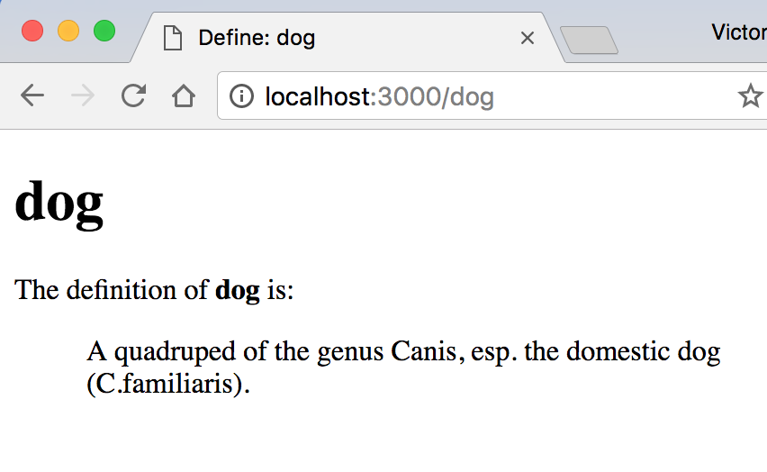
Dynamically generated pages
Instead, we'll make our server dynamically generate a web page for the word as soon as it is requested:
GET localhost:3000/dog
server.js
And we see the HTML displayed.

Slide 24
Dynamically generated pages
Instead, we'll make our server dynamically generate a web page for the word as soon as it is requested:
GET localhost:3000/dog
...
localhost:3000/dog
Server.js will create an HTML page for the word on the spot...
server.js
How does this step work?

Slide 25
Recall: Web app architectures

Slide 26
Structuring a web app
There are roughly 4 strategies for architecting a web application:
Server-side rendering:
Server sends a new HTML page for each unique path
Single-page application: Server sends the exact same web page for every unique path (and the page runs JS to change what it look like)
Combination of 1 and 2 ("Isomorphic" / "Universal")
Progressive Loading

Slide 27
Structuring a web app
There are roughly 4 strategies for architecting a web application:
Server-side rendering:
Server sends a new HTML page for each unique path
→ Let's start with this one.

Slide 28
Dynamically generated pages
We'll make our server dynamically generate a web page for the word as soon as it is requested:
GET localhost:3000/dog
...
localhost:3000/dog
Server.js will create an HTML page for the word on the spot...
server.js

Slide 29
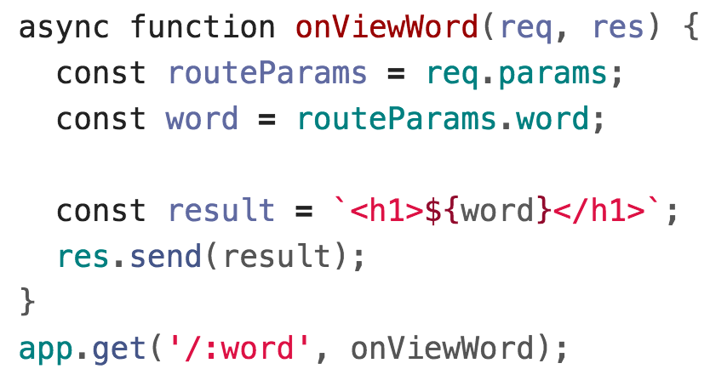
HTML Strings
We start with defining a dummy route:

Slide 30
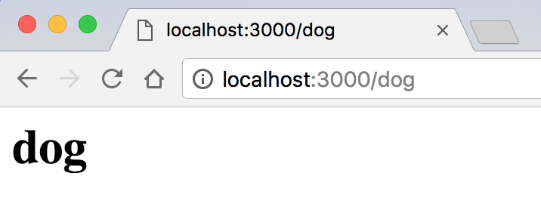
HTML Strings
We start with defining a dummy route:
This just echoes what we passed in as a query parameter.

Slide 31
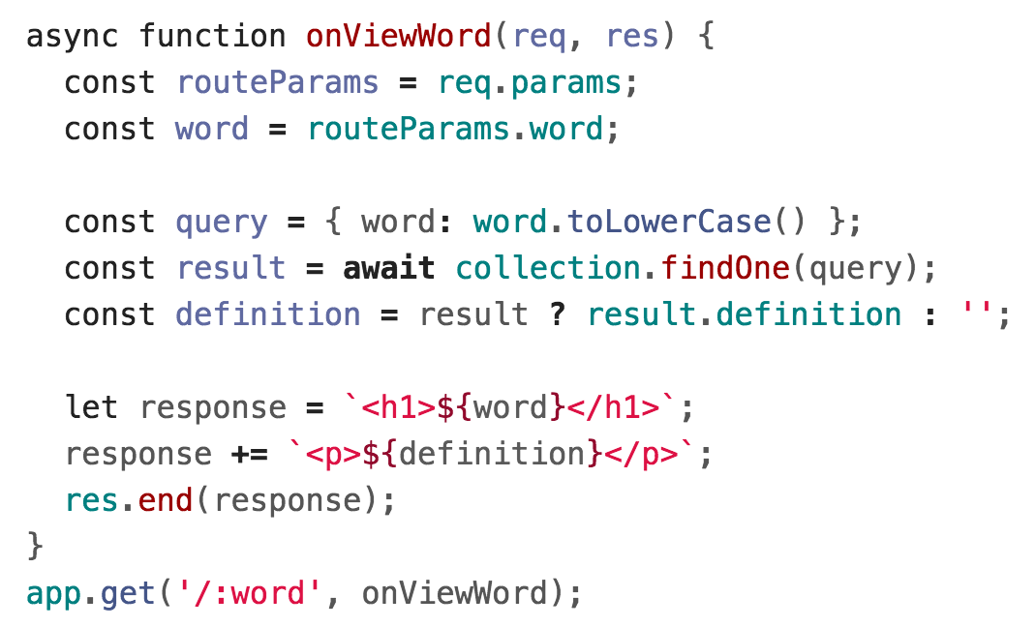
HTML Strings
Now we look up and show the definition too:

Slide 32
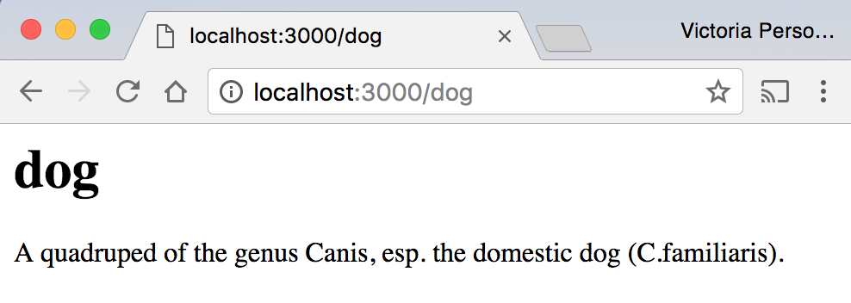
HTML Strings

Slide 33
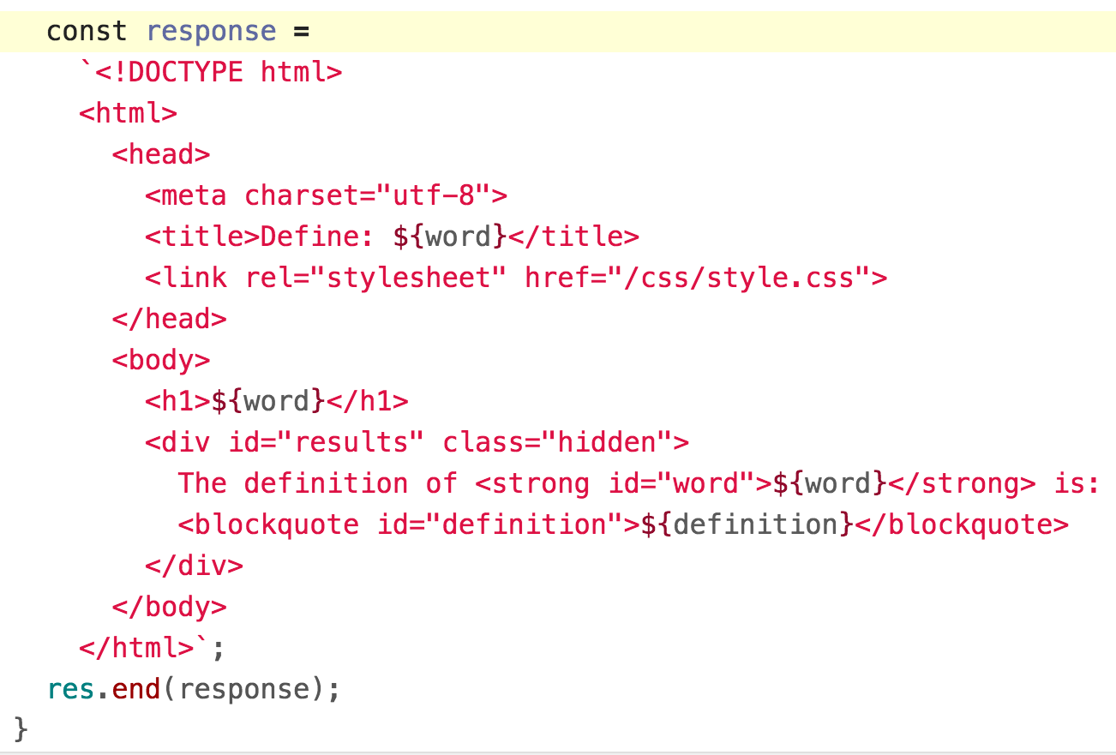
HTML Strings
We can make our HTML response a little fancier:

Slide 34
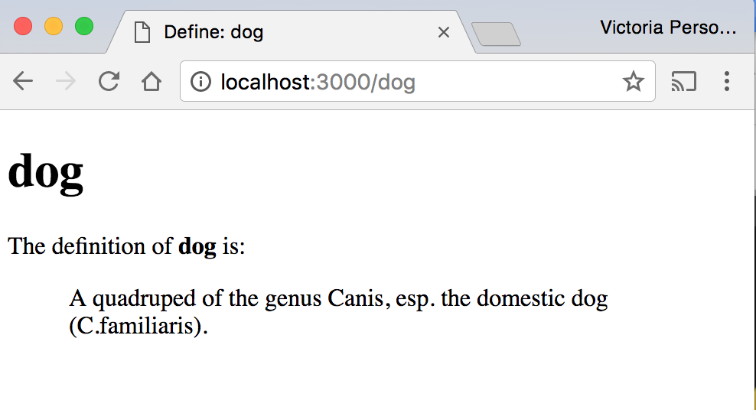
HTML Strings
We can make our HTML response a little fancier:

Slide 35
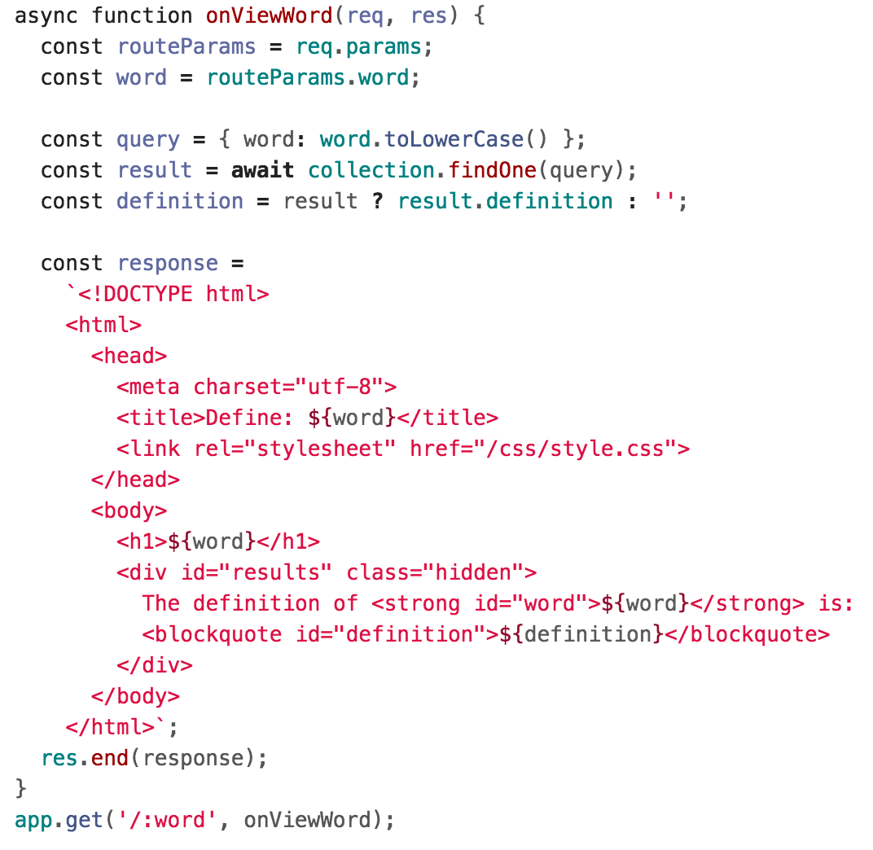
HTML Strings
This works, but now we have a big HTML string in our server code:

Slide 36
Template Engines

Slide 37
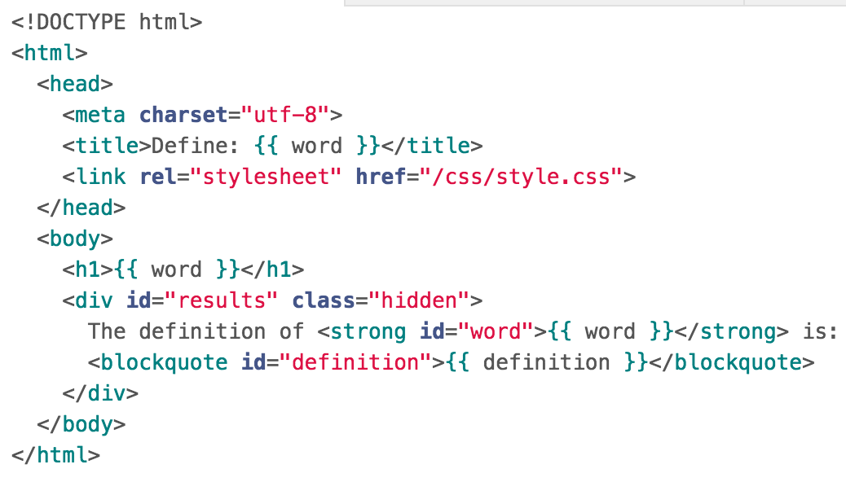
Goal: HTML Template
We want our NodeJS code to be able to take an HTML template, fill in its placeholder values, and return the completed page:
GET localhost:3000/dog
word: "dog",
definition: "A quadruped of the genus Canis, …"
server.js

Slide 38
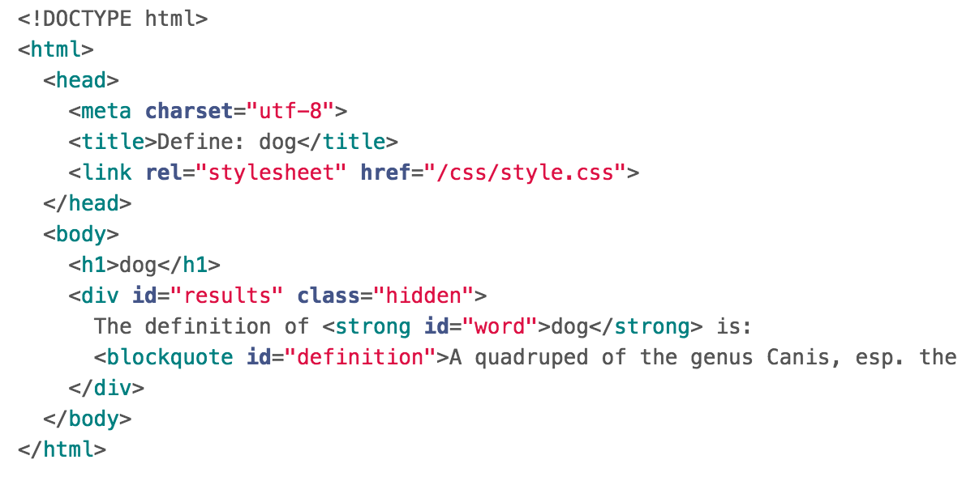
Goal: HTML Template
We want our NodeJS code to be able to take an HTML template, fill in its placeholder values, and return the completed page:
GET localhost:3000/dog
server.js

Slide 39
Template Engine
Template Engine: Allows you to define templates in a text file, then fill out the contents of the template in JavaScript.
Node will replace the variables in a template file with actual values, then it will send the result to the client as an HTML file.
Some popular template engines:
Handlebars: We'll be using this one
Pug
EJS

Slide 40
Handlebars: Template engine
Handlebars lets you write templates in HTML
You can embed {{ placeholders }} within the HTML that can get filled in via JavaScript.
Your templates are saved in .handlebars files
<div class="entry"> <h1>{{title}}</h1> <div class="body"> {{body}} </div> </div>

Slide 41
Handlebars and NodeJS
You can setup Handlebars and NodeJS using the express-handlebars NodeJS library:
const exphbs = require('express-handlebars');
…
const app = express();
const hbs = exphbs.create();
app.engine('handlebars', hbs.engine);
app.set('view engine', 'handlebars');

Slide 42
Dictionary example
So instead of our large template string:

Slide 43
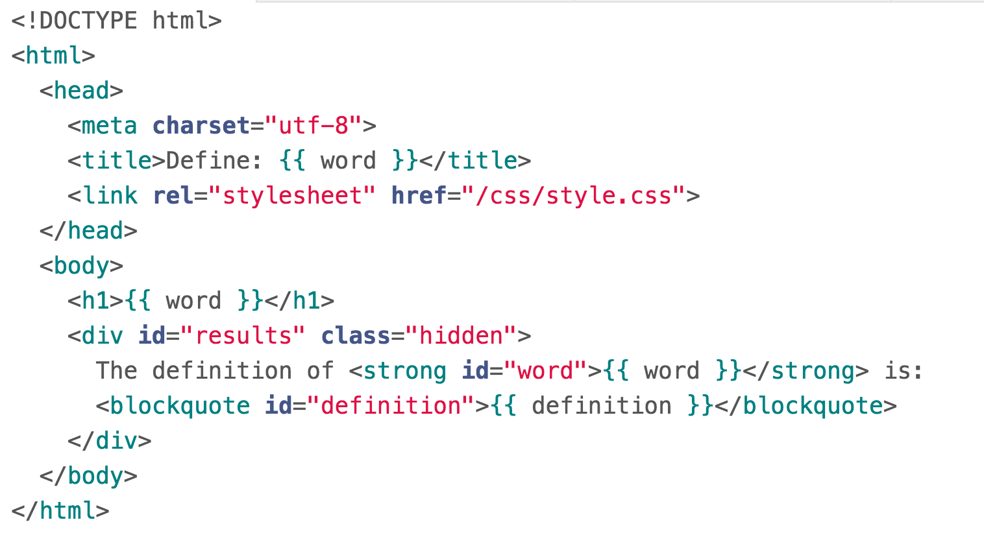
Handlebars template
We can create a template in a file words.handlebars:
.handlebars is the file extension for Handlebar templates.

Slide 44
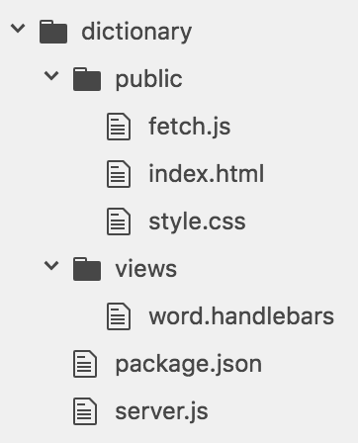
Handlebars template
We save this in a directory called "views":
views/ is the default directory in which Handlebars will look for templates.

Slide 45
Dictionary example
Now instead of returning a long string on the server side:

Slide 46
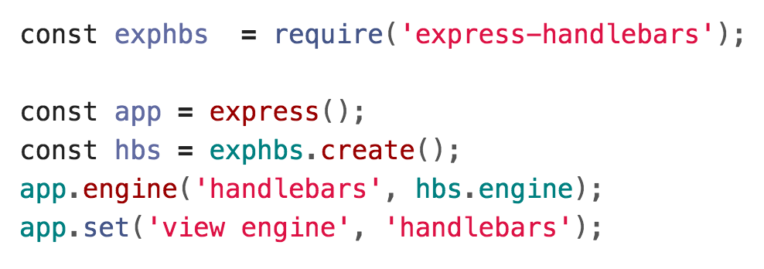
Set template engine
We configure our server to use Handlebars as the template engine:

Slide 47
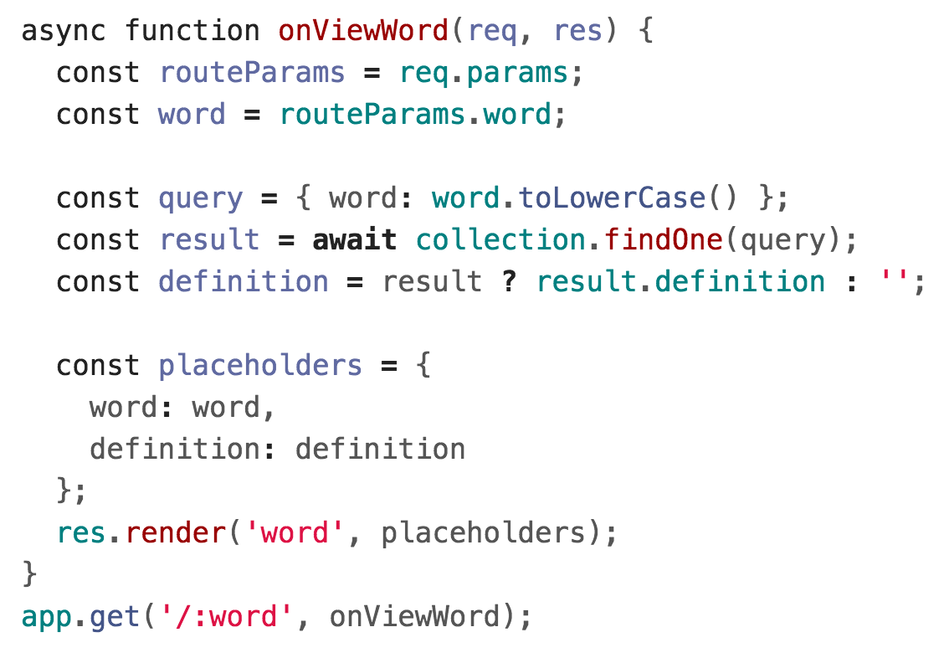
Call res.render
We call res.render to fill in the "word" Handlebars template.

Slide 48
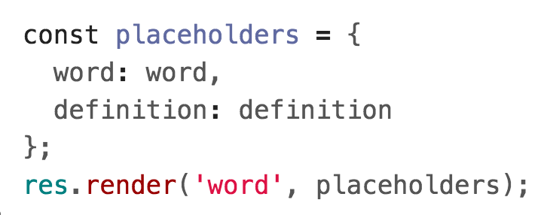
Call res.render
The first parameter is the string name of the template to render, without the ".handlebars" extension.

Slide 49
Call res.render
The second parameter contains the definitions of the variables to be filled out in the template.
...
...

Slide 50
HTML Template
The Handlebars templating engine will return to the client the filled in template as HTML:
GET localhost:3000/dog
server.js

Slide 51
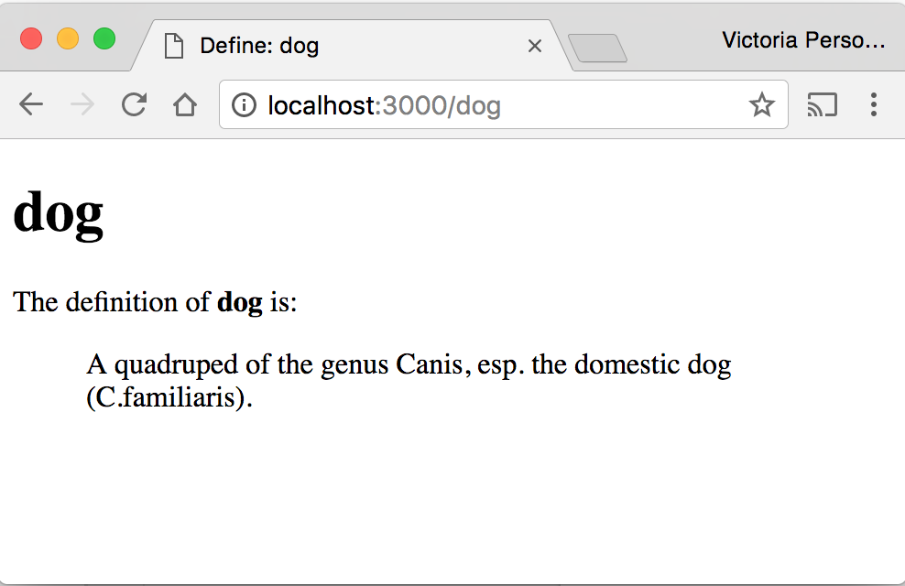
HTML Template
The Handlebars templating engine will return to the client the filled in template as HTML:

Slide 52
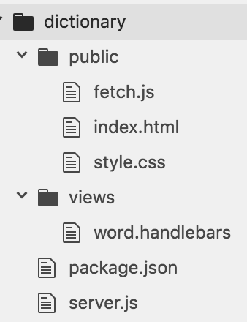
Note on templates
The server is dynamically generating HTML files to return back to the client, but these HTML files aren't saved on the server; they are just passed directly to the client from memory.

Slide 53
Note on style
Right now, we are splitting our view code in two places:
index.html: The file that gets loaded when you go to localhost:3000
word.handlebars: The HTML template for word pages
Style-wise, if you use a template engine, you usually serve *all* your view files via the template engine.

Slide 54
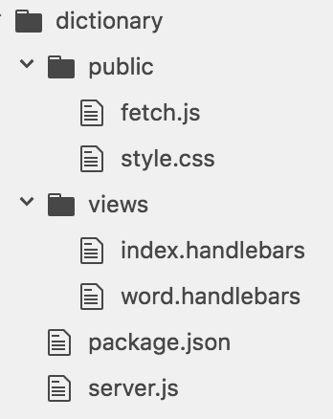
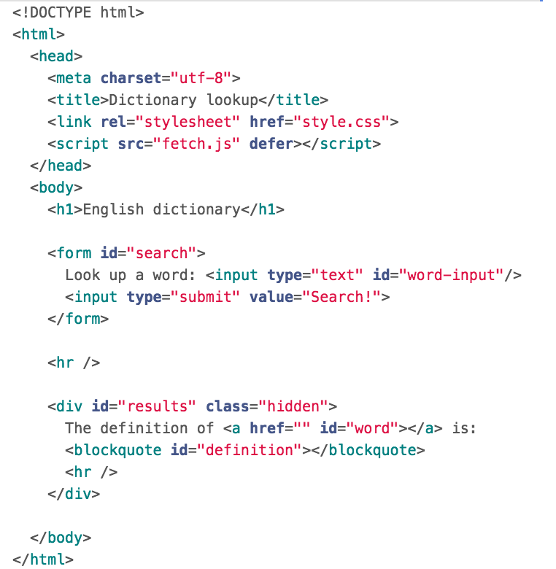
Note on style
We can make index.html into a Handlebars "template" that does not have any parameters:

Slide 55
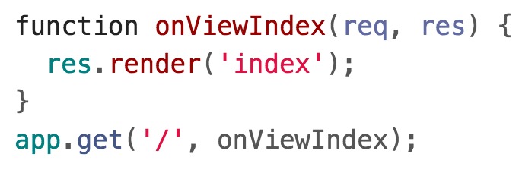
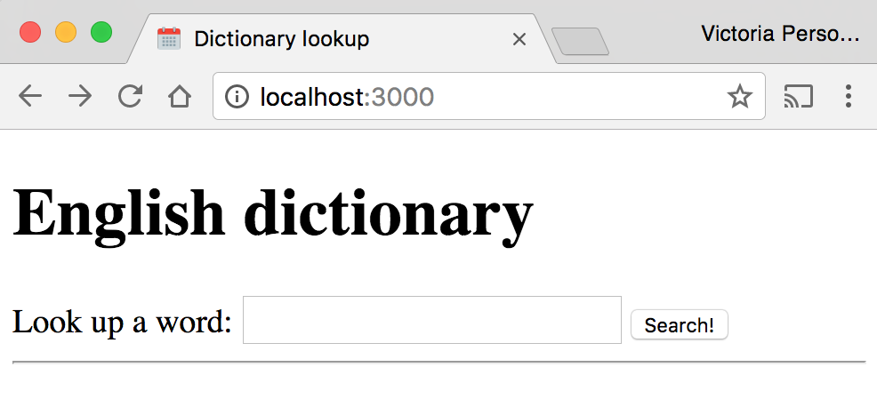
Note on style
Then in server.js, we will render the "index" template when there is a GET request to localhost:3000:

Slide 56
Completed example
Completed example code:
dictionary-server-side
See run instructions

Slide 57
Modules and Routes

Slide 58
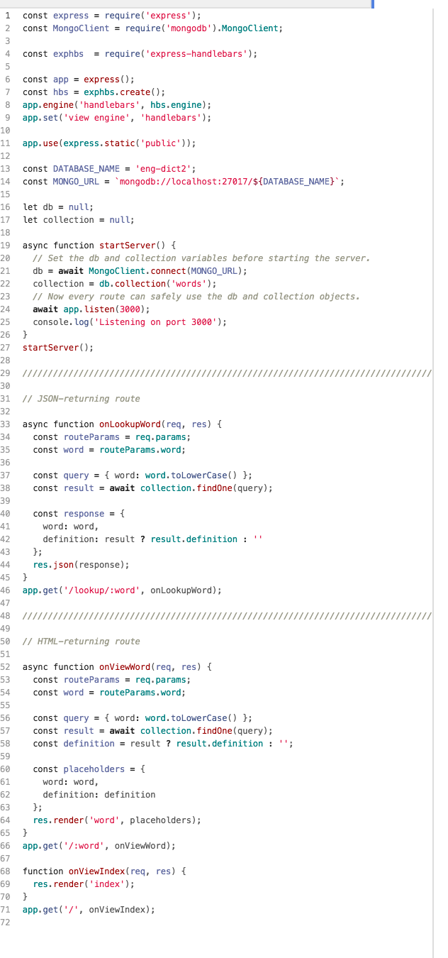
Routes
So far, our server routes have all been defined in one file.
Right now, server.js:
Starts the server
Sets the template engine
Serves the public/ directory
Defines the JSON-returning routes
Defines the HTML-returning routes
As our server grows, it'd be nice to split up server.js into separate files.

Slide 59
NodeJS modules
NodeJS allows you to load external files, or "modules", via require(). We've already loaded three types of modules:
Core NodeJS modules, e.g. require('http')
External NodeJS modules downloaded via npm, e.g. require('express')
A JSON file, e.g. require('./dictionary.json')
We will now see how to define our own NodeJS modules and include them in other JavaScript files via the require() statement.

Slide 60
NodeJS modules
A NodeJS module is just a JavaScript file.
One module = One file
There can only be one module per file
Let's say that you define the following JavaScript file:

Slide 61
NodeJS modules
You can include it in another JavaScript file by using the require statement:
Note that you MUST specify "./", "../", "/", etc.
Otherwise NodeJS will look for it in the node_modules/ directory. See require() resolution rules

Slide 62
NodeJS modules
The NodeJS file executes immediately when require()d.
$ node scripts.js
hello

Slide 63
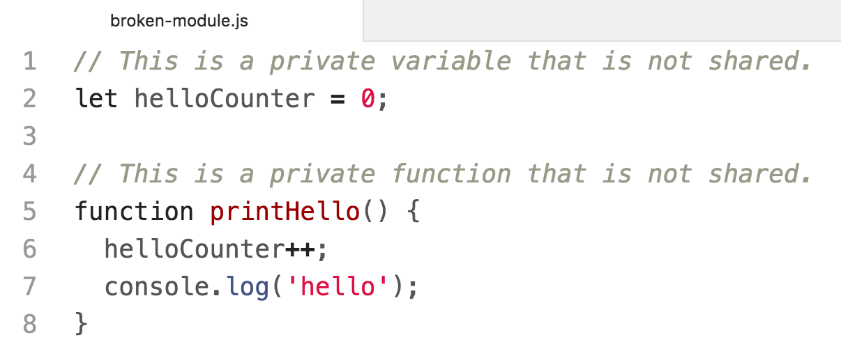
Private variables
Everything declared in a module is private to that module by default.
Let's say that you define the following JavaScript file:

Slide 64
Private variables
If we include it and try to run printHello or access helloCounter, it will not work:
$ node scripts.js
/.../scripts.js:2
printHello();
^
ReferenceError: printHello is not defined
at Object.<anonymous>

Slide 65
Private variables
If we include it and try to run printHello or access helloCounter, it will not work:
$ node scripts.js
scripts.js:2
console.log(helloCounter);
^
ReferenceError: helloCounter is not defined
at Object.<anonymous>

Slide 66
module.exports
module is a special object automatically defined in each NodeJS file, representing the current module.
When you call require('./fileName.js'), the require() function will return the value of module.exports as defined in fileName.js
module.exports is initialized to an empty object.

Slide 67
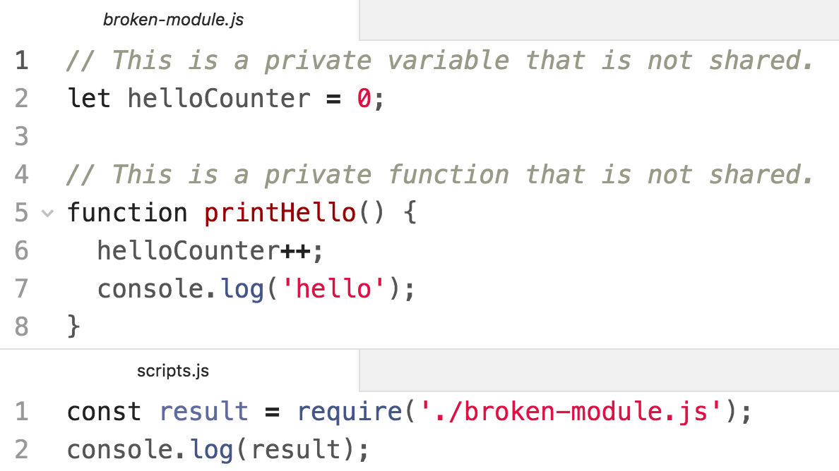
Prints an empty object because we didn't modify module.exports in broken-module.js.
$ node scripts.js
{}

Slide 68
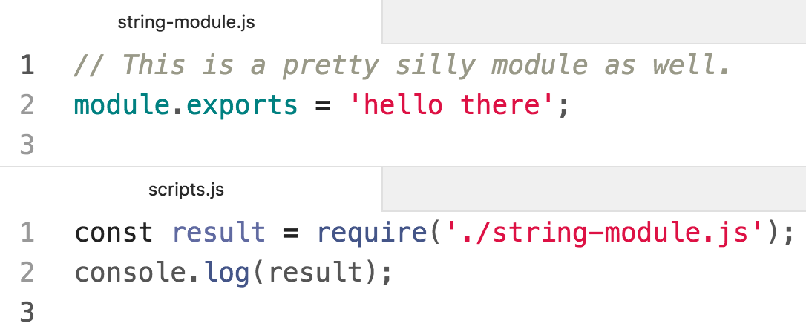
$ node scripts.js
hello there
Prints "hello there", because we set module.exports to "hello there" in string-module.js.
The value of "result" is the value of "module.exports" in string-module.js.

Slide 69
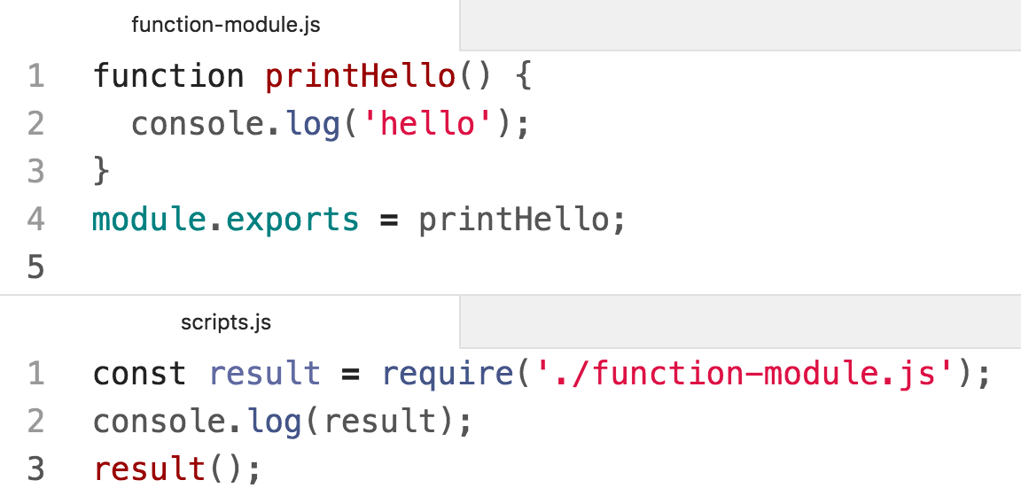
$ node scripts.js
[Function: printHello]
hello
We can export a function by setting it to module.exports

Slide 70
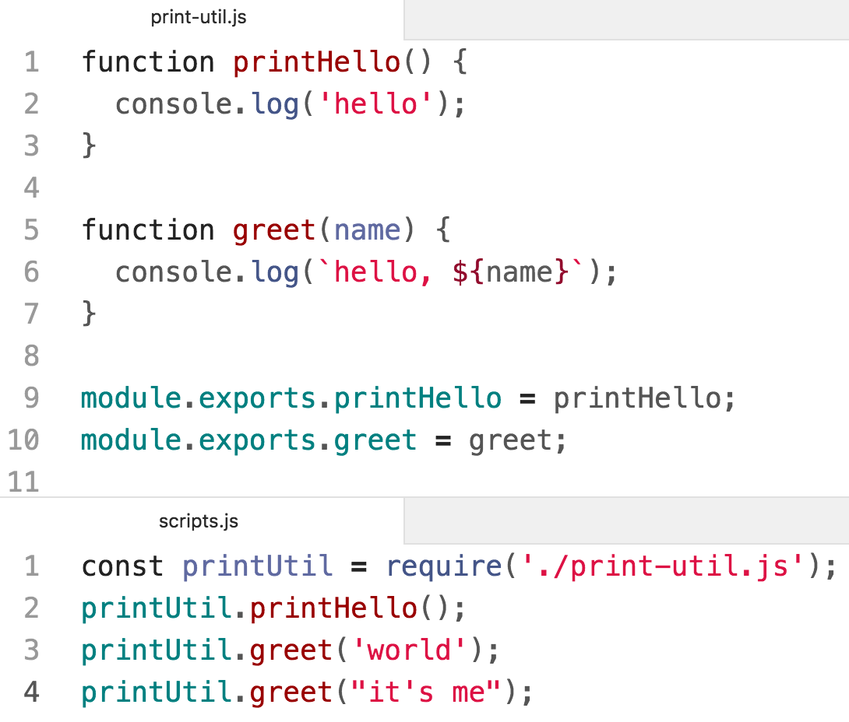
$ node scripts.js
hello
hello, world
hello, it's me
We can export multiple functions by setting fields of the module.exports object

Slide 71
$ node scripts.js
hello
hello, world
hello, it's me
We can export multiple functions by setting fields of the module.exports object

Slide 72
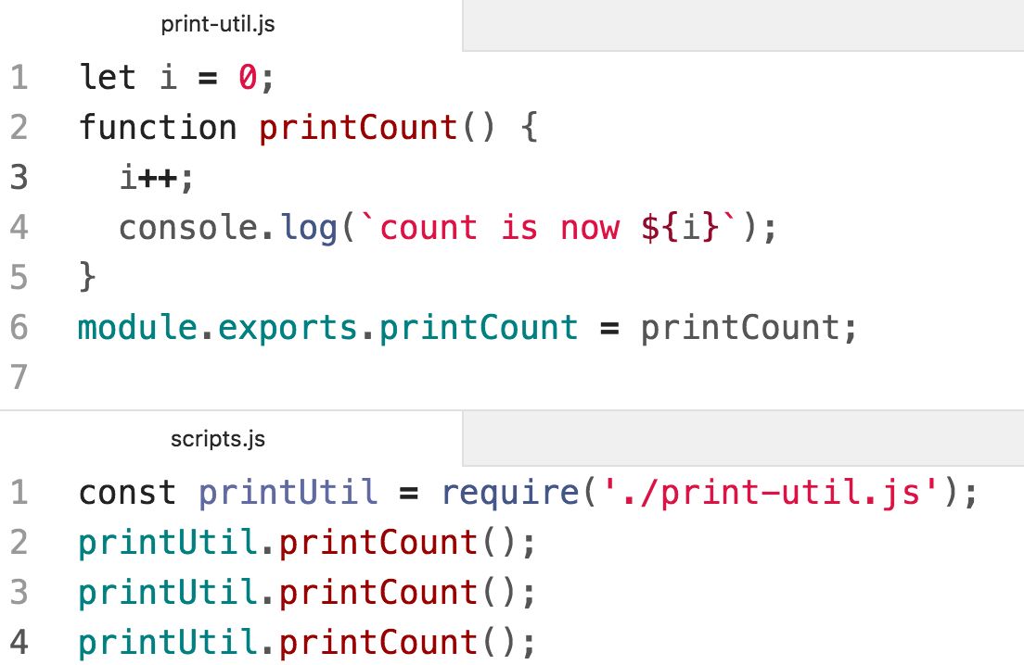
$ node scripts.js
count is now 1
count is now 2
count is now 3
You can create private variables and fields by not exporting them.

Slide 73
Simple module examples
Module example code is here:
simple-modules
Run instructions
NodeJS Module documentation:
https://nodejs.org/api/modules.html

Slide 74
Back to Routes

Slide 75
Routes
So far, our server routes have all been defined in one file.
Right now, server.js:
Starts the server
Sets the template engine
Serves the public/ directory
Defines the JSON-returning routes
Defines the HTML-returning routes
As our server grows, it'd be nice to split up server.js into separate files.

Slide 76
Goal: HTML vs JSON routes
Let's try to split server.js into 3 files.
Right now, server.js does the following:
Starts the server
Sets the template engine
Serves the public/ directory
Defines the JSON-returning routes
Defines the HTML-returning routes
→ We'll continue to use server.js for the logic in blue
→ We'll try to move JSON routes to api.js
→ We'll try to move the HTML routes to view.js

Slide 77
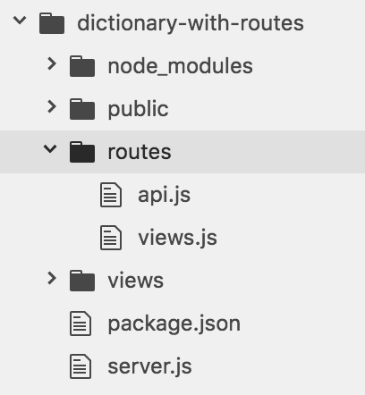
Goal: HTML vs JSON routes
→ We'll continue to use server.js for the logic in blue
→ We'll try to move JSON routes to api.js
→ We'll try to move the HTML routes to view.js
Desired directory structure:

Slide 78
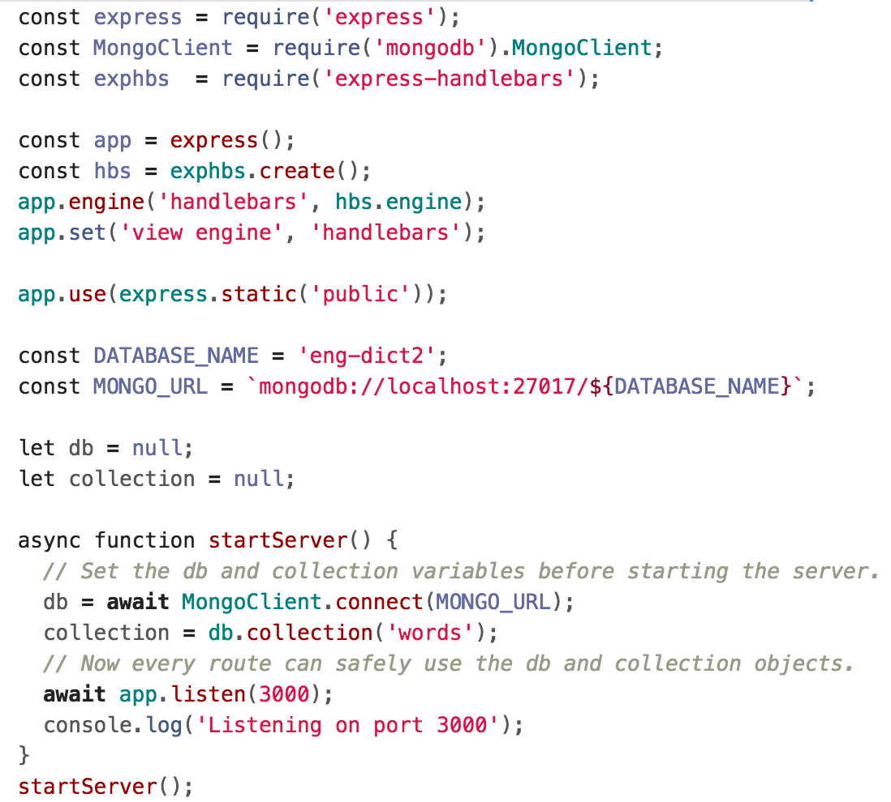
Desired: server.js
We'd like to keep all set-up stuff in server.js...

Slide 79
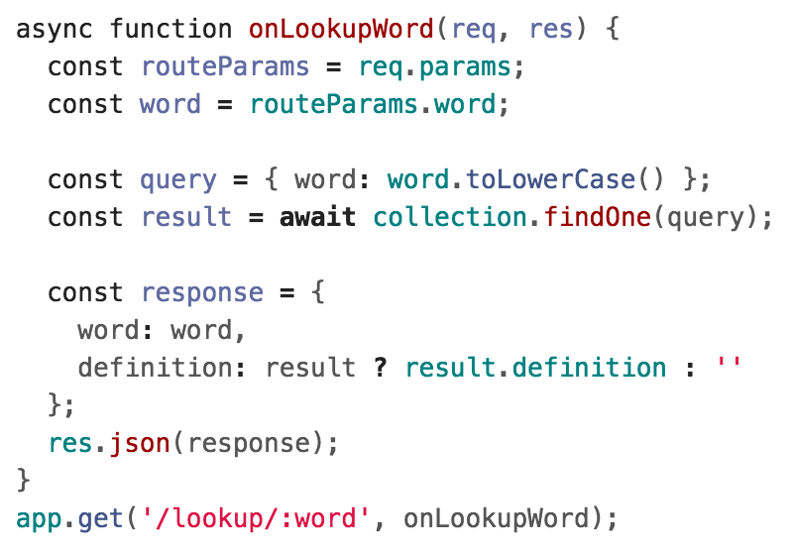
Desired api.js (DOESN'T WORK)
And we'd like to be able to define the /lookup/:word route in a different file, something like the following:
Q: How do we define routes in a different file?

Slide 80
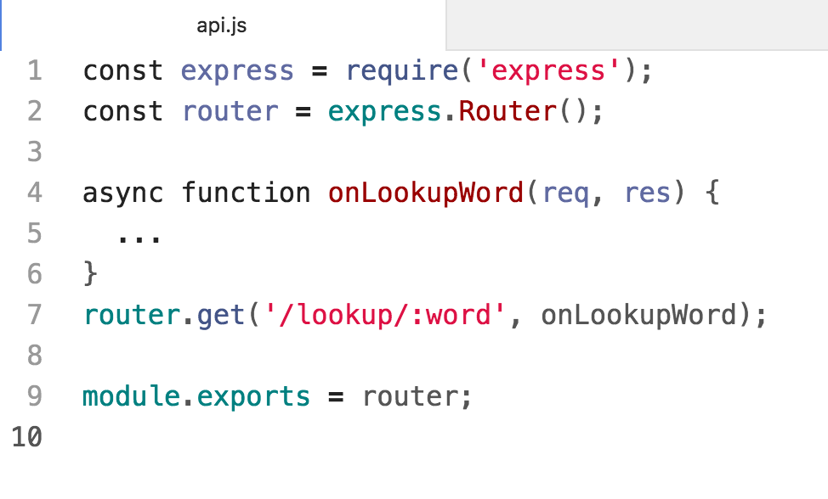
Router
Express lets you create Router objects, on which you can define modular routes:

Slide 81
Router
Create a new Router by calling express.Router()
Set routes the same way you'd set them on App
Export the router via module.exports

Slide 82
Using the Router
Now we include the router by:
Importing our router module via require()
Calling app.use(router) on the imported router
Now the app will also use the routes defined in routes/api.js!
However, we have a bug in our code...

Slide 83
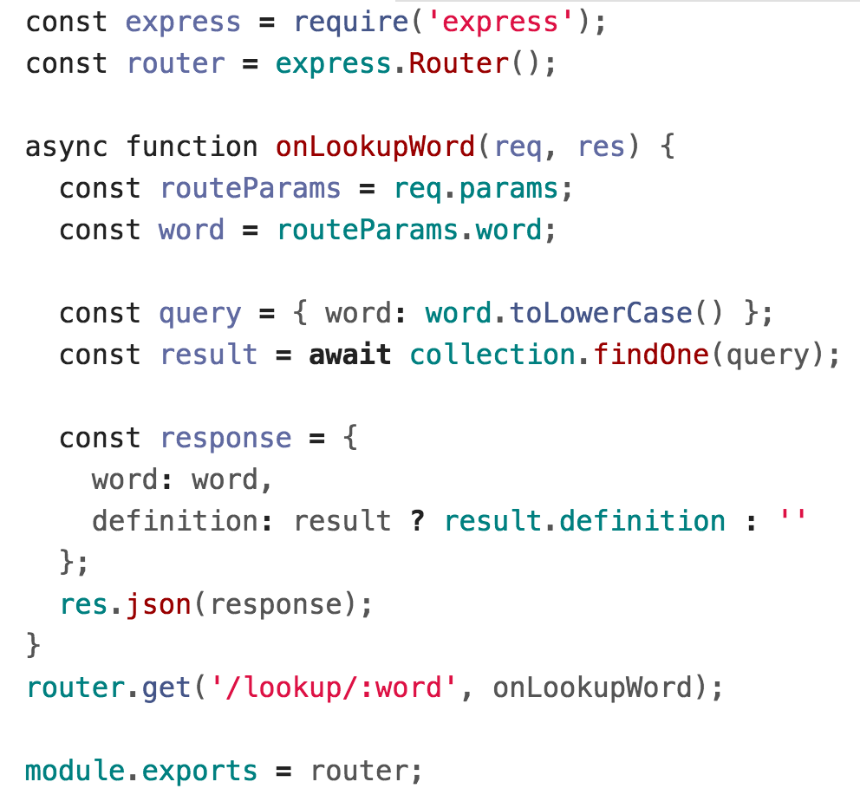
MongoDB variables
We need to access the MongoDB collection in our route...

Slide 84
MongoDB variables
...Which used to be defined as a global variable in server.js.
Q: What's the right way to access the database data?

Slide 85
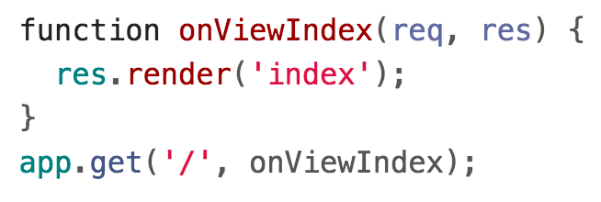
Middleware
In Express, you define middleware functions that get called certain requests, depending on how they are defined.
The app.METHOD routes we have been writing are actually middleware functions:
onViewIndex is a middleware function that gets called every time there is a GET request for the "/" path.

Slide 86
Middleware: app.use()
We can also define middleware functions using app.use():
Middleware functions receive 3 parameters:
req and res, same as in other routes
next: Function parameter. Calling this function invokes the next middleware function in the app.
If we resolve the request via res.send, res.json, etc, we don't have to call next()

Slide 87
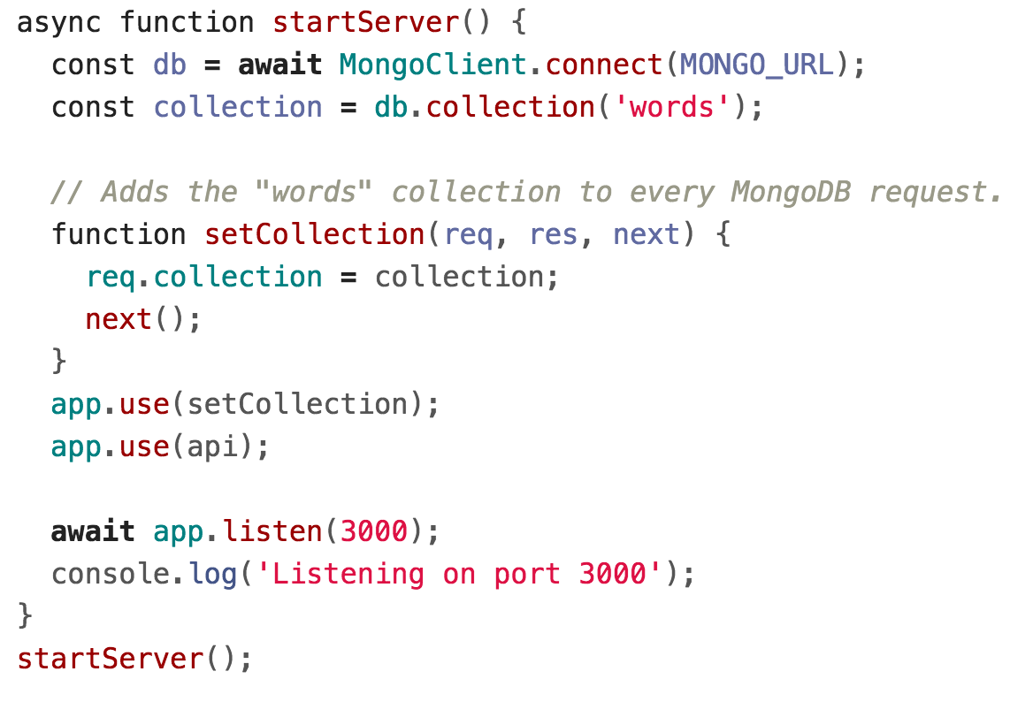
Middleware: app.use()
We can write middleware that defines new fields on each request:

Slide 88
Middleware: app.use()
Now if we load this middleware on each request:

Slide 89
Middleware: app.use()
Now if we load this middleware on each request:
Note that we need to use the api router AFTER the middleware

Slide 90
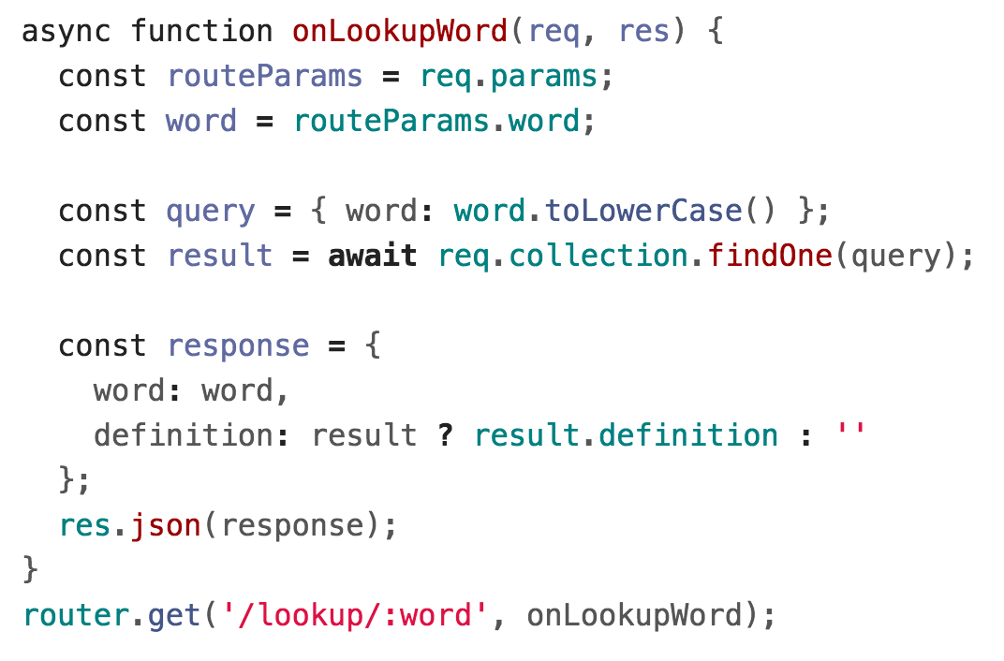
Middleware: app.use()
Then we can access the collection via req.collection:

Slide 91
Middleware: app.use()
Then we can access the collection via req.collection:

Slide 92
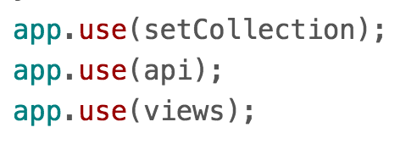
Views router
We can similarly move the HTML-serving logic to views.js and require() the module in server.js:

Slide 93
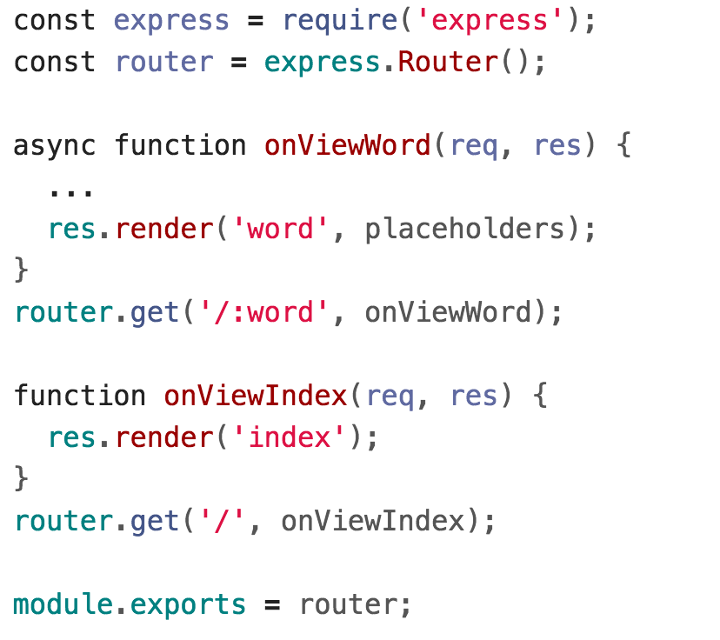
Views router

Slide 94
Routes and middleware
Simple middleware example code is here:
simple-middleware
Run instructions
Dictionary with routes example code here:
dictionary-with-routes
Run instructions
Express documentation:
Router
Writing / Using Middleware

Slide 95
Recall: Web app architectures

Slide 96
Structuring a web app
There are roughly 4 strategies for architecting a web application:
Server-side rendering:
Server sends a new HTML page for each unique path
Single-page application: Server sends the exact same web page for every unique path (and the page runs JS to change what it look like)
Combination of 1 and 2 ("Isomorphic" / "Universal")
Progressive Loading

Slide 97
Structuring a web app
There are roughly 4 strategies for architecting a web application:
Server-side rendering:
Server sends a new HTML page for each unique path
Single-page application: Server sends the exact same web page for every unique path (and the page runs JS to change what it look like)
→ Let's talk about this one now

Slide 98
Single-page web app

Slide 99
Single page web app
The server always sends the same one HTML file for all requests to the web server.
The server is configured so that requests to /<word> would still return e.g. index.html.
The client JavaScript parses the URL to get the route parameters and initialize the app.
GET localhost:3000/
index.html

Slide 100
Single page web app
The server always sends the same one HTML file for all requests to the web server.
The server is configured so that requests to /<word> would still return e.g. index.html.
The client JavaScript parses the URL to get the route parameters and initialize the app.
GET localhost:3000/dog
index.html

Slide 101
Single page web app
Another way to think of it:
You embed all your views into index.html
You use JavaScript to switch between the views
You configure JSON routes for your server to handle sending and retrieving data
GET localhost:3000/dog
index.html

Slide 102
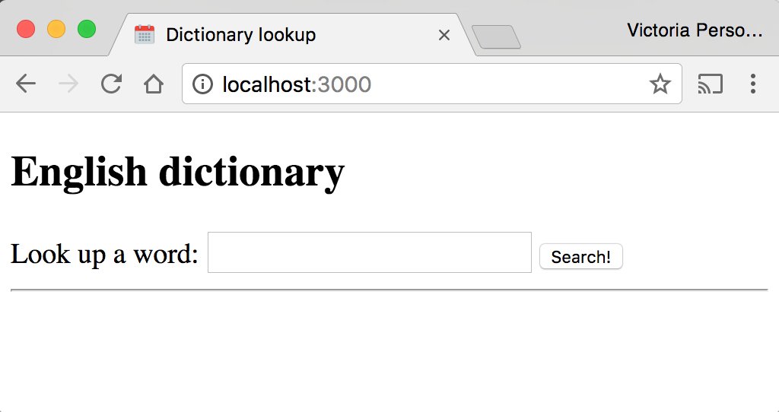
Dictionary example
Let's write our dictionary example as a single-page web app.

Slide 103
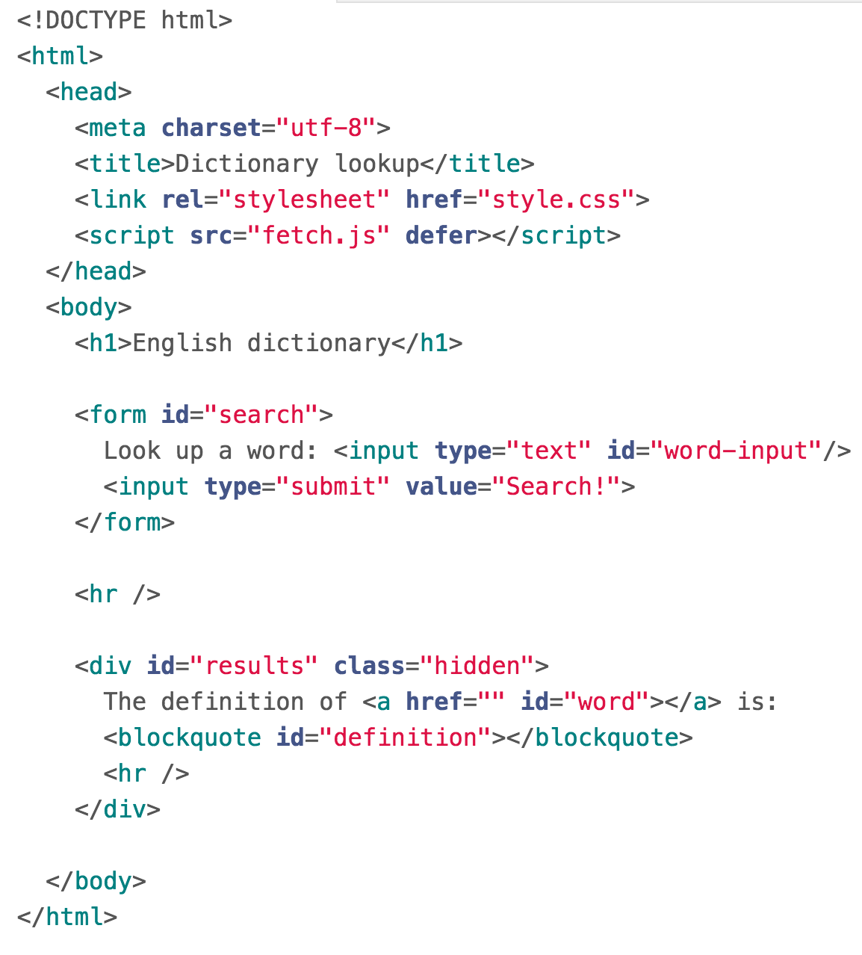
Recall: Handlebars
For our multi-page dictionary app, we had two handlebars files: index.handlebars and word.handlebars
word.handlebars
index.handlebars

Slide 104
SPA
In a single-page web app, the HTML for both the Search page and the Word page are in index.html:

Slide 105
Server-side routing
For all requests that are not JSON requests, we return "index.html"

Slide 106
Client-side parameters
All views are hidden at first by the client.

Slide 107
Client-side parameters
When the page loads, the client looks at the URL to decide what page it should display.

Slide 108
Client-side parameters
To display the word view, the client makes a fetch() requests for the definition.

Slide 109
Completed example
Completed example code:
dictionary-spa
See run instructions

