Slide 1
4102165:
Full Stack Web Development Fundamentals
Spring 2019
簡立仁 Li-Ren Chien
ccumouse@gmail.com

Slide 2
Schedule
Today:
Querying REST APIs
  Form submission
Fetch API gotchas
  CORS
  Closures
Single-threaded asynchrony
  JS Event loop
Next: NodeJS!

Slide 3
JSON

Slide 4
JavaScript Object Notation
JSON: Stands for JavaScript Object Notation
Created by Douglas Crockford
Defines a way of serializing JavaScript objects
  to serialize: to turn an object into a string that can be deserialized
  to deserialize: to turn a serialized string into an object

Slide 5
Fetch API and JSON
The Fetch API also has built-in support for JSON:
function onJsonReady(json) {
console.log(json);
}
function onResponse(response) {
return response.json();
}
fetch('images.json')
.then(onResponse)
.then(onJsonReady);
Return response.json() instead of response.text() and Fetch will essentially call JSON.parse() on the response string.

Slide 6
Querying REST APIs

Slide 7
RESTful API
RESTful API: URL-based API that has these properties:
Requests are sent as an HTTP request:
  HTTP Methods: GET, PUT, POST, DELETE, etc
Requests are sent to base URL, also known as an "API Endpoint"
Requests are sent with a specified MIME/content type, such as HTML, CSS, JavaScript, plaintext, JSON, etc.

Slide 8
API endpoint example
Look at the URL for this Google slide deck:
https://docs.google.com/presentation/d/1ohtGeZP2Pb2LnBm8d7O-_UNkNjNLkHO3lMQszZ7EJ3Y
presentation: Tells the server that we are requesting a doc of type "presentation"
d/1ohtGeZP2Pb2LnBm8d7O-_UNkNjNLkHO3lMQszZ7EJ3Y: Tells the server to request a doc ("d") with the document id of "1ohtGeZP2Pb2LnBm8d7O-_UNkNjNLkHO3lMQszZ7EJ3Y"

Slide 9
RESTful API
RESTful API: URL-based API that has these properties:
Requests are sent as an HTTP request:
  HTTP Methods: GET, PUT, POST, DELETE, etc
Requests are sent to base URL, also known as an "API Endpoint"
Requests are sent with a specified MIME/content type, such as HTML, CSS, JavaScript, plaintext, JSON, etc.

Slide 10
Using REST APIs

Slide 11
3rd-Party APIs
Many websites expose REST APIs to outside developers. These are often called "3rd-party APIs" or "Developer APIs"
Examples:
Spotify
Giphy
GitHub
Hoards of Google APIs
Facebook
Instagram
Twitter
etc...
Try Googling "<product name> API" to see if one exists for a given company!

Slide 12
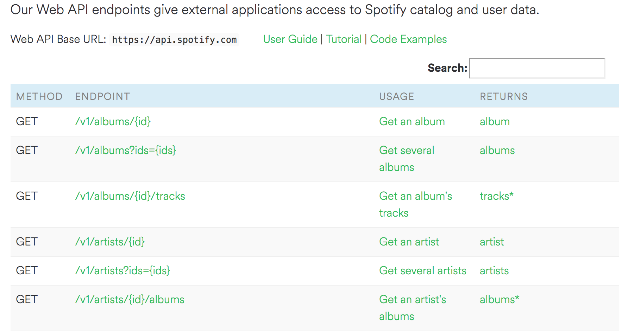
Example: Spotify
Spotify has a REST API that external developers (i.e. people who aren't Spotify employees) can query:

Slide 13
Example: Spotify
REST API structure (details):
The Base URL is https://api.spotify.com
The HTTP method is GET
The API endpoint to query is: https://api.spotify.com/v1/albums/<spotify_id>
It returns JSON data about the album that's requested

Slide 14
Example: Spotify
If we had Spotify Album ID 0sNOF9WDwhWunNAHPD3Baj, how would we make a GET request for the album information?
REST API structure (details):
The Base URL is https://api.spotify.com
The HTTP method is GET
The API endpoint to query is: https://api.spotify.com/v1/albums/<spotify_id>
It returns JSON data about the album that's requested

Slide 15
GET request: Browse to URL
Loading a URL in a browser issues an HTTP GET request for that resource.
So if we just piece together this URL:
API Endpoint:
https://api.spotify.com/v1/albums/<spotify_id>
Album ID: 0sNOF9WDwhWunNAHPD3Baj
Request URL:
https://api.spotify.com/v1/albums/0sNOF9WDwhWunNAHPD3Baj
If you click on the link, you see it returns a JSON object.

Slide 16
GET request: fetch()
Actually, the fetch() API also issues an HTTP GET request by default.
So if we do:
Fetch('https://api.spotify.com/v1/albums/0sNOF9WDwhWunNAHPD3Baj'
{...}
)
.then(onResponse)
.then(onTextReady);
...we can load the JSON data as a JavaScript object, as we did with our .json files!
(CodePen / demo)

Slide 17
Add Header to fetch
https://developer.spotify.com/console/get-search-item/?q=tania+bowra&type=artist
fetch(SPOTIFY_PATH + query,
{ method: "GET",
headers: {
"Accept": "application/json",
"Content-Type": "application/json",
"Authorization": "Bearer BQC5d8HVSbS0ZXcumz9VwyzvUmsSOEigs6-y4fyzEODyKP1scF5oiQZzLqetcsOSRT9fB1Wo61VuTexIVIfli711LlKCihZBl_xqjoiknTUkulfhwUi3j0JwsZWGnSZ7GBxelQvIbXEbNQM5Z-VDMbmK8_fDtHx696e3peyJyKcVOW1W6B8"
}
}
)
.then(this._onResponse)
.then(this._onJsonReady);
curl -X "GET" "https://api.spotify.com/v1/search?q=tania%20bowra&type=artist" -H "Accept: application/json" -H "Content-Type: application/json" -H "Authorization: Bearer BQC5d8HVSbS0ZXcumz9VwyzvUmsSOEigs6-y4fyzEODyKP1scF5oiQZzLqetcsOSRT9fB1Wo61VuTexIVIfli711LlKCihZBl_xqjoiknTUkulfhwUi3j0JwsZWGnSZ7GBxelQvIbXEbNQM5Z-VDMbmK8_fDtHx696e3peyJyKcVOW1W6B8"

Slide 18
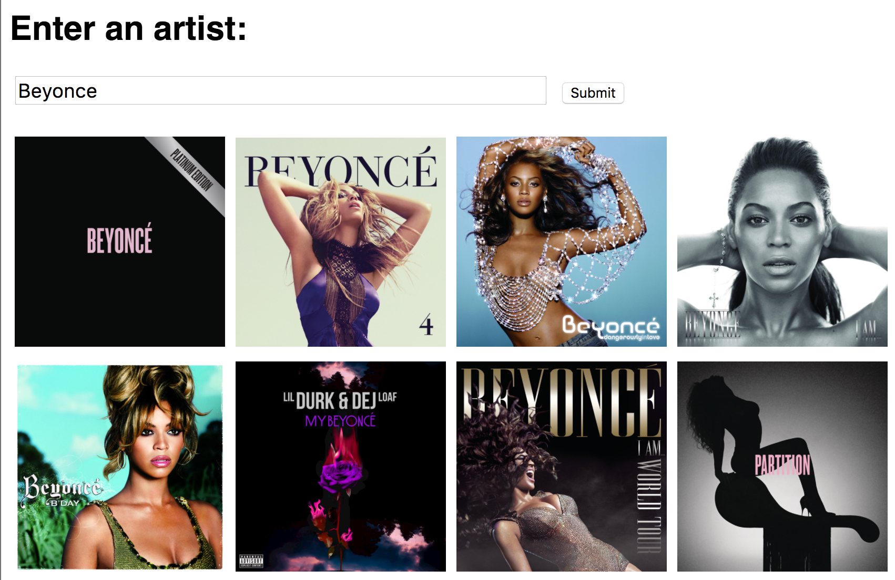
Album example
Let's write a web page that asks the user to enter an artist's name, then displays the albums of that artist, as provided by the Spotify Search API. (live demo)

Slide 19
Spotify search API
Spotify Search URL:
https://api.spotify.com/v1/search?type=album&q=query
E.g.
https://api.spotify.com/v1/search?type=album&q=beyonce
Q: Hey, what's that at the end of the URL?
?type=album&q=beyonce

Slide 20
Query parameters
You can pass parameters to HTTP GET requests by adding query parameters to the URL:
?type=album&q=beyonce
Defined as key-value pairs
  param=value
The first query parameter starts with a ?
Subsequent query parameters start with &

Slide 21

Reminder: HTML elements
Single-line text input:
In JavaScript, you can read and set the input text via inputElement.value
Some other input types:
Select
Textarea
Checkbox

Slide 22
Form submit
Q: What if you want the form to submit after you click "enter"?

Slide 23
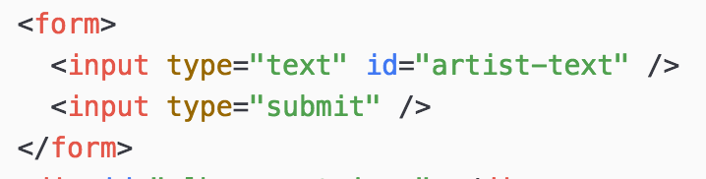
Form submit
Wrap your input elements in a <form>
You should also use <input type="submit"> instead of <button> for the reason on the next slide...

Slide 24
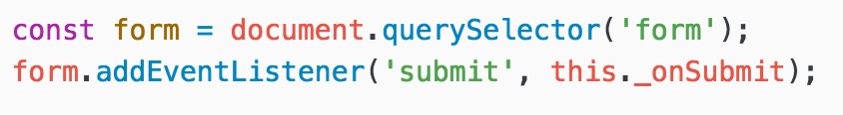
Form submit
2. Listen for the 'submit' event on the form element:
This is why you want to use <input type="submit"> instead of <button> -- the 'submit' event will fire on click for but not <button>.

Slide 25
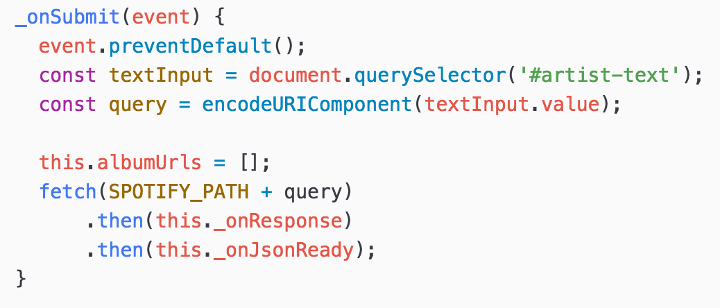
Form submit
3. Prevent the default action before handling the event through event.preventDefault():
The page will refresh on submit unless you explicitly prevent it.

Slide 26
Album example
Let's write a web page that asks the user to enter an artist's name, then displays the albums of that artist, as provided by the Spotify Search API. (live demo)

Slide 27
Other REST APIs

Slide 28
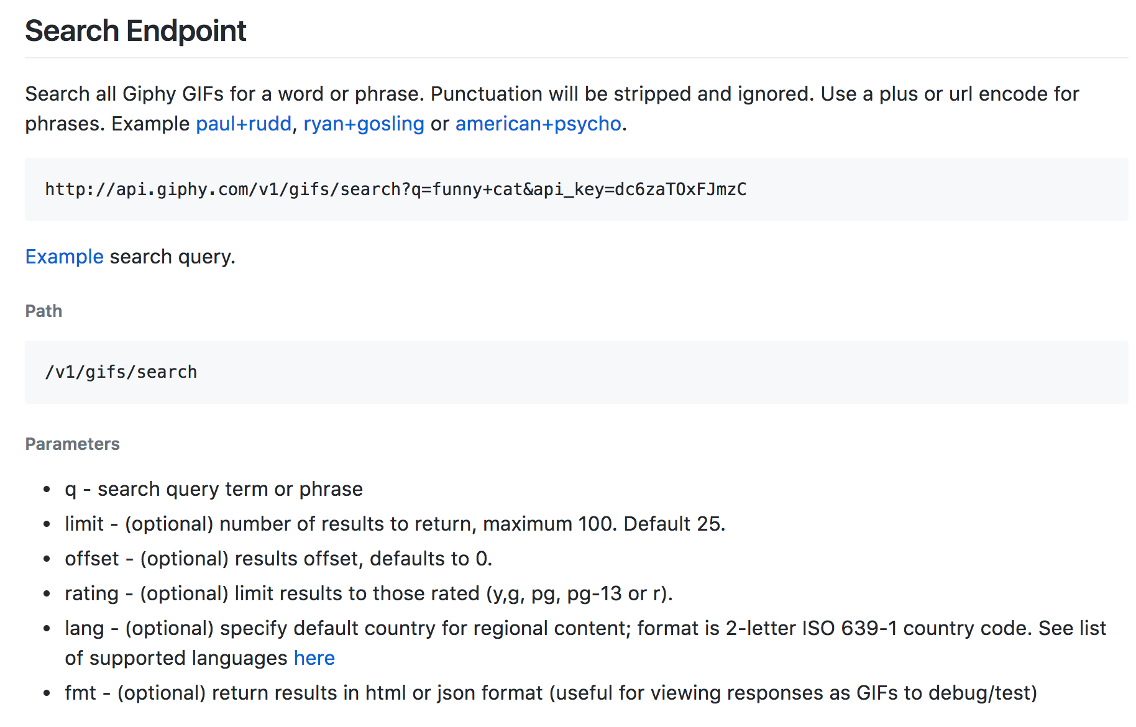
Giphy API
https://github.com/Giphy/GiphyAPI#search-endpoint

Slide 29
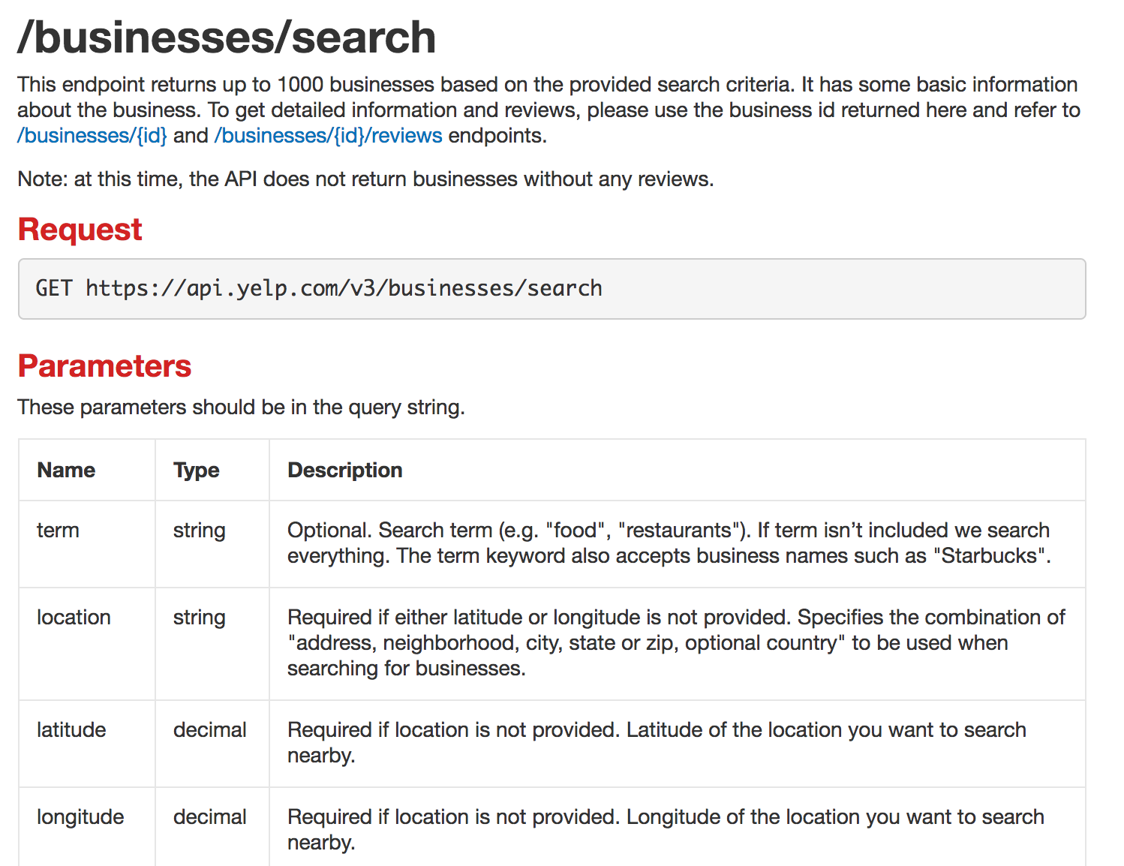
Yelp API
https://www.yelp.com/developers/documentation/v3/business_search

Slide 30
Fetch gotchas

Slide 31

Mixed/CORS error
If you try to fetch() this JSON file:
http://fullstackccu.github.io/lectures/18/albums/albums.json
You get this error:
If you try to fetch() this JSON file:
https://web.stanford.edu/class/cs193x/lectures/18/albums.json
You get this error:
Q: Why do we get this error, when the JSON file is served over HTTP?

Slide 32
CORS
CORS: Cross-Origin Resource Sharing (wiki)
Browser policies for what resources a web page can load
Cross-origin: between two different domains
  If abc.com/users requests something from abc.com/search, it's still a same-origin request (not cross-origin) because it's the same domain
  But if abc.com/foo requests something from xyz.com/foo, it's a cross-origin request.

Slide 33
CORS summarized
You can make same-origin requests by default for any request type
You can make cross-origin requests by default for:
  Images loaded via <img>
  CSS files loaded via <link>
  JavaScript files loaded via <script>
  Etc
You cannot make cross-origin requests by default for:
  Resources loaded via fetch() or XHR

Slide 34
CORS configuration
However, a web server can be configured to override these default rules:
If you want to allow other domains to make fetch() requests to your servers, you can configure your server to allow them (e.g. on apache)
  All 3rd party APIs do this, otherwise you couldn't access them
If you don't want other domains to certain resources such as images, you can disallow them

Slide 35
In this class
In 4102165, we will either be:
Making same-origin requests
Making requests on APIs that have allowed cross-origin access
So you don't need to do anything with CORS for 4102165.
Still, CORS is good to know about:
Helps you understand error messages
You may have to deal with this in the future (common scenario: file:// trying to access an HTTP resource: HTTP resource must allow CORS for this to be allowed)

Slide 36
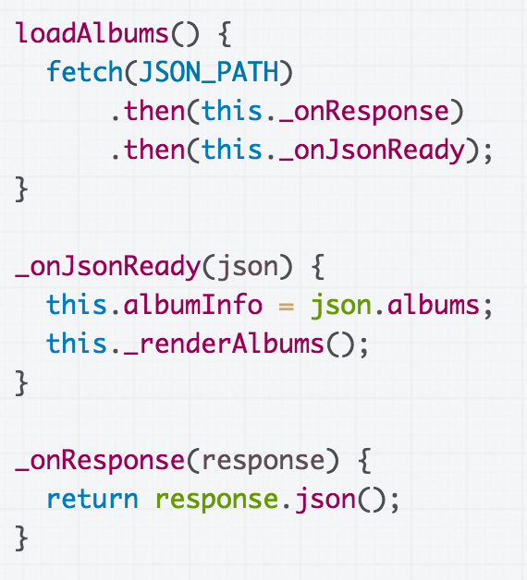
Fetch and closures
What if instead of code like this in a class: (CodePen)

Slide 37
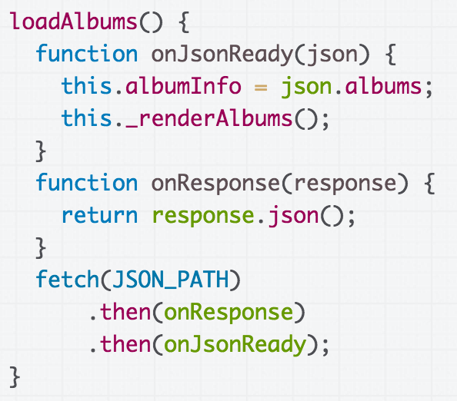
Fetch and closures
We wrote code that looked like this, where onResponse and onJsonReady were inner functions (CodePen):

Slide 38
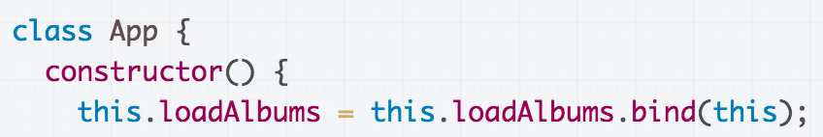
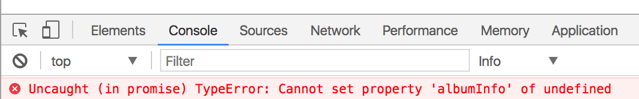
Fetch and closures
Even if we bind loadAlbums:
We get this error (CodePen):

Slide 39
Closures and this
Every function has its own "this" argument, meaning closures (inner functions) also have their own "this" arguments...

Slide 40
Closures and this
x
So even if you've bound the this value for loadAlbums, it doesn't bind the this value for the closures.

Slide 41
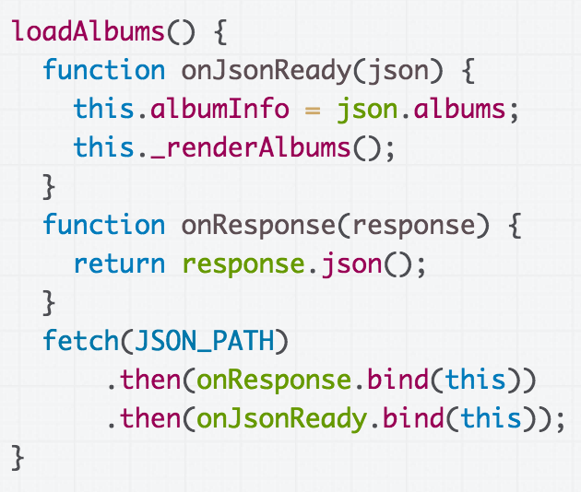
Solution 1: Bind explicitly
You can bind the closures to the this value of loadAlbums when it is called: (CodePen)

Slide 42
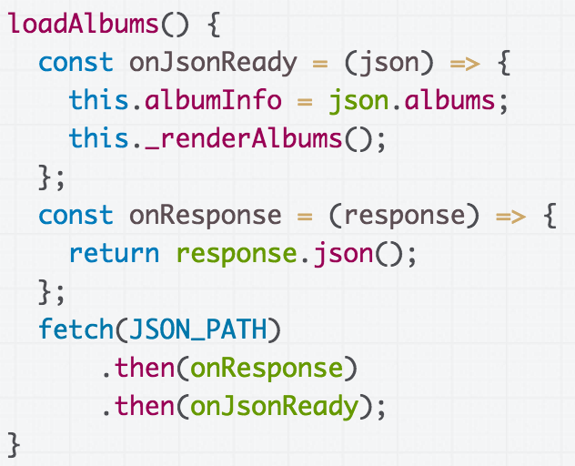
Solution 2: Bind with =>
Functions defined with the arrow syntax are auto-bound to the "this" of their enclosing context (CodePen):

Slide 43
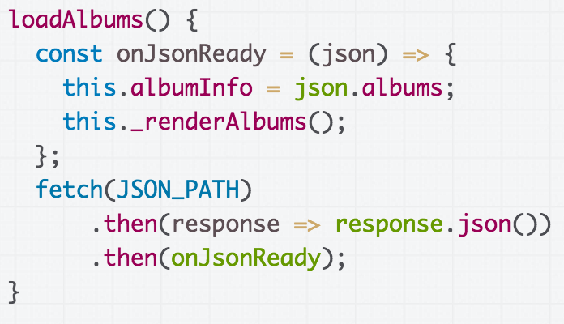
Solution 2: Bind with =>
We can also use the concise syntax:

Slide 44
Single-threaded asynchrony

Slide 45
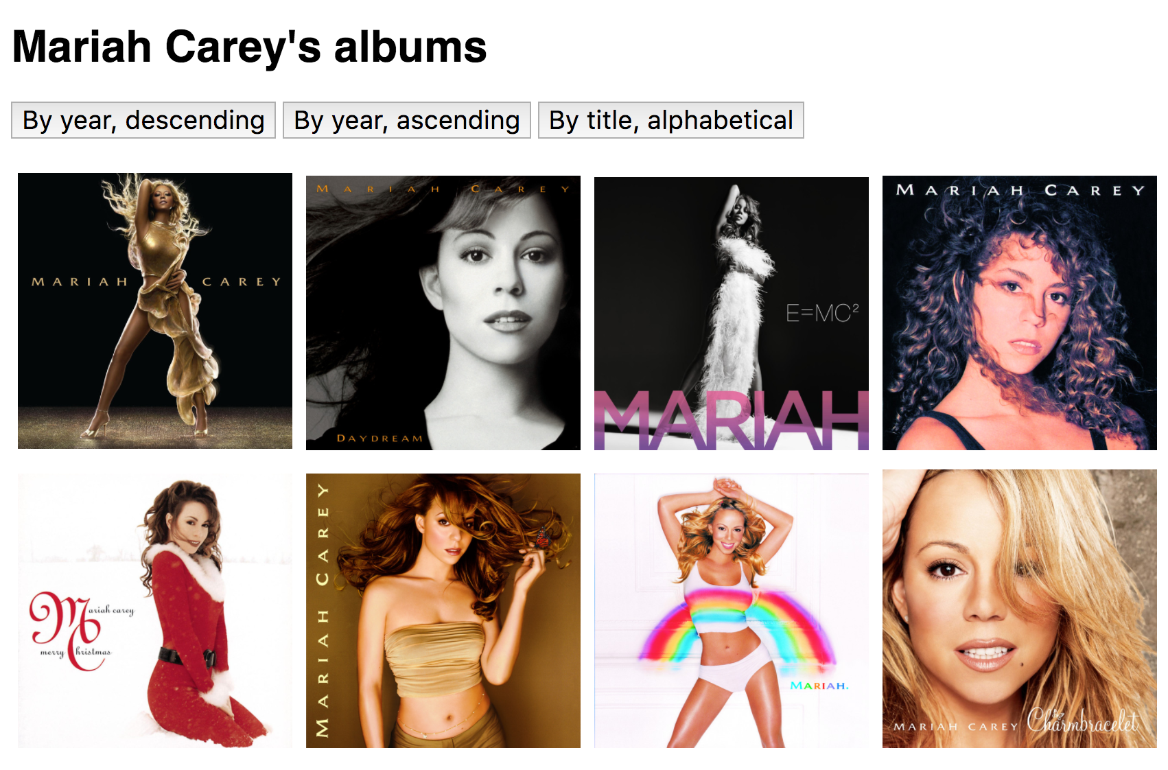
Recall: Discography page
We wrote a web page that lists the Mariah Carey albums stored in albums.json and lets us sort the albums:
(CodePen)

Slide 46
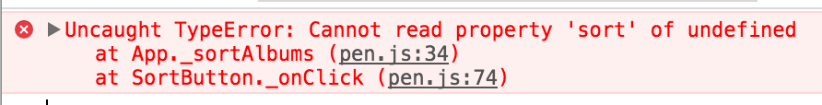
Error?!
If we click on one of the buttons before the albums load, we get an error:
Why?!

Slide 47
On page load
When we first load the page, the following things happen immediately:
1. Script creates App
3. App requests albums.json through fetch()
script.js
App
albums.json
2. App creates SortButtons
SortButton

Slide 48
On page load
When the fetch() finishes, the app creates an Album object for each album that was fetched:
script.js
App
albums.json
5. App creates Album objects
4. fetch() finishes
Album

Slide 49
Before fetch() returns
However, before the fetch() completes, a user might click the sort button:
fetch() is still pending
script.js
App
albums.json
"App, you should sort your album data"
SortButton
Click event!

Slide 50
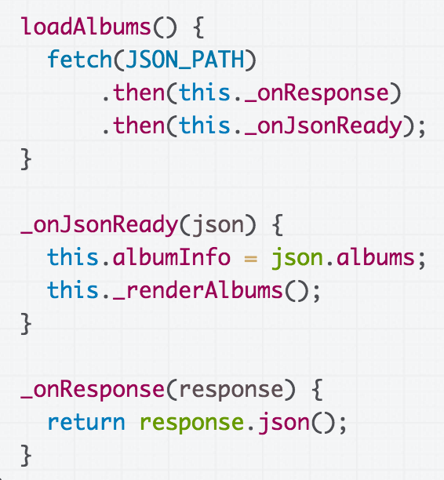
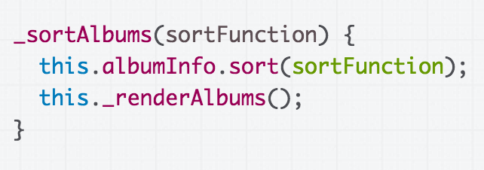
The albumInfo field is filled out after the fetch() from loadAlbums() returns

Slide 51
But if the button is clicked before fetch() returns, albumInfo is not defined yet and we get an error.

Slide 52
Asynchronous events
We have written our code in a way that assumes fetch() will complete before clicking, but on a slow connection, that's not a safe assumption.
script.js
App
albums.json
Fetch finishes!
SortButton
Click event!

Slide 53
General problem
The problem stated generically:
There are 2+ events that can occur at unpredictable times, and the two events are dependent on each other in some way
(Some people call this a "race condition", though other people reserve the term for multiple threads only.)
Click
event!
Fetch finishes!

Slide 54
Solutions
You can either "force" loading to occur before button click, for example:
Disable buttons until the JSON loads
OR: Don't show buttons until the JSON loads
OR: Don't show the UI at all until the JSON completes

Slide 55
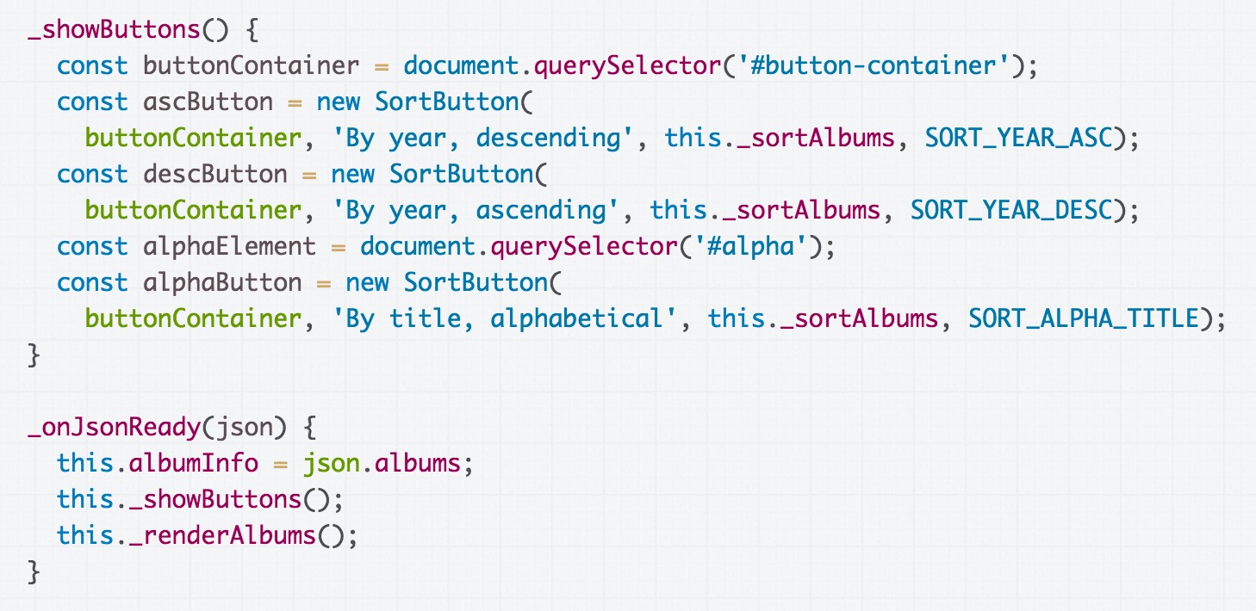
Don't show buttons until JSON is loaded ready: CodePen

Slide 56
Solutions
Or you can make the button event handler work independent of the fetch call
Initialize albumInfo to an empty array in the constructor
Sorting nothing does nothing, which is fine
CodePen

Slide 57
Single-threaded asynchrony

Slide 58
Is it possible for the _onJsonReady function to fire *in the middle* of sortAlbums?

Slide 59
Solutions
You can either "force" loading to occur before button click, for example:
Disable buttons until the JSON loads
OR: Don't show buttons until the JSON loads
OR: Don't show the UI at all until the JSON completes

Slide 60
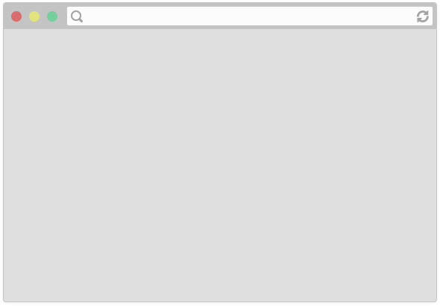
...
The browser is fetching albums.json...

Slide 61

...
User clicks a button, so the event handler is running

Slide 62
...
Is it possible that while the click handler is still running (still on the call stack), the fetch() callback also fires?

Slide 63
...
The answer is No, because JavaScript is single-threaded.

Slide 64
Single-threaded?
Some hand-wavy definitions:
Single-threaded:
  When your computer processes one command at a time
  There is one call stack
Multi-threaded
  When your computer processes multiple commands simultaneously
  There is one call stack per thread
thread: a linear sequence of instructions; an executable container for instructions

Slide 65
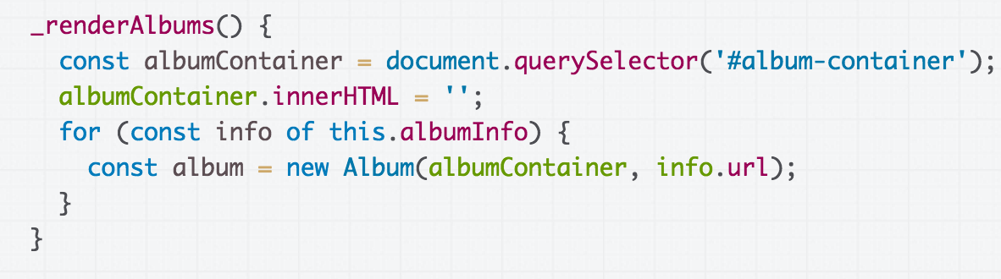
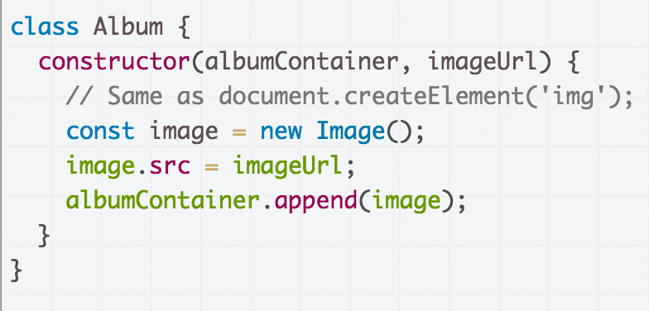
Single-threaded JS
We create a new Album for each album in the JSON file
For each album, we create a new DOM Image
Q: If in JavaScript, only one thing happens at a time, does that mean only one image loads at a time?

Slide 66
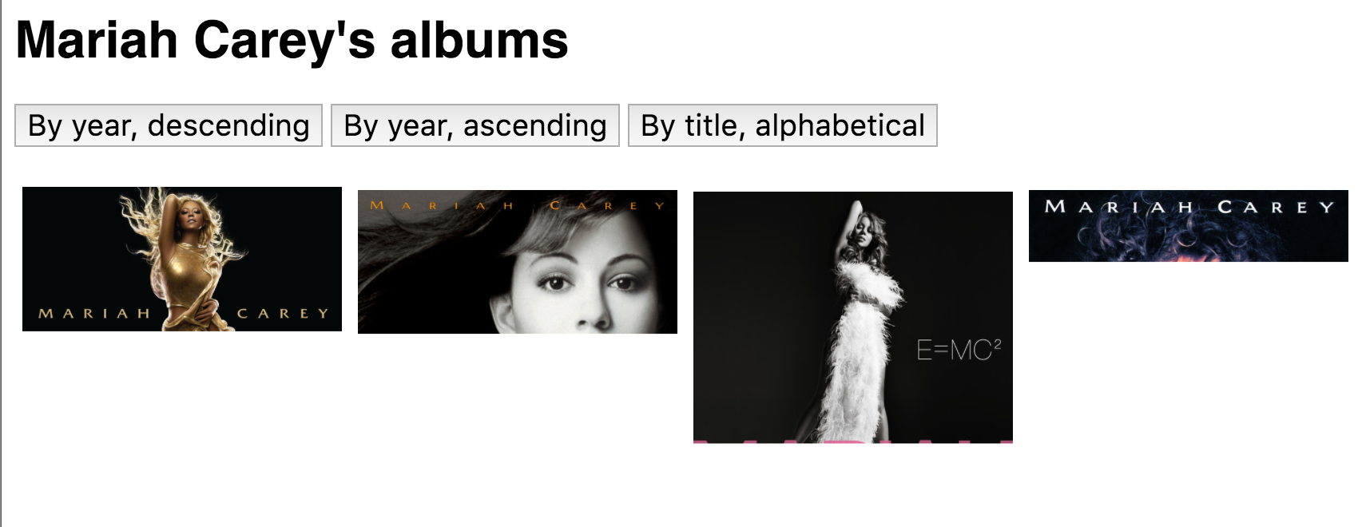
Image loading
Empirically, that doesn't seem to be the case:

Slide 67
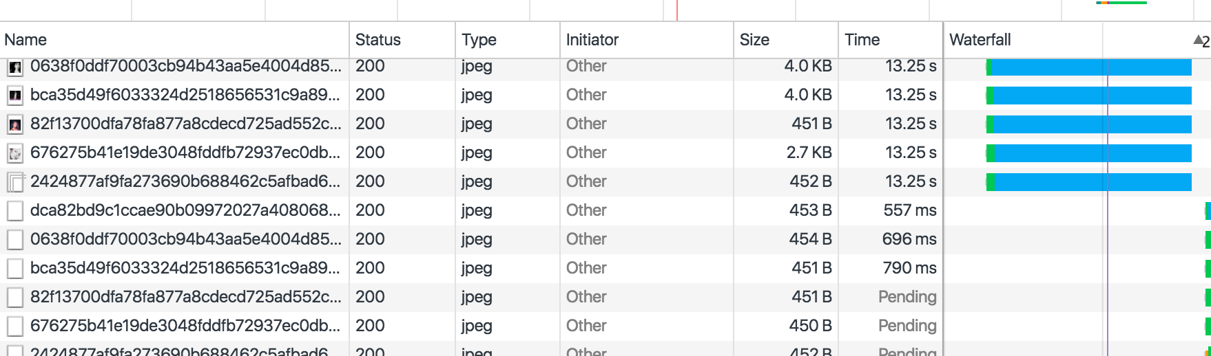
Network tab
If we look at Chrome's Network tab, we see there are several images being loaded simultaneously:
Q: If JavaScript is single-threaded, i.e. if only one thing happens at a time, how can images be loaded in parallel?

Slide 68
JavaScript event loop

Slide 69
Note: see talk!
(For a perfectly great talk on this, see Philip Roberts' talk: https://www.youtube.com/watch?v=8aGhZQkoFbQ&t=1s
And for a perfectly great deep dive on this, see Jake Archibald's blog post:
https://jakearchibald.com/2015/tasks-microtasks-queues-and-schedules/
These slides are inspired by these resources!)

Slide 70
setTimeout
To help us understand the event loop better, let's learn about a new command, setTimeout:
setTimeout(function, delay);
function will fire after delay milliseconds
CodePen example

Slide 71
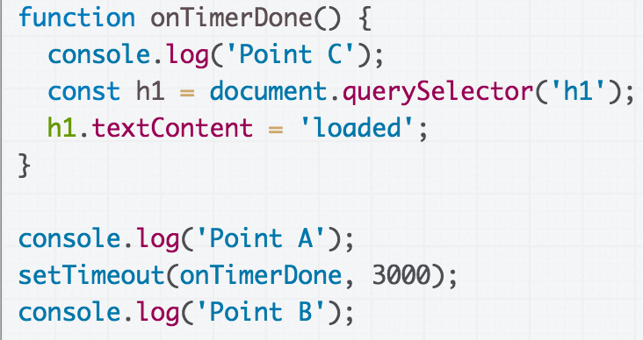
Call stack + setTimeout
Call Stack
(global function)

Slide 72
Call stack + setTimeout
Call Stack
(global function)

Slide 73
Call stack + setTimeout
Call Stack
console.log('Point A');
(global function)

Slide 74
Call stack + setTimeout
Call Stack
(global function)

Slide 75
Call stack + setTimeout
Call Stack
setTimeout(...);
(global function)

Slide 76
Call stack + setTimeout
Call Stack
(global function)

Slide 77
Call stack + setTimeout
Call Stack
console.log('Point B');
(global function)

Slide 78
Call stack + setTimeout
Call Stack
(global function)

Slide 79
Call stack + setTimeout
Call Stack

Slide 80
Call stack + setTimeout
Call Stack
onTimerDone()

Slide 81
Call stack + setTimeout
Call Stack
console.log('Point C');
onTimerDone()

Slide 82
Call stack + setTimeout
Call Stack
onTimerDone()

Slide 83
Call stack + setTimeout
Call Stack
querySelector('h1');
onTimerDone()

Slide 84
Call stack + setTimeout
Call Stack
onTimerDone()

Slide 85
Call stack + setTimeout
Call Stack
onTimerDone()

Slide 86
Call stack + setTimeout
Call Stack

Slide 87
Call stack + setTimeout
Call Stack
What "enqueues" onTimerDone? How does it get fired?
setTimeout(...);
(global function)

Slide 88
Tasks, Micro-tasks,
and the Event Loop

Slide 89
Tasks and the Event Loop
Call Stack
The JavaScript runtime can do only one thing at a time...
setTimeout()
(global function)

Slide 90
Tasks and the Event Loop
Call Stack
setTimeout()
(global function)
But the JS runtime runs within a browser, which can do multiple things at a time.

Slide 91


Browser internal implementation
Call Stack
setTimeout()
Task Queue
(global function)
Event loop
Micro-task queue
Here's a picture of the major pieces involved in executing JavaScript code in the browser.

Slide 92
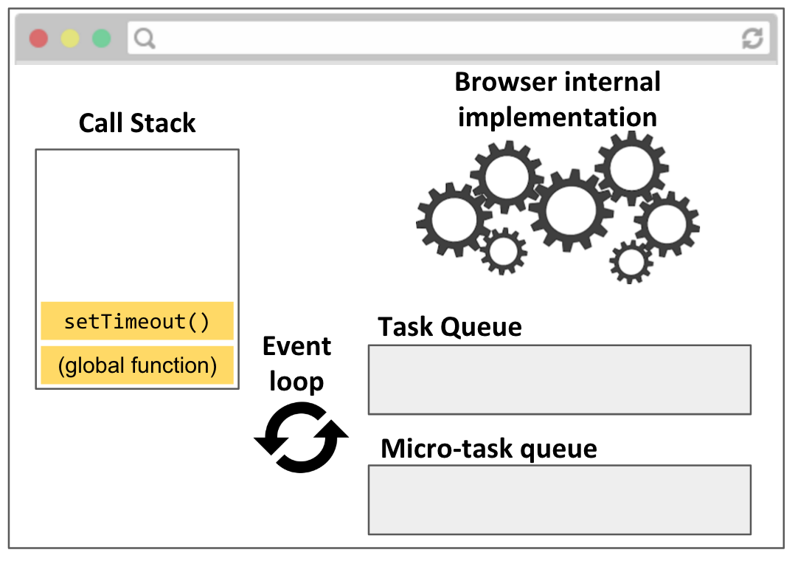
JS execution
Call stack: JavaScript runtime call stack. Executes the JavaScript commands, functions.
Browser internal implementation: The C++ code that executes in response to native JavaScript commands, e.g. setTimeout, element.classList.add('style'), etc.

Slide 93
JS execution
The browser itself is multi-threaded and multi-process!
Call stack: JavaScript runtime call stack. Executes the JavaScript commands, functions.
Browser internal implementation: The C++ code that executes in response to native JavaScript commands, e.g. setTimeout, element.classList.add('style'), etc.

Slide 94
JS execution
Task Queue: When the browser internal implementation notices a callback from something like setTimeout or addEventListener is should be fired, it creates a Task and enqueues it in the Task Queue

Slide 95
JS execution
Micro-task Queue: Promises are special tasks that execute with higher priority than normal tasks, so they have their own special queue. (see details here)

Slide 96
JS execution
Event loop: Processes the task queues.
When the call stack is empty, the event loop pulls the next task from the task queues and puts it on the call stack.
The Micro-task queue has higher priority than the Task Queue.

Slide 97
Demo
Philip Roberts wrote a nice visualizer for the JS event loop:
setTimeout
With click

