Slide 1
4102165: Full Stack Web Development Fundamentals
Spring 2019
簡立仁 Li-Ren Chien
ccumouse@gmail.com

Slide 2
Schedule
Today:
More on callbacks
Functional JavaScript
Currying
Closures
Anonymous functions

Slide 3
Prereq: Command line
Sometime next week, we will need to start using the command line.
We will not be teaching how to use a command line interface.
Please make sure you know how to:
Navigate between directories in a command line
Open / edit files via command-line
Execute scripts via command-line

Slide 4
Callbacks

Slide 5
A real example: Callbacks
Another way we can communicate between classes is through callback functions:
Callback: A function that's passed as a parameter to another function, usually in response to something.

Slide 6
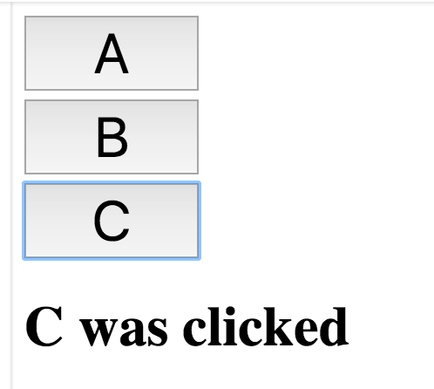
Recall: Button example
Menu:
Has an array of Buttons
Also updates the <h1> with what was clicked
Button:
Notifies Menu when clicked, so that Menu can update the <h1>
Solution with Custom Events
Menu
"Button B was clicked!"
Has a list of Buttons
Button
Button
Button

Slide 7
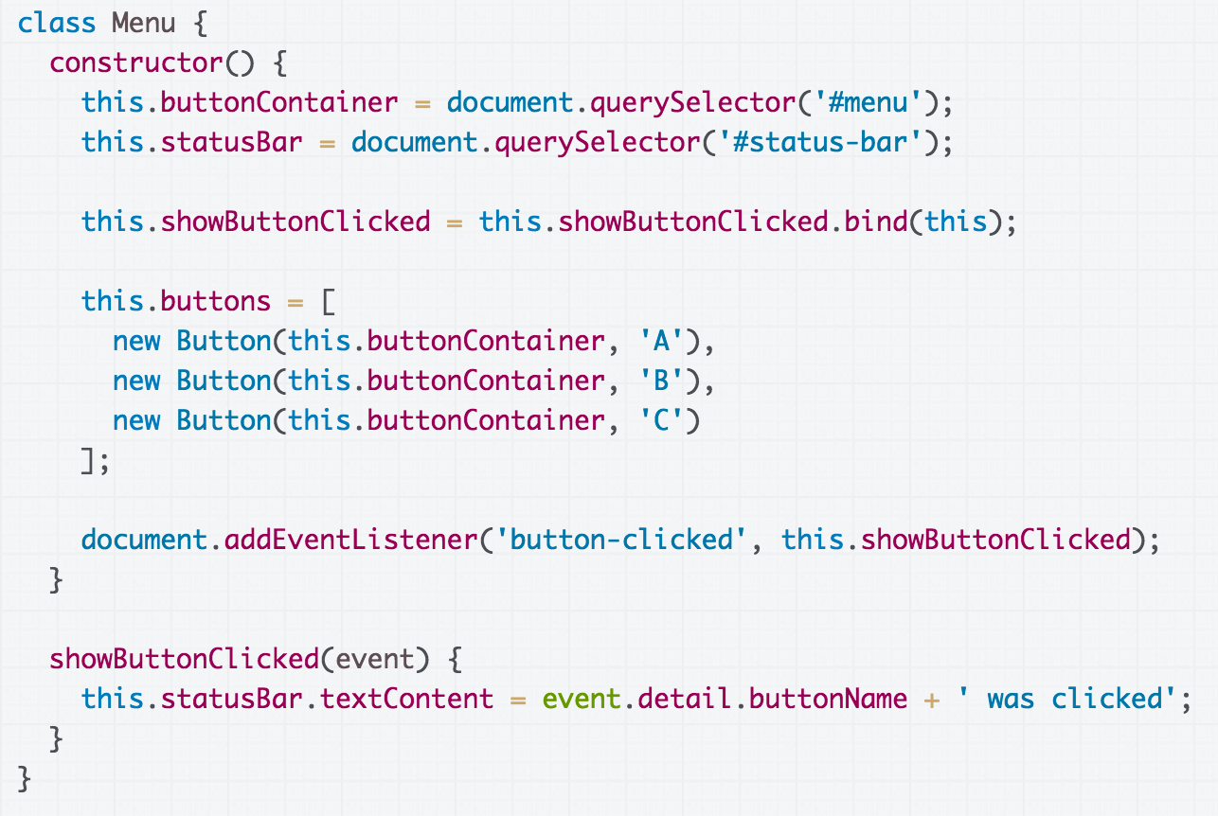
Custom Events: Menu listens for a 'button-clicked' event

Slide 8
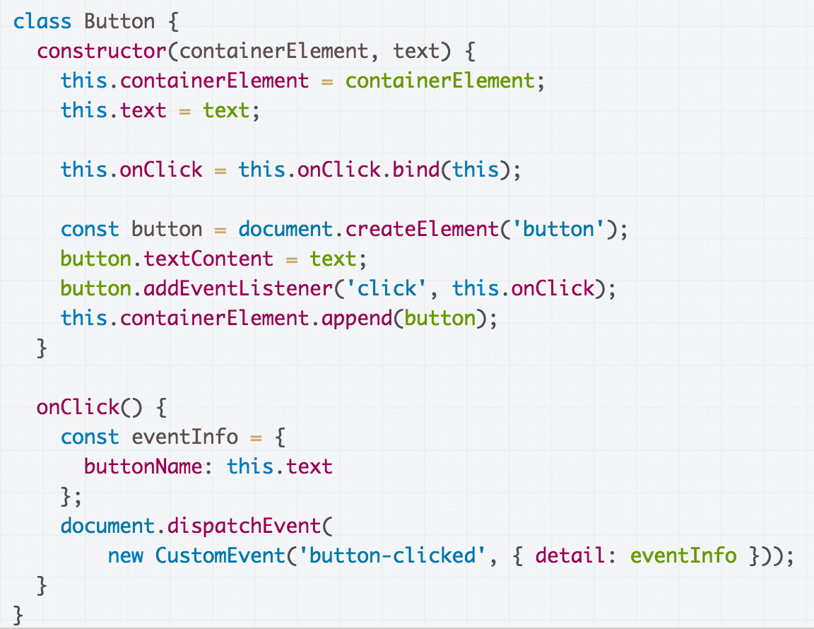
Custom Events: Button dispatches a 'button-clicked' event, with information on what was clicked

Slide 9
How would we implement the same thing with callbacks?

Slide 10
Callback solution
Button:
Takes a function parameter (callback) in the constructor
Saves this parameter as a field
Invokes the saved callback function when clicked
Menu:
Passes showButtonClicked method as parameter in Button constructor
Menu
"Button B was clicked!"
Has a list of Buttons
Button
Button
Button

Slide 11
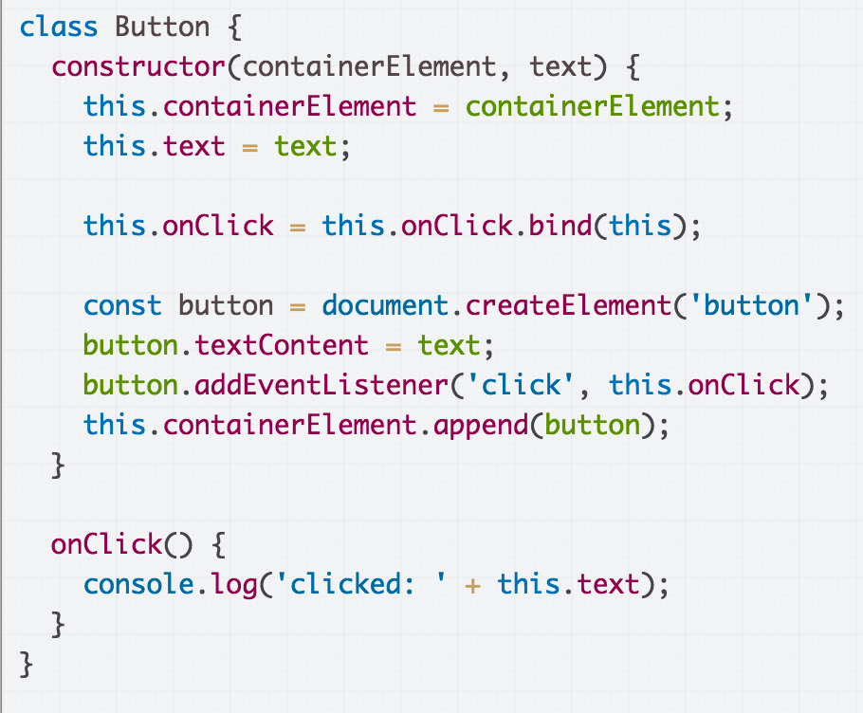
Callback Sender Strategy: Add an onClickedCallback function parameter to the Button constructor, save it in field, and invoke it onClick.

Slide 12
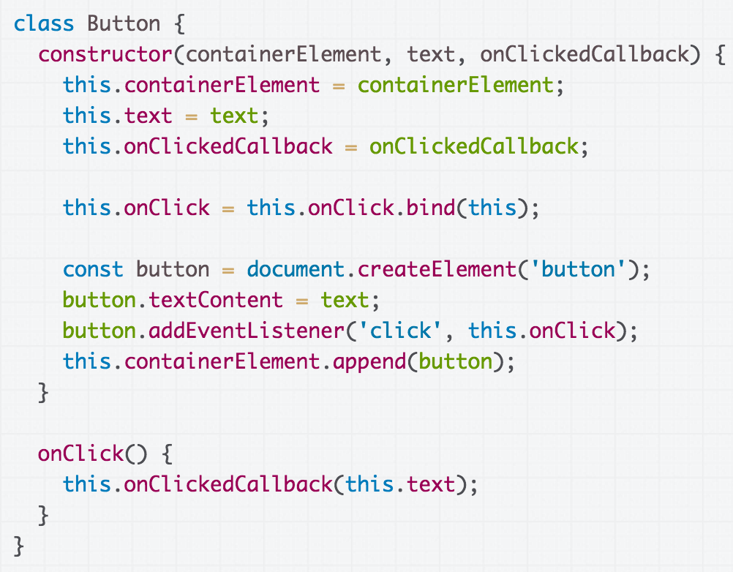

Slide 13
Button constructor takes an onClickedCallback function parameter, which is saves in a field of the same name

Slide 14
Invoke the saved callback function when clicked.

Slide 15
You can send whatever parameter(s) you'd like in the callback function.

Slide 16
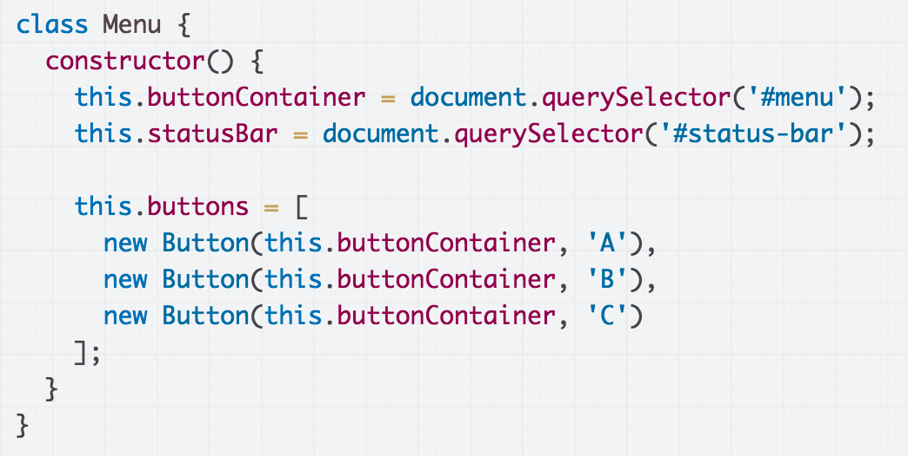
Callback Receiver Strategy: Add a method to be called when a button is clicked and pass it to the constructor of Button

Slide 17
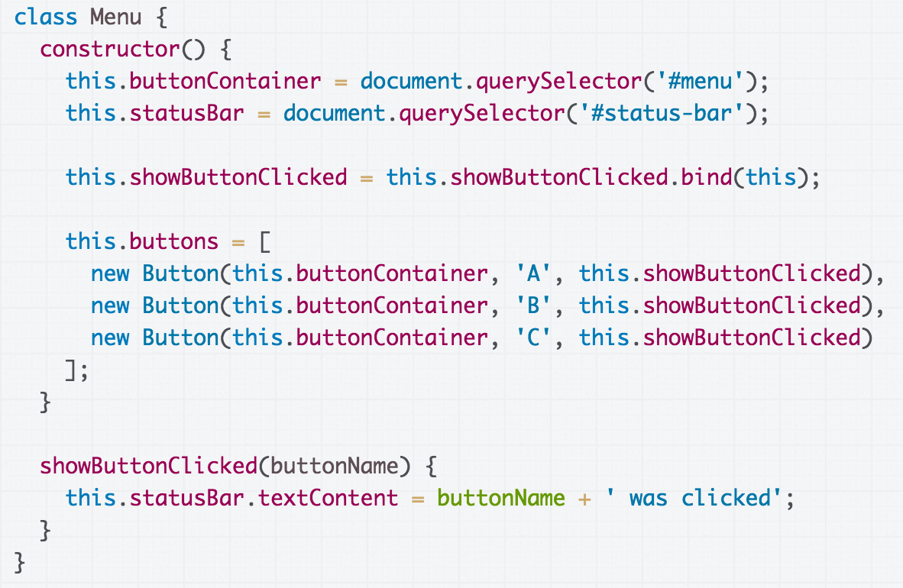
Add the showButtonClicked method, which should be called when the button is clicked.

Slide 18
Add the showButtonClicked method, which should be called when the button is clicked.

Slide 19
Note that we still have to bind showButtonClicked, even though it won't be invoked as a result of a DOM event.

Slide 20
Pass the showButtonClicked method to the constructor of Button

Slide 21
Button example solution
Solution with Callbacks

Slide 22
Q: Why did we have to bind showButtonClick?

Slide 23
this in a method

Slide 24
this in different contexts
this in a constructor:
this is set to the new object being created
this in a function firing in response to a DOM event:
this is set to the DOM element to which the event handler was attached
this being called as a method on an object:
this is set to the that is calling the method, or the object on which the method is called.
(all values of this)

Slide 25
When Button is constructed, showButtonClicked is being saved in Button's onClickedCallback field

Slide 26
Button is the object that ultimately calls the showButtonClicked function.

Slide 27
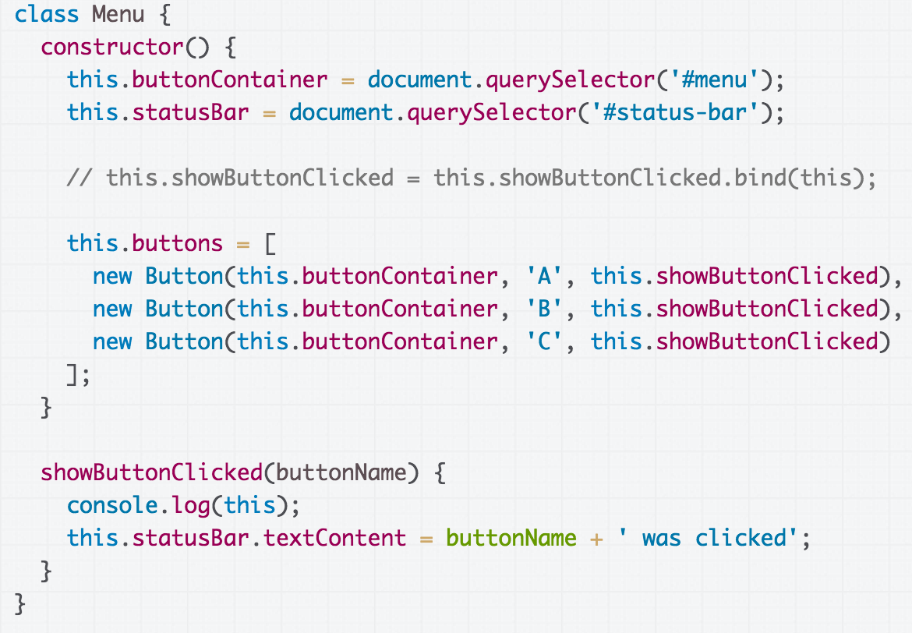
Without the call to bind, this in showButtonClicked is Button, and this will result in a JS error when we try to refer to this.statusBar.textContent (CodePen)

Slide 28
But with the call to bind, this in showButtonClicked is the Menu, which is the behavior we want. (CodePen)

Slide 29
One more look at bind

Slide 30
Objects in JS
Objects in JavaScript are sets of property-value pairs:
const bear = { name: 'Ice Bear',
hobbies: ['knitting', 'cooking', 'dancing'] };

Slide 31
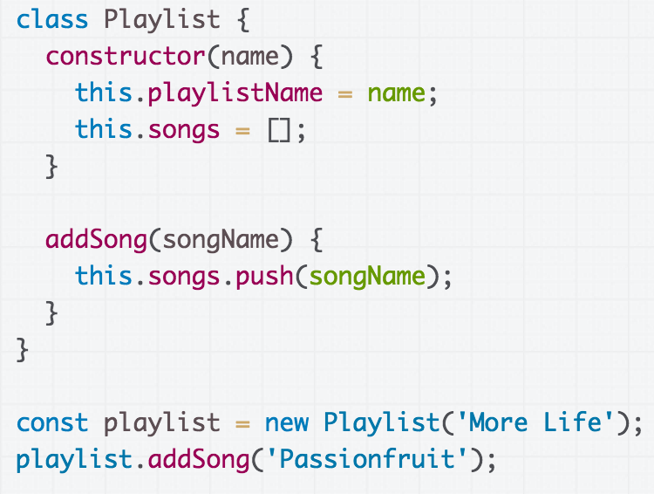
Classes in JS
Classes in JavaScript produce objects through new.
(CodePen)

Slide 32
Classes in JS
Q: Are the objects created from classes also sets of property-value pairs?

Slide 33
Classes and objects
A: Yes.
The playlist object created by the constructor essentially* looks like this:
{
playlistName: 'More Life',
songs: [],
addSong: function(songName) {
this.songs.push(songName);
}
}
Technically addSong (and the constructor function) is defined in the prototype of the playlist object, but we haven't talked about prototypes and probably won't talk about prototypes until the end of the quarter.

Slide 34
Classes and objects
{
playlistName: 'More Life',
songs: [],
addSong: function(songName) {
this.songs.push(songName);
}
}
In JavaScript, a method of an object is just a property whose value is of Function type.

Slide 35
Classes and objects
{
playlistName: 'More Life',
songs: [],
addSong: function(songName) {
this.songs.push(songName);
}
}
In JavaScript, a method of an object is just a property whose value is of Function type.
And just like any other Object property, the value of that method can be changed.

Slide 36
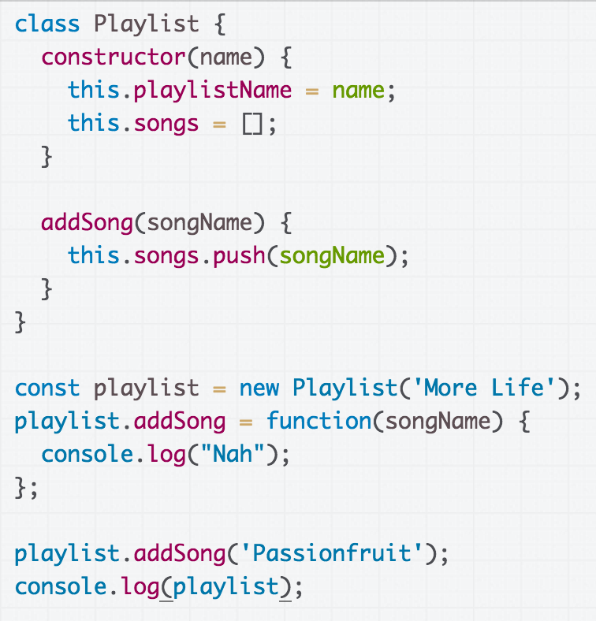
Rewriting a function
Q: What is the output of this code?
CodePen

Slide 37
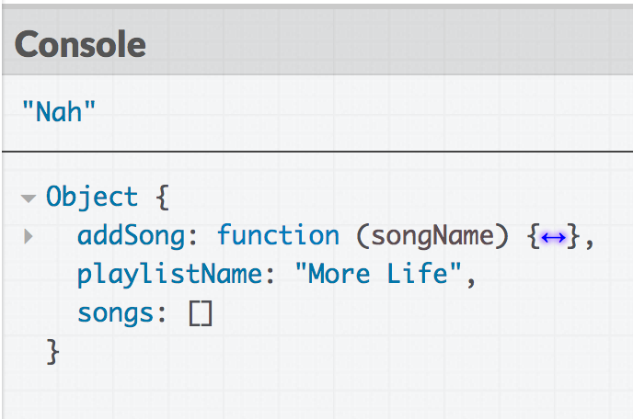
Rewriting a function

Slide 38
When would you ever want to rewrite the definition of a method?!

Slide 39
bind in classes
constructor() {
const someValue = this;
this.onClick = this.onClick.bind(someValue);
}
The code in purple is saying:
Make a copy of onClick, which will be the exact same as onClick except this in onClick is always set to the someValue

Slide 40
bind in classes
constructor() {
const someValue = this;
this.onClick = this.onClick.bind(someValue);
}
The code in purple is rewriting the onClick property of the object:
Assign the value of the onClick property: set it to the new function returned by the call to bind

Slide 41
Practical Functional JavaScript

Slide 42
Functional programming
We are going to cover some topics that are fundamental to a programming paradigm called functional programming.
Pure functional programming is pretty extreme:
Everything in your code is either a function or an expression
There are no statements
There is no state:
No variables, fields, objects, etc
Comes from the idea of treating a computer program as a mathematical function
Lambda_calculus ( wiki/ Visual Lambda-Calculator )

Slide 43
Functional programming
This is a code snippet from Scheme, a functional programming language:
Everything is a function or the result of a function call.

Slide 44
Practical FP in JS
Most software is not built using a pure functional programming paradigm, so we won't be covering it.
But there are some ideas from functional programming that are immensely useful:
First-class functions (functions as objects)
Currying
Closures
Anonymous functions / lambdas / function literals

Slide 45
Why FP matters
Why should we learn about this other programming paradigm?
There are ideas you can express more clearly and concisely with functional programming.
There are problems you can solve much more easily with functional programming.
(very practically) You will see JavaScript code in the wild that uses functional programing and the code will be indecipherable if you don't learn it.
(very practically) Functional programming is trendy and so useful that C++ and Java added support for a few critical FP concepts (lambdas/closures) in the past few years.

Slide 46
First-class functions
Functions in JavaScript are objects.
They can be saved in variables
They can be passed as parameters
They have properties, like other objects
They can be defined without an identifier
(This is also called having first-class functions, i.e. functions in JavaScript are "first-class" because they are treated like any other variable/object.)

Slide 47
Recall: Functions as parameters
We know that we can pass functions as parameters to other functions. We've already done this multiple times:
The event handler parameter to addEventListener
As a parameter for a constructor of a new object
Array objects also have several methods that take functions as parameters.

Slide 48
Example: findIndex
list.findIndex(callback, thisArg):
Returns the index of an element.
callback is a function with the following parameters:
element: The current element being processed.
index: The index of the current element being processed in the array.
array: the array findIndex was called upon.
callback is called for every element in the array, and returns true if found, false otherwise.
thisArg is the value of this in callback

Slide 49
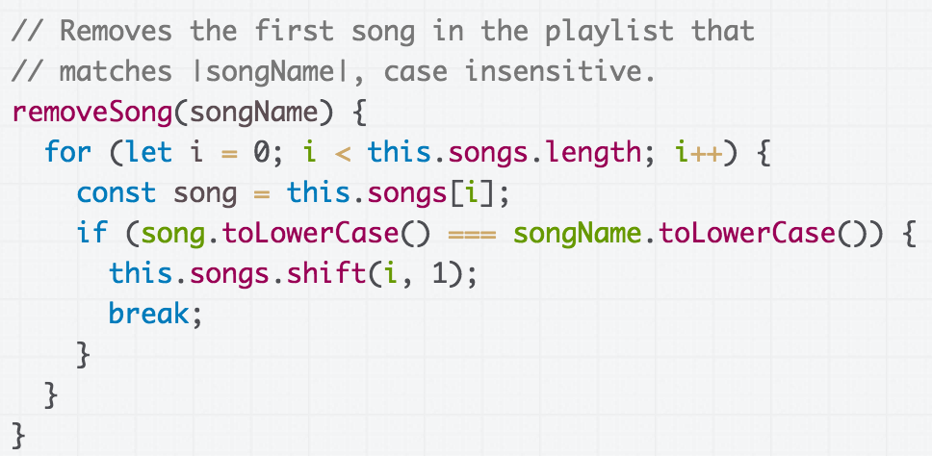
Remove with for-loop
Let's say that we added a removeSong method to Playlist (CodePen)

Slide 50
Remove with findIndex
How would we rewrite this using findIndex?
Starter CodePen

Slide 51
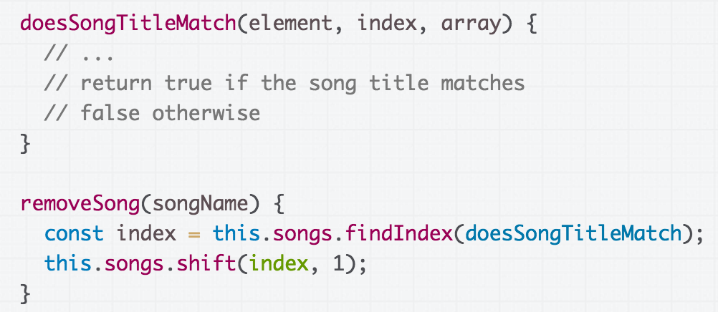
General approach
We want to do something like this...

Slide 52
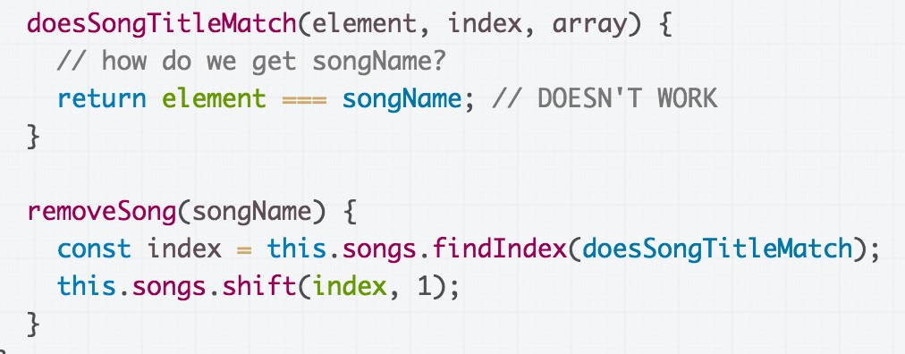
General approach
But the problem is that we want to pass songName into the doesSongTitleMatch function somehow.

Slide 53
General approach
But the problem is that we want to pass songName into the doesSongTitleMatch function somehow.

Slide 54
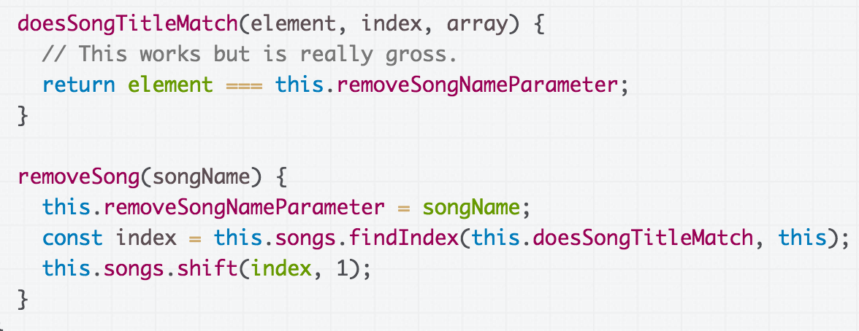
Clunky solution: field
We could save the song parameter as a field, which the doesSongTitleMatch method can access…
(CodePen)

Slide 55
Clunky solution: field
But then you have this weird removeSongNameParameter field that is only valid in between these method calls. (CodePen)

Slide 56
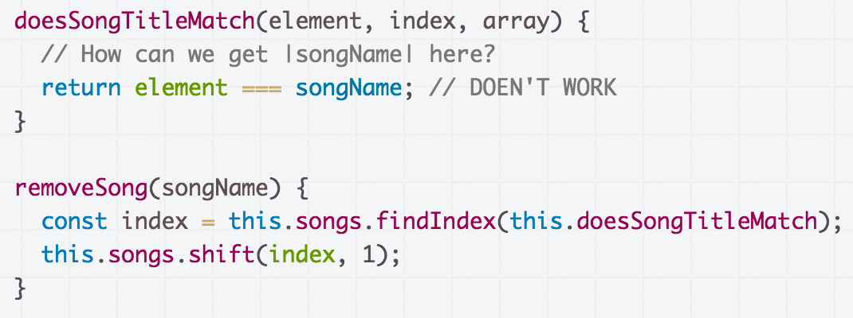
Add a parameter?
We really want to pass the songName value from removeSong to doesSongTitleMatch …

Slide 57
Add a parameter?
But the callback for findIndex expects 3 specific parameters, and we can't somehow add songName.

Slide 58
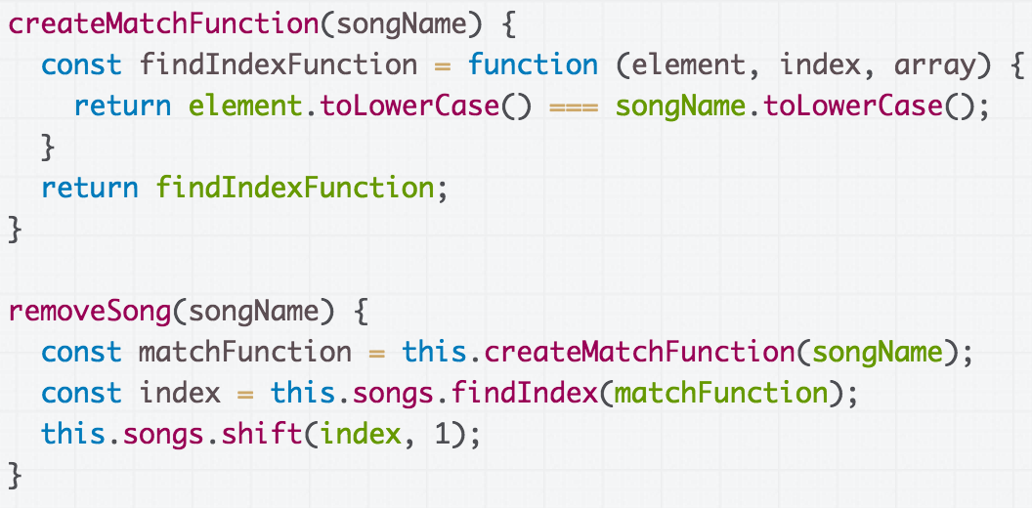
One solution: new function
We can do this (CodePen):

Slide 59
One solution: new function
We can do this (CodePen):
??????

Slide 60
Creating functions within functions

Slide 61
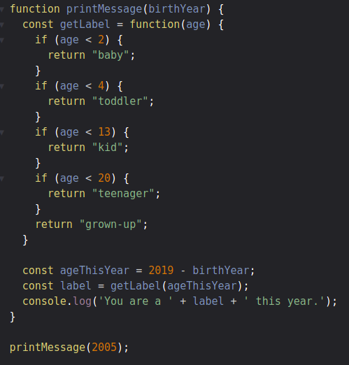
Functions that create functions
In JavaScript, we can create functions from within functions (CodePen).

Slide 62
Functions that create functions
In JavaScript, we can create functions from within functions (CodePen).
A function declared within a function is also known as a closure.

Slide 63
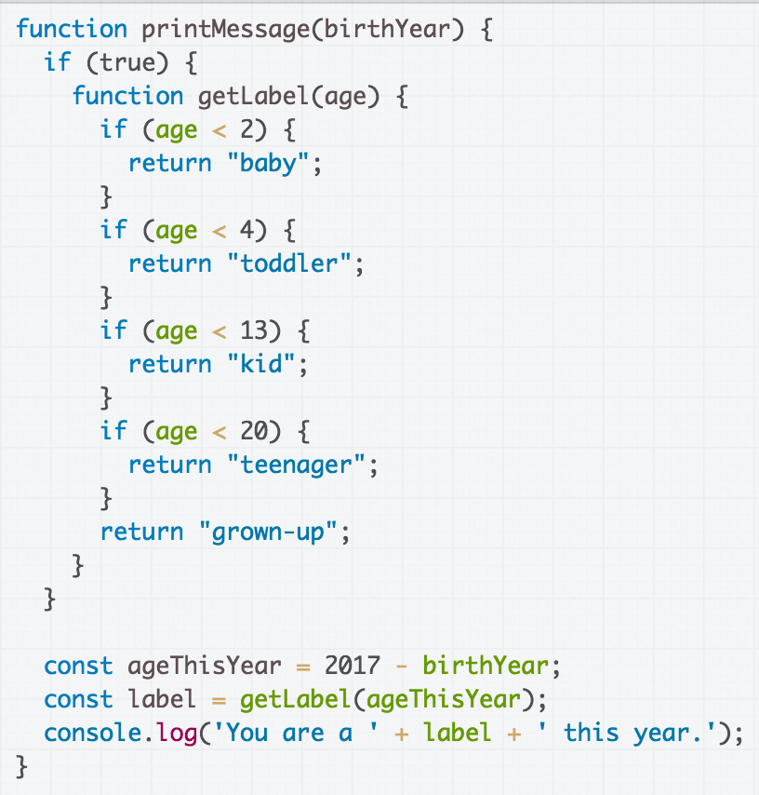
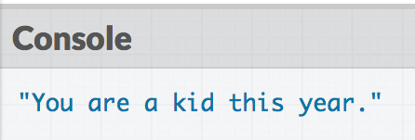
Scope of closures
Functions declared with function (or var) have function scope.
Can be referenced anywhere in the function after declaration
This example works:

Slide 64
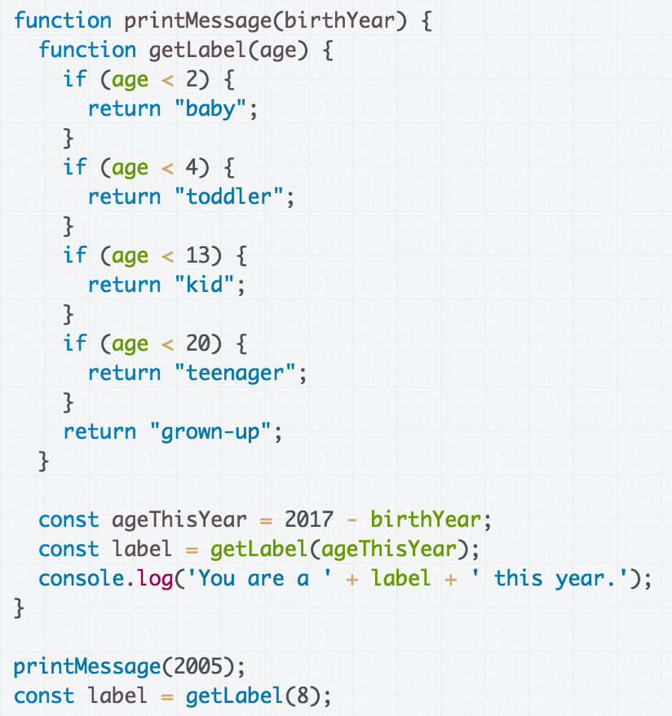
Scope of closures
Functions declared with function (or var) have function scope.
Cannot be referenced outside the function
This example doesn't work:

Slide 65
Scope of closures
Functions declared with function (or var) have function scope.
Cannot be referenced outside the function
This example doesn't work:

Slide 66
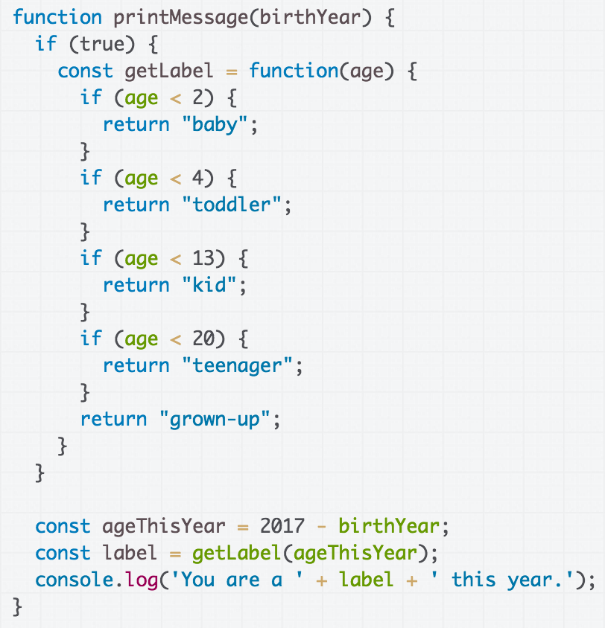
Scope of closures
Functions declared with const or let have block scope
Cannot be referenced outside of the block.
This example doesn't work:

Slide 67
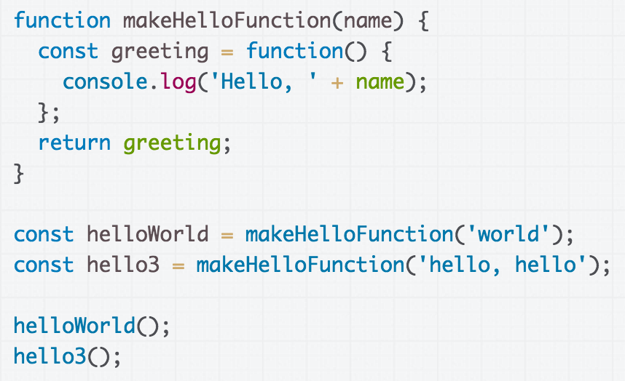
Functions that return functions
In JavaScript, we can return new functions as well.
(We kind of knew this already because bind returns a new function.)
CodePen

Slide 68
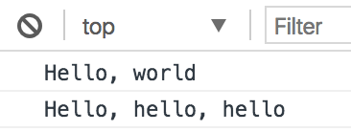
Functions that create functions
CodePen

Slide 69
Closure: an inner function
When you declare a function inside another function, the inner function is called a closure.

Slide 70
Closure: an inner function
Within a closure, you can reference variables that were declared in the outer function, and those variables will not go away after the outer function returns.

Slide 71
Functions that create functions
The scope of greeting is only in the makeHelloFunction function, as well as the scope of name...

Slide 72
Functions that create functions
But the makeHelloFunction function returns a reference to the function, which is an object, so the function object doesn't go away

Slide 73
Functions that create functions
And the function object keeps a reference to the name parameter, so that when the created function is called...

Slide 74
Functions that create functions
… we see that the new function returned from makeHelloFunction still has access to the name variable.

Slide 75
Functions that create functions
The idea of constructing a new function that is "partially instantiated" with arguments is called currying. (article)(Wiki)

Slide 76
Anonymous functions
We do not need to give an identifier to functions.
When we define a function without an identifier, we call it an anonymous function
Also known as a function literal, or a lambda function

Slide 77
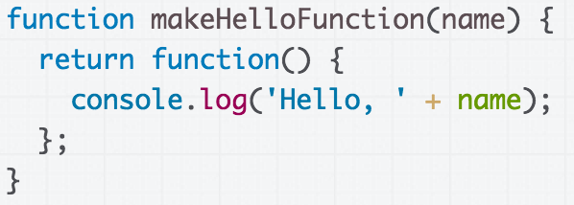
Anonymous functions
We do not need to give an identifier to functions.
When we define a function without an identifier, we call it an anonymous function
Also known as a function literal, or a lambda function
CodePen

Slide 78
Back to our Playlist

Slide 79
General approach
We want to do something like this...

Slide 80
General approach
But the problem is that we want to pass songName into the doesSongTitleMatch function somehow.

Slide 81
Instantiating a function...
We want to create a version of doesSongTitleMatch, with a value assigned to songName.

Slide 82
Currying
We can do this (CodePen):

Slide 83
Currying
We've created a function whose signature matches what findIndex expects.

Slide 84
Currying
We're creating this function within an outer function that takes the songName.

Slide 85
Currying
This allows us to essentially construct a new findIndexFunction, with a set songName value.
This is called currying.

Slide 86
Cleaning up removeSong
We can also define the findIndexFunction directly in removeSong, instead of making a separate function to create one with the right parameters (CodePen):

Slide 87
Cleaning up removeSong
We don't need to include the parameters we aren't using:

Slide 88
Cleaning up removeSong
We can define the function directly in the findIndex parameter instead of saving it in a variable:

Slide 89
Cleaning up removeSong
We can use the arrow function syntax for defining functions:

Slide 90
Cleaning up removeSong
We can use the concise version of the arrow function:
You can omit the parentheses if there is only one parameter
You can omit the curly braces if there's only one statement in the function, and it's a return statement

Slide 91
removeSong before/after

Slide 92
More Array functions
Function name | Description
list.forEach(function) | Executes the provided function once for each array element. (mdn)
list.filter(function) | Creates a new array with all elements that pass the test implemented by the provided function. (mdn)
list.every(function) | Tests whether all elements in the array pass the test implemented by the provided function. (mdn)
All Array functions

Slide 93
Gotchas and style notes

Slide 94
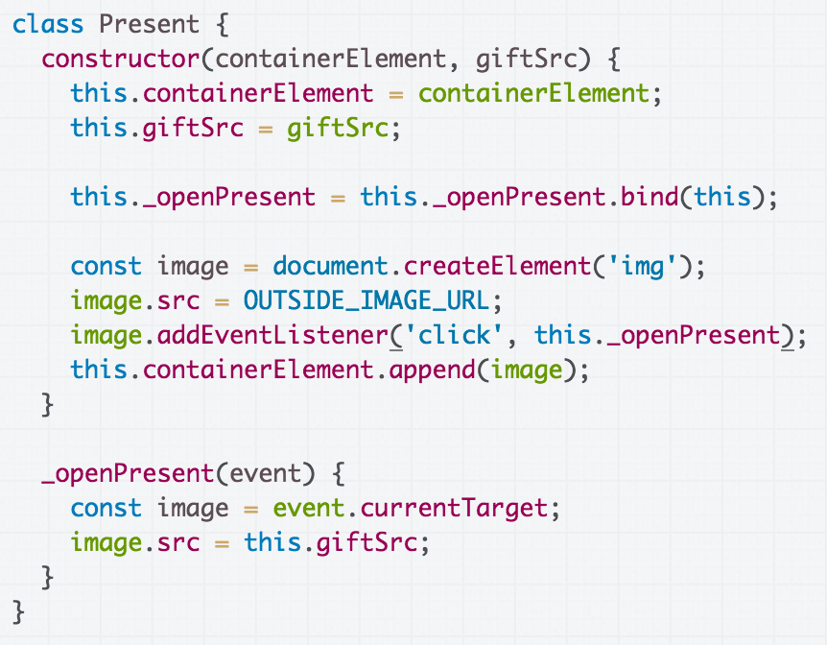
Recall: Present example
We implemented a Present class that had a separate _openPresent method.
CodePen

Slide 95
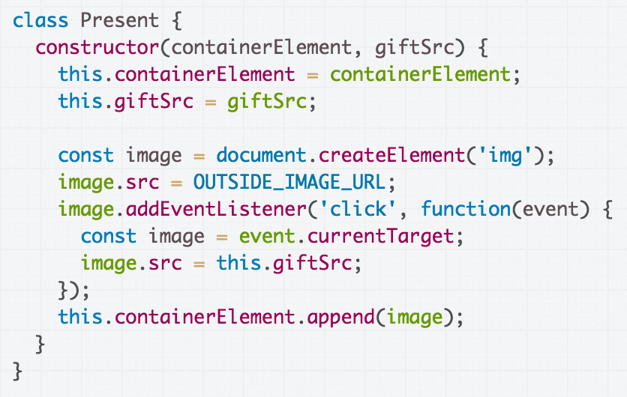
What would happen if we defined the click event handler directly in the call to addEventListener (CodePen)?

Slide 96
We didn't bind this, so we have a bug:
this is the img instead of the Present object.

Slide 97
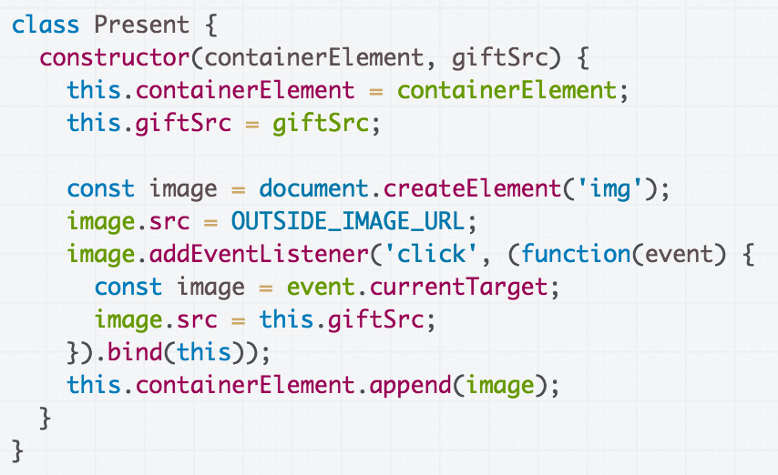
Fixed CodePen

Slide 98
Fixed CodePen

Slide 99
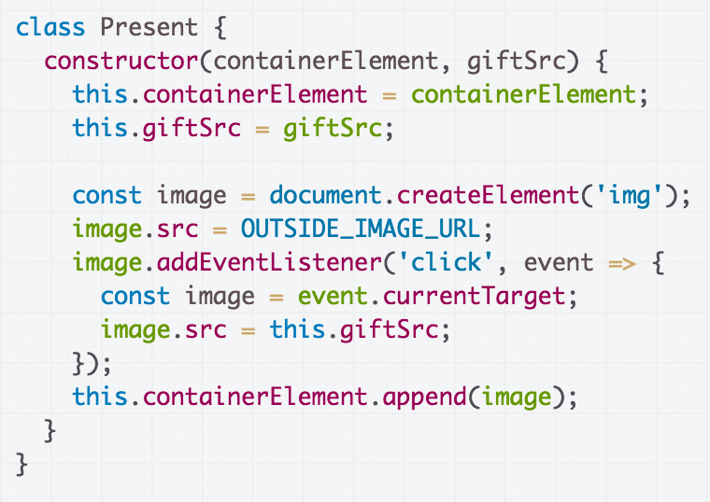
What would happen if we defined the click event handler like this, with the arrow function instead (CodePen)?

Slide 100
This works! Why?!
(CodePen)

Slide 101
=> versus function
When you define a function using function syntax:
const onClick = function() {
const image = event.currentTarget;
image.src = this.giftSrc;
};
this is will be dynamically assigned to a different value depending on how the function is called, like we've seen before (unless explicitly bound with bind)

Slide 102
=> versus function
When you define a function using arrow syntax:
const onClick = event => {
const image = event.currentTarget;
image.src = this.giftSrc;
};
this is bound to the value of this in its enclosing context

Slide 103
Since we've used the arrow function in the constructor, the this in the enclosing context is the new Present object.

Slide 104
Which is better style?

Slide 105
(A) Explicit event handler

Slide 106
(B) Inline event handler

Slide 107
Callback style
Version A: Explicit event handler
Pros:
Easier to read
More modular
Scales better to long functions, several event handlers
Cons:
Because all class methods are public, it exposes the onClick function (which should be private)

Slide 108
Callback style
Version A: Explicit event handler
Pros:
Easier to read
More modular
Scales better to long functions, several event handlers
Cons:
Because all class methods are public, it exposes the onClick function (which should be private)
Need to bind explicitly

Slide 109
Callback style
Version A: Explicit event handler
Pros:
Easier to read
More modular
Scales better to long functions, several event handlers
Cons:
Because all class methods are public, it exposes the onClick function (which should be private)
Need to bind explicitly
This is the style recommended and the preferred style for course.

Slide 110
Callback style
Version B: Inline event handler
Pros:
Does not expose the event handler: function is privately encapsulated
Cons:
Constructor logic has unrelated logic inside of it
Will get messy with lots of event handlers, long event handlers

Slide 111
Callback style
Version B: Inline event handler
Pros:
Does not expose the event handler: function is privately encapsulated
Cons:
Constructor logic has unrelated logic inside of it
Will get messy with lots of event handlers, long event handlers
Some people strongly prefer this style because of the encapsulation aspect.

Slide 112
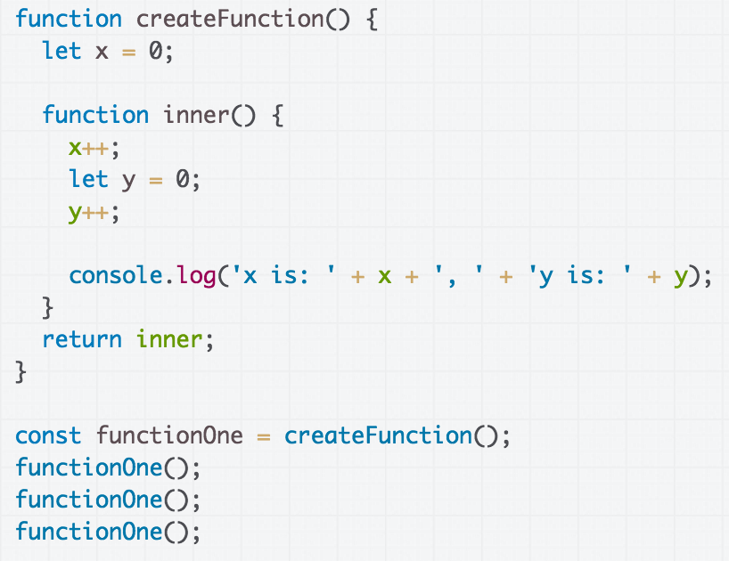
Advanced closures
What's the output of this program? (CodePen)

Slide 113
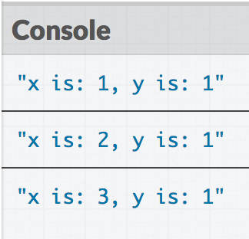
Advanced closures

Slide 114
Closures
Within a closure, you can reference variables that were declared in the outer function, and those variables will not go away after the outer function returns.

Slide 115
Closures
The variable is not copied to the inner function; the inner function has a reference to the variable in the outer scope.
See this iconic StackOverflow post to learn more

Slide 116
Closures
tl;dr: Be careful with closures! For now, we are not going to be modifying outer function variables in the closure.

Slide 117
Review: ES6 classes
ES6 classes mostly work the way you expect
this in a constructor: refers to the new object being created
this outside a constructor: refers to a different value depending on how the function is called
In response to a DOM event, this is the element that the event handler was tied to
When called in a method, this is the object that the method is called from
bind: sets the value of this for a function so it does not change depending on the context

Slide 118
Review: Functional JavaScript
Functions in JavaScript are first-class citizens:
Objects that can be passed as parameters
Can be created within functions:
Inner functions are called closures
Can be created without being saved to a variable
These are called anonymous functions, or function literals, or lambdas
Can be created and returned from functions
Constructing a new function that references part of the outer function's parameters is called currying

