Slide 1
4102165: Full Stack Web Development Fundamentals
Spring 2019
簡立仁 Li-Ren Chien
ccumouse@gmail.com

Slide 2
Today's schedule
Today:
Keyboard events
Mobile events
Simple CSS animations
Next
Classes and objects in JavaScript
this keyword and bind
HW2 due
HW3 assigned

Slide 3
Other JavaScript events?
We've been doing a ton of JavaScript examples that involve click events…
Aren't there other types of events?

Slide 4
Other JavaScript events?
We've been doing a ton of JavaScript examples that involve click events…
Aren't there other types of events?
Of course!
Today we'll talk about:
Keyboard events
Pointer / mobile events
(possibly) Animation events

Slide 5
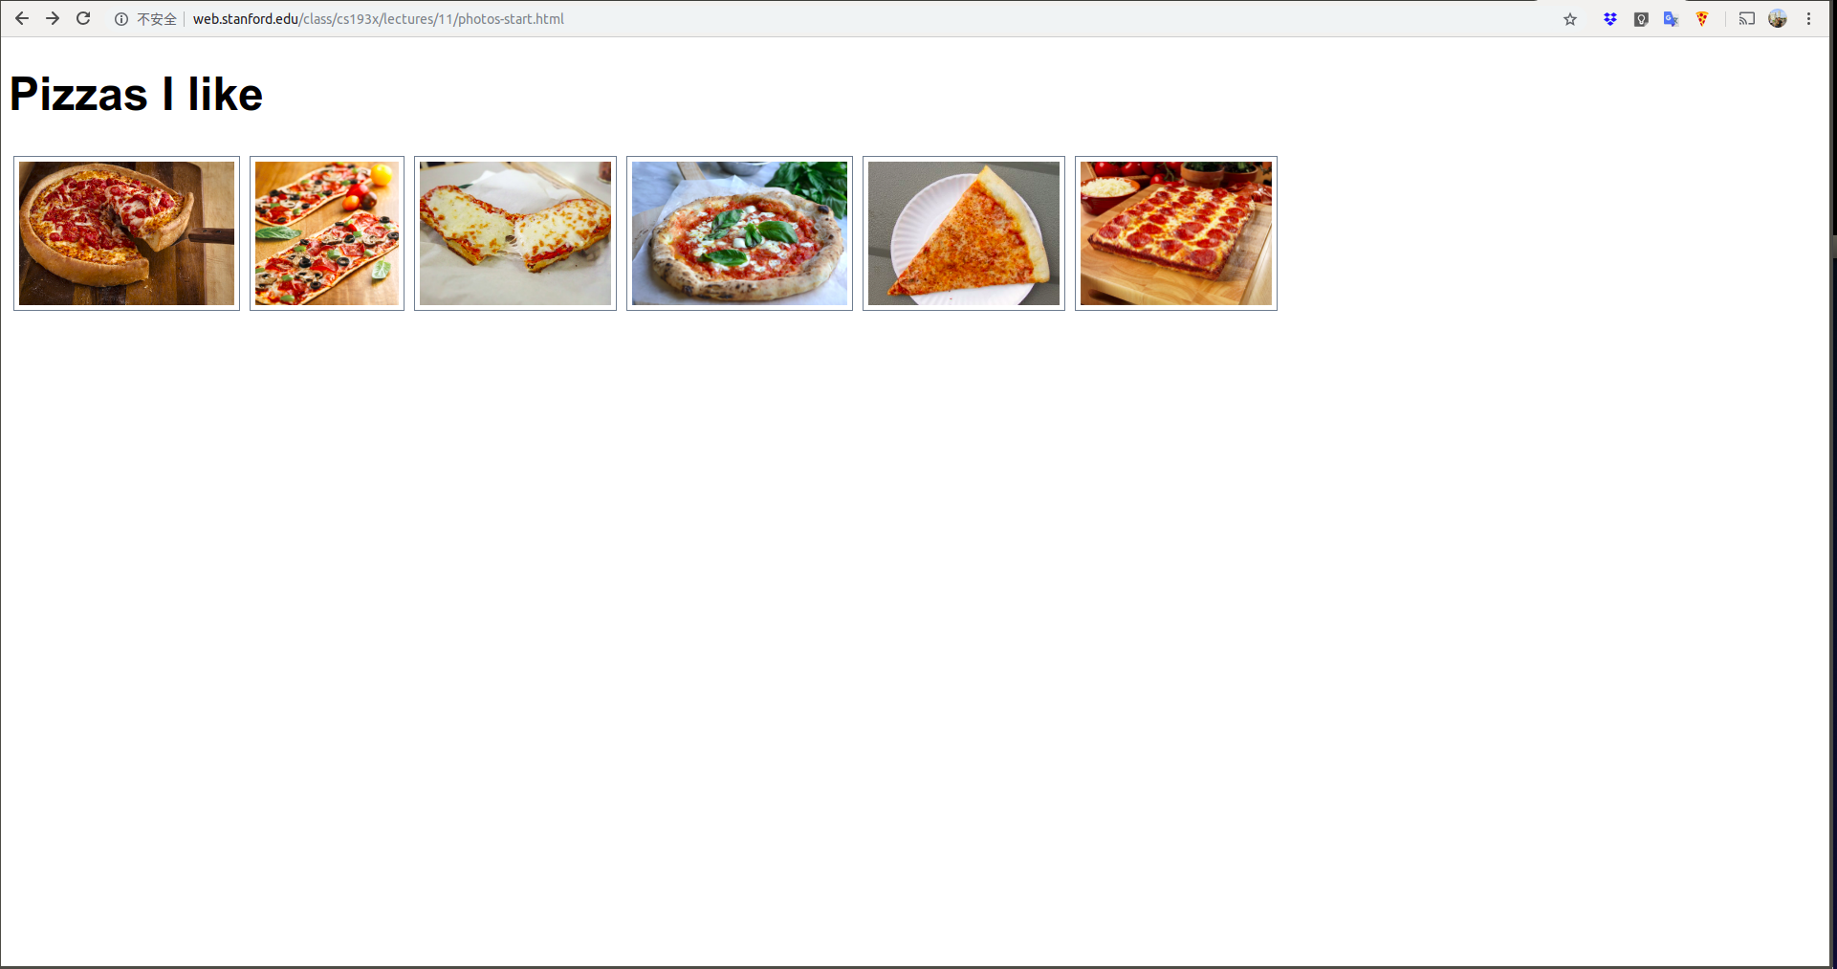
Example: Photo Album
We're going to add a few features to this photo album:

Slide 6
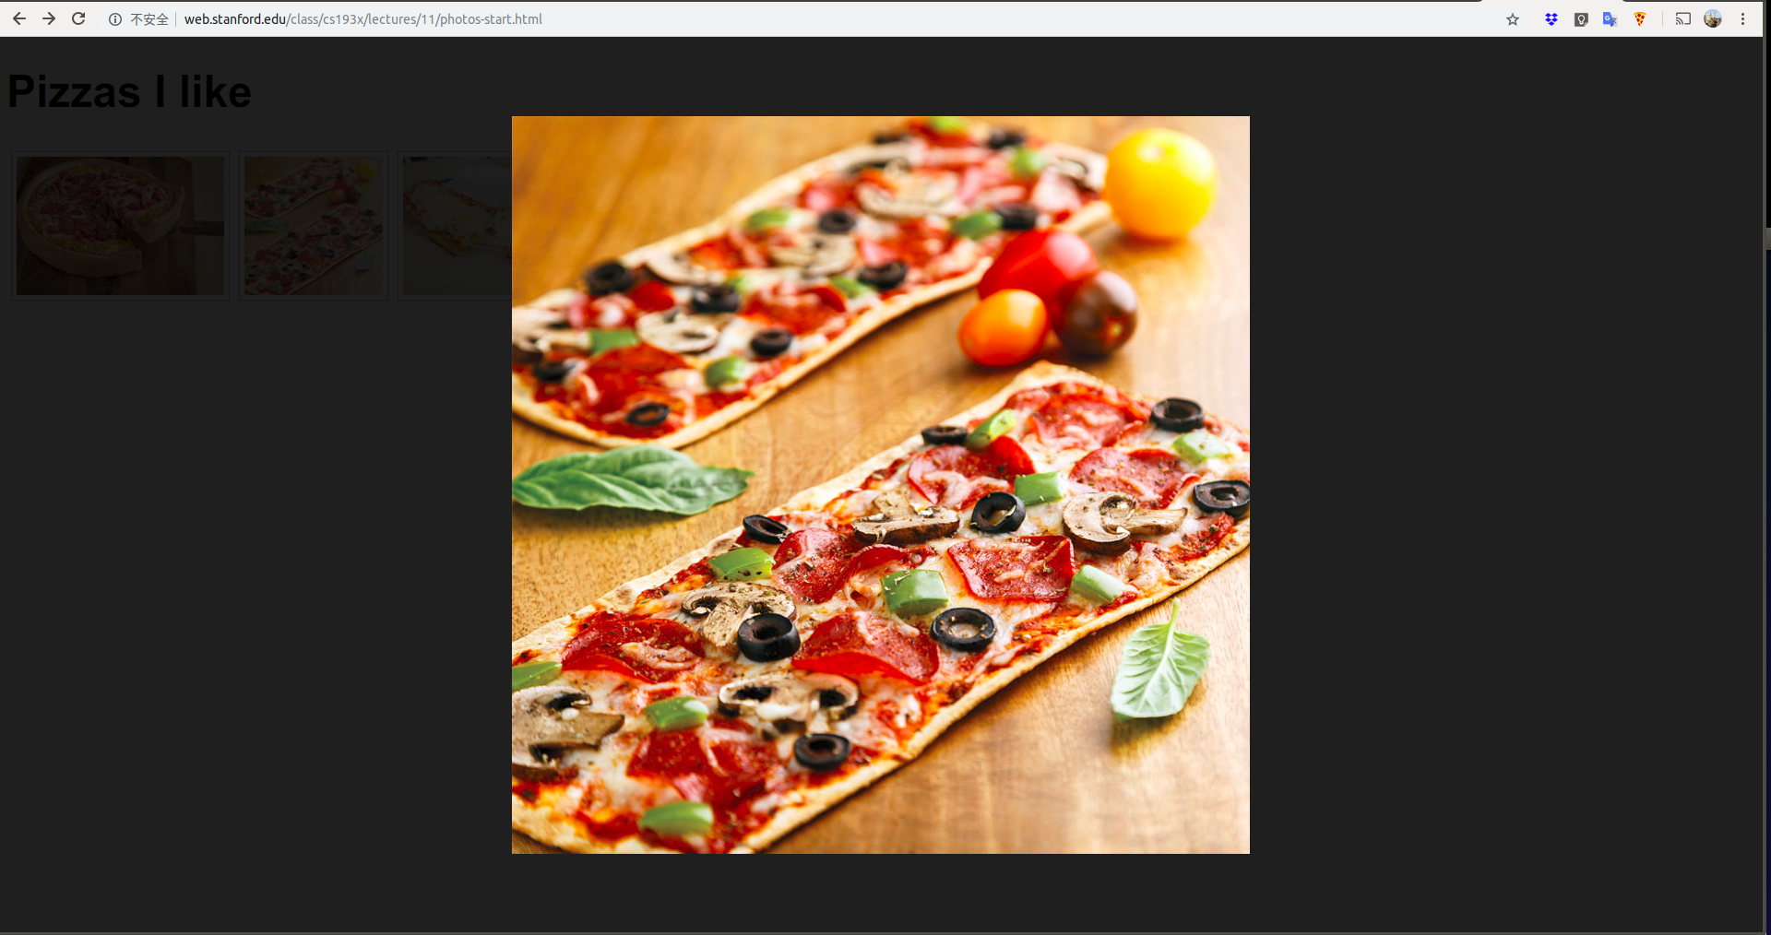
Example: Photo Album
We're going to add a few features to this photo album:

Slide 7
Code walkthrough: photo-start.html photo.js photo.css

Slide 8
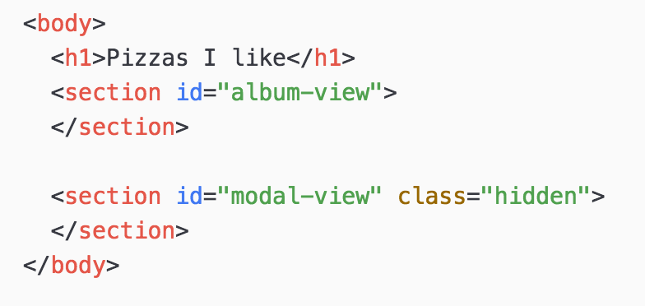
General setup
photo.html contains both "screens":
The album view: Thumbnails of every photo
The "modal" view: A single photo against a semi-transparent black background
Hidden by default

Slide 9
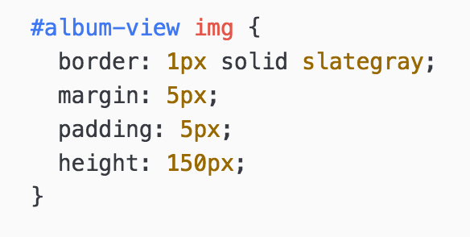
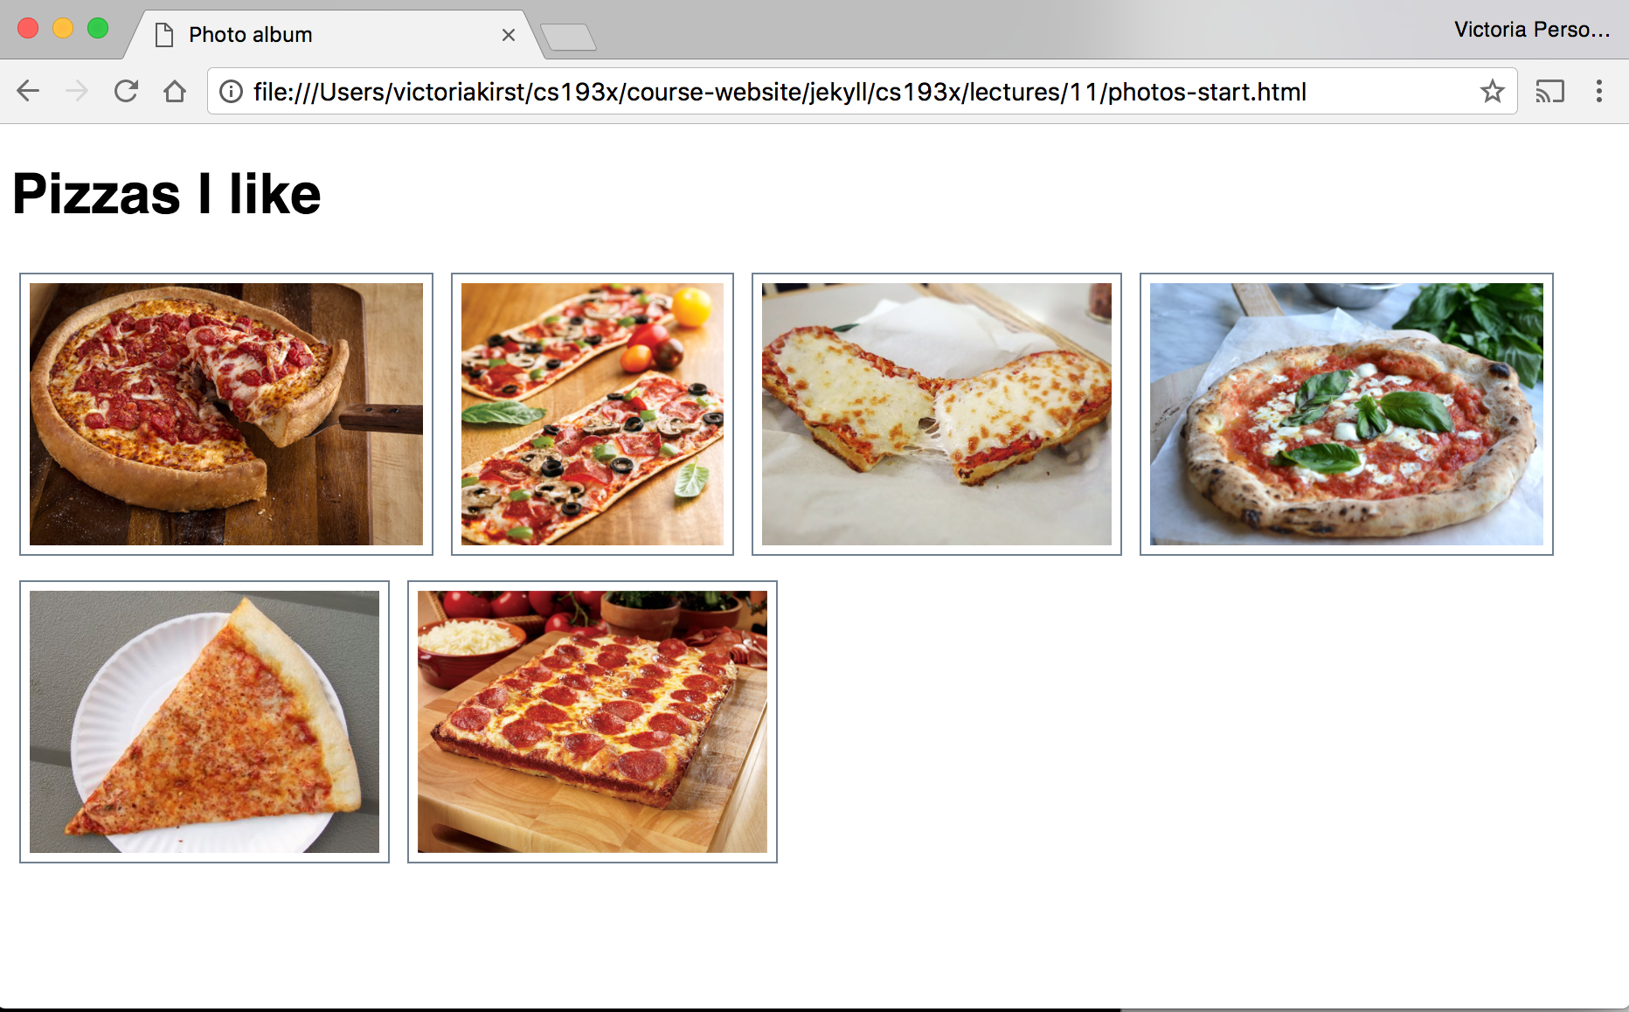
CSS: Album
photo.css: The album view CSS is pretty straightforward:

Slide 10
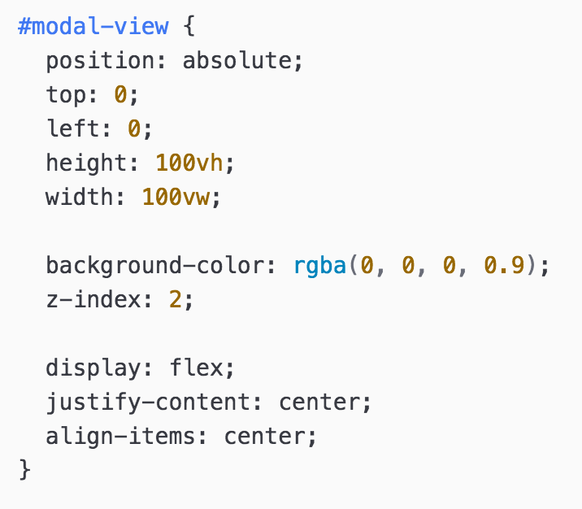
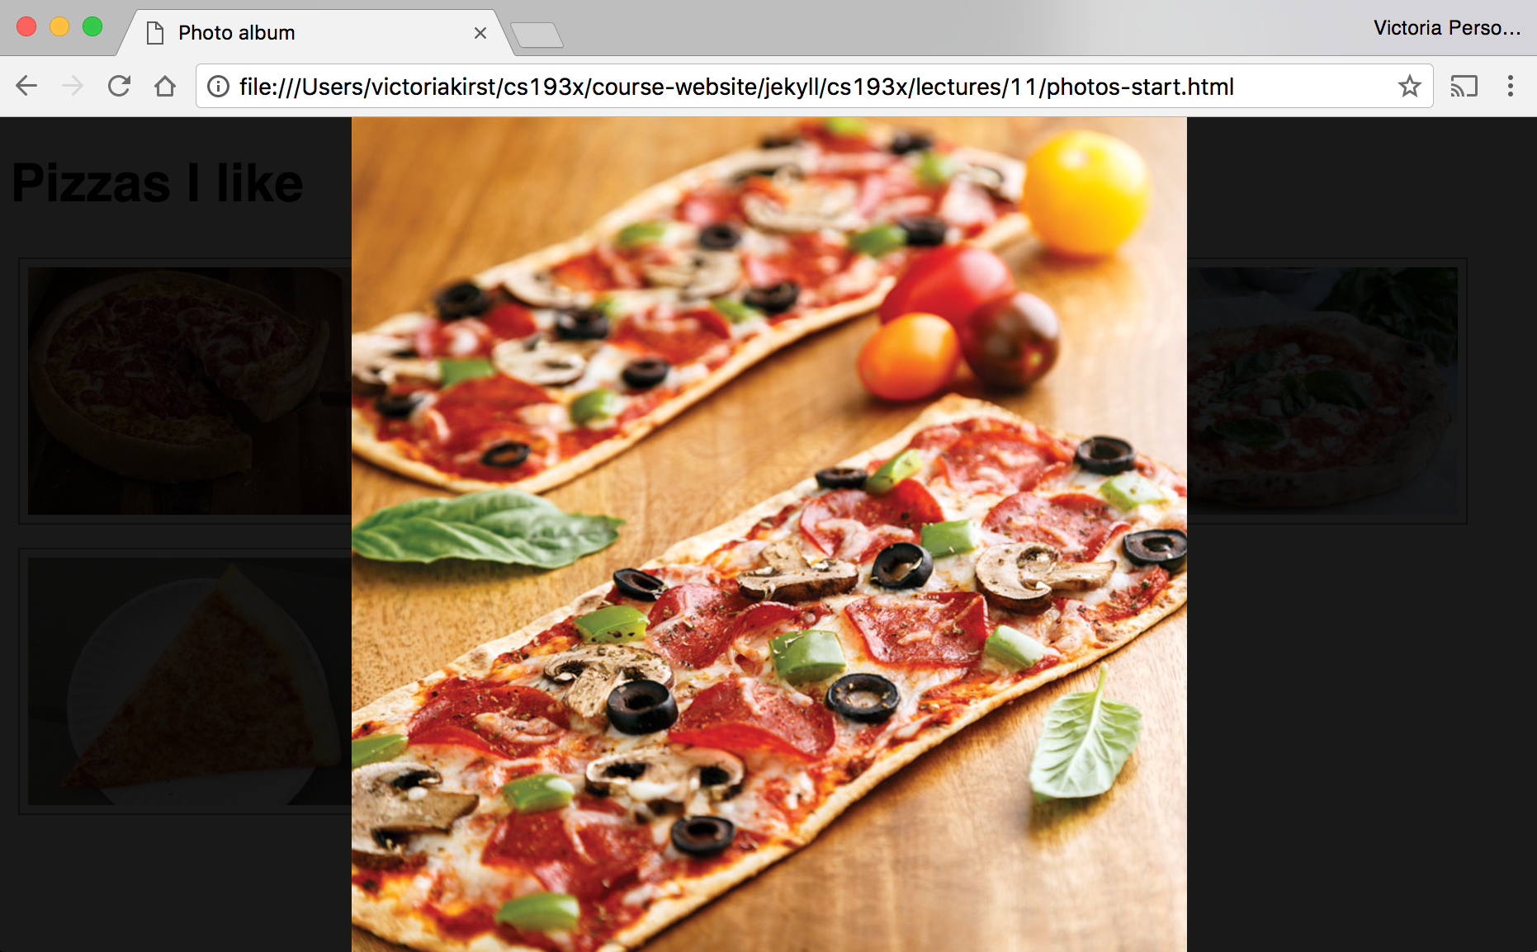
CSS: Modal
Modal view is a little more involved, but all stuff we've learned:

Slide 11
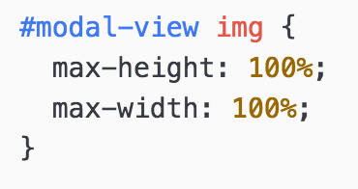
CSS: Modal image
Image sizes are constrained to the height and width of the parent, #modal-view (whose height and width are set to the size of the viewport)

Slide 12
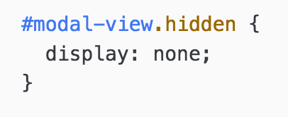
CSS: Hidden modal
Even though both the album view and modal view are in the HTML, the model view is set to display: none; so it does not show up.

Slide 13
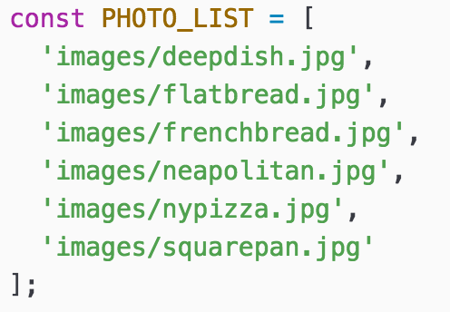
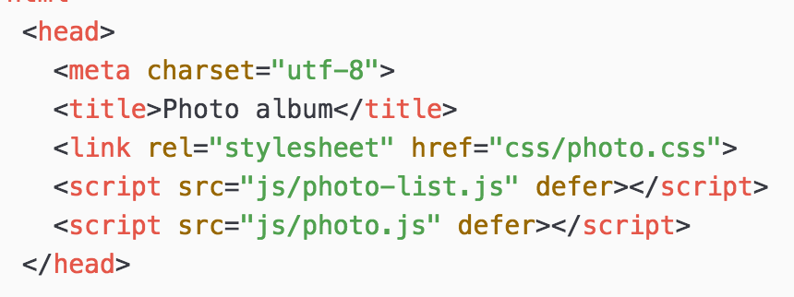
Global List of Photos
photo-list.js: There is a global array with the list of string photo sources called PHOTO_LIST.

Slide 14
Photo thumbnails
photo.js: We populate the initial album view by looping over PHOTO_LIST and appending <img>s to the #album-view.

Slide 15
Clicking a photo
When the user clicks a thumbnail:
We create another <img> tag with the same src
We append this new <img> to the #modal-view
We unhide the #modal-view

Slide 16
Positioning the modal
We'll add another line of JavaScript to anchor our modal dialog to the top of the viewport, not the top of the screen:
modalView.style.top = window.pageYOffset + 'px';
(See window.pageYOffset mdn. It is the same as window.scrollY.)

Slide 17
Aside: style attribute
Every HTMLElement has a style attribute that lets you set a style directly on the element:
element.style.top = window.pageYOffset + 'px';
Generally you should not use the style property, as adding and removing classes via classList is a better way to change the style of an element via JavaScript
But when we are setting a CSS property based on JavaScript values, we must set the style attribute directly.

Slide 18
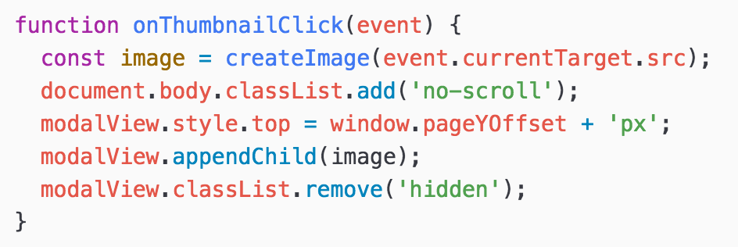
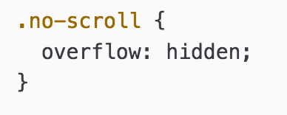
No scroll on page
And we'll also set body { overflow: hidden; } as a way to disable scroll on the page.

Slide 19
Closing the modal dialog
When the user clicks the modal view:
We hide the modal view again
We enable scroll on the page again
We clear the image we appended to it by setting innerHTML = '';

Slide 20
Adding keyboard navigation

Slide 21
Navigating photos
Let's add some keyboard events to navigate between photos in the Modal View:
Left arrow: Show the "i - 1"th picture
Right arrow: Show the "i + 1"th picture
Escape key: Close dialog

Slide 22
How do we listen to keyboard events?

Slide 23
Keyboard events
Event name | Description
keydown | Fires when any key is pressed. Continues firing if you hold down the key. (mdn)
keypress | Fires when any character key is pressed, such as a letter or number. Continues firing if you hold down the key. (mdn)
keyup | Fires when you stop pressing a key. (mdn)
You can listen for keyboard events by adding the event listener to document:
document.addEventListener('keyup', onKeyUp);

Slide 24
KeyboardEvent.key
function onKeyUp(event) {
console.log('onKeyUp:' + event.key);
}
document.addEventListener('keyup', onKeyUp);
Functions listening to a key-related event receive a parameter of KeyboardEvent type.
The KeyboardEvent object has a key property, which stores the string value of the key, such as "Escape"
List of key values

Slide 25
Useful key values
Key string value | Description
"Escape" | The Escape key
"ArrowRight" | The right arrow key
"ArrowLeft" | The left arrow key
Example: key-events.html

Slide 26
Let's finish the feature!

Slide 27
Finished result: photo-desktop-finished.html

Slide 28
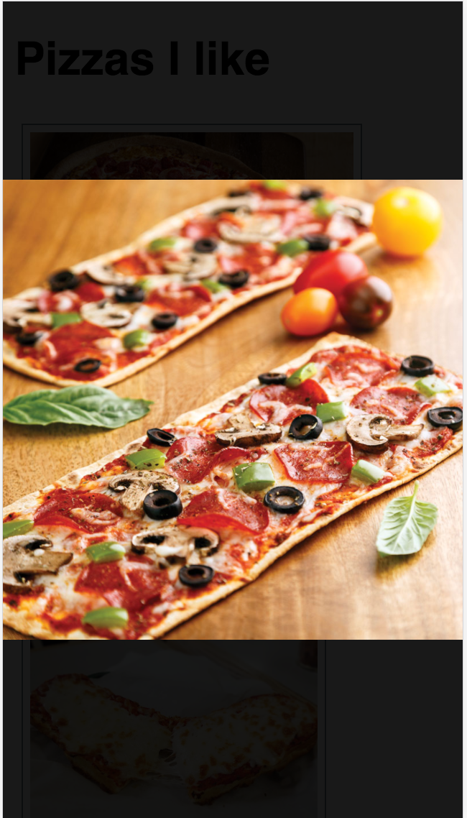
Mobile?
Keyboard events work well on desktop, but keyboard navigation doesn't work well for mobile.
On your phone, you can usually navigate photo albums using gestures:
Left swipe reveals the next photo
Right swipe reveals the previous photo
Next
Previous

Slide 29
Mobile?
Keyboard events work well on desktop, but keyboard navigation doesn't work well for mobile.
On your phone, you can usually navigate photo albums using gestures:
Left swipe reveals the next photo
Right swipe reveals the previous photo
How do we implement the swipe gesture on the web?
Next
Previous

Slide 30
Custom swipe events
There are no gesture events in JavaScript (yet).
That means there is no "Left Swipe" or "Right Swipe" event we can listen to. (Note that drag does not do what we want, nor does it work on mobile)
To get this behavior, we must implement it ourselves.
To do this, it's helpful to learn about a few more JS events:
MouseEvent
TouchEvent
PointerEvent

Slide 31
MouseEvent
Event name | Description
click | Fired when you click and release (mdn)
mousedown | Fired when you click down (mdn)
mouseup | Fired when when you release from clicking (mdn)
mousemove | Fired repeatedly as your mouse moves (mdn)
*mousemove only works on desktop, since there's no concept of a mouse on mobile.

Slide 32
TouchEvent
Event name | Description
touchstart | Fired when you touch the screen (mdn)
touchend | Fired when you lift your finger off the screen (mdn)
touchmove | Fired repeatedly while you drag your finger on the screen (mdn)
touchcancel | Fired when a touch point is "disrupted" (e.g. if the browser isn't totally sure what happened) (mdn)
*touchmove only works on mobile (example)

Slide 33
clientX and clientY
function onClick(event) {
console.log('x' + event.clientX);
console.log('y' + event.clientY);
}
element.addEventListener('click', onClick);
MouseEvents have a clientX and clientY :
clientX: x-axis position relative to the left edge of the browser viewport
clientY: y-axis position relative to the top edge of the browser viewport

Slide 34
Implementing drag
Drag Me!
When a user clicks down/touches an element…

Slide 35
Implementing drag
originX = 100;
Drag Me!
Take note of the starting position.

Slide 36
Implementing drag
originX = 100;
newX = 150;
Drag Me!
Then on mousemove / touchmove, make note of the new mouse position

Slide 37
Implementing drag
originX = 100;
newX = 150;
Drag Me!
Drag Me!
Move the element by the difference between the old and new positions.

Slide 38
Implementing drag
Drag Me!
Then on release...

Slide 39
Implementing drag
Drag Me!
… stop listening to mousemove / touchmove.

Slide 40
Dragging on mobile and desktop
Wouldn't it be nice if we didn't have to listen to different events for mobile and desktop?

Slide 41
PointerEvent
PointerEvent: "pointer" events that work the same with for both mouse and touch
Not to be confused with pointer-events CSS property (completely unrelated)
Note: In this case, Mozilla's documentation on PointerEvent is not great.
A Google blog post on PointerEvent
PointerEvent inherits from MouseEvent, and therefore has clientX and clientY

Slide 42
PointerEvent
Event name | Description
pointerdown | Fired when a "pointer becomes active" (touch screen or click mouse down) (mdn)
pointerup | Fired when a pointer is no longer active (mdn)
pointermove | Fired repeatedly while the pointer moves (mouse move or touch drag) (mdn)
pointercancel | Fired when a pointer is "interrupted" (mdn)
*pointermove works on mobile and desktop!
… Except…

Slide 43
Our first controversial feature!
PointerEvent is not implemented on all browsers yet:
Firefox implementation is in progress
Safari outright opposes this API… since 2012.
Argh!!! Does this mean we can't use it?

Slide 44
Polyfill library
A polyfill library is code that implements support for browsers that do not natively implement a web API.
Luckily there is a polyfill library for PointerEvent:
https://github.com/jquery/PEP

Slide 45
PointerEvent Polyfill
To use the PEP polyfill library, we add this script tag to our HTML:
<script src="https://code.jquery.com/pep/0.4.1/pep.js"></script>
And we'll add need to add touch-action="none" to the area where we want PointerEvents to be recognized*:
*Technically what this is doing is it is telling the browser that we do not want the default touch behavior for children of this element, i.e. on a mobile phone, we don't want to recognize the usual "pinch to zoom" type of events because we will be intercepting them via PointerEvent. This is normally a CSS property, but the limitations of the polyfill library requires this to be an HTML attribute instead.

Slide 46
Moving an element
We are going to use the transform CSS property to move the element we are dragging from its original position:
originX = 100;
newX = 150;
delta = newX - originX;
Drag Me!
Drag Me!
element.style.transform = 'translateX(' + delta + 'px)';

Slide 47
transform
transform is a strange but powerful CSS property that allow you to translate, rotate, scale, or skew an element.
transform: translate(x, y) | Moves element relative to its natural position by x and y
transform: translateX(x) | Moves element relative to its natural position horizontally by x
transform: translateY(y) | Moves element relative to its natural position vertically by y
transform: rotate(deg) | Rotates the element clockwise by deg
transform: rotate(10deg) translate(5px, 10px); | Rotates an element 10 degrees clockwise, moves it 5px down, 10px right
Examples

Slide 48
translate vs position
Can't you use relative or absolute positioning to get the same effect as translate? What's the difference?
translate is much faster
translate is optimized for animations
See comparison (article):
Absolute positioning (click "10 more macbooks")
transform: translate (click "10 more macbooks")

Slide 49
Finally, let's code!

Slide 50
preventDefault()
On desktop, there's a default behavior for dragging an image, which we need to disable with event.preventDefault():

Slide 51
setPointerCapture()
To listen to pointer events that occur when the pointer goes offscreen, call setPointerCapture on the target you want to keep tracking:

Slide 52
style attribute
Every HTMLElement also has a style attribute that lets you set a style directly on the element:
element.style.transform =
'translateX(' + value + ')';
Generally you should not use the style property, as adding and removing classes via classList is a better way to change the style of an element via JavaScript
But when we are dynamically calculating the value of a CSS property, we have to use the style attribute.

Slide 53
style attribute
The style attribute has higher precedence than any CSS property.
To undo a style set via the style attribute, you can set it to the empty string:
element.style.transform = '';
Now the element will be styled according to any rules in the CSS file(s).

Slide 54
(requestAnimationFrame)
(We are missing one key piece of getting smooth dragging motion, which is: requestAnimationFrame
However, using requestAnimationFrame well requires us to know a little bit more about the JavaScript event loop. Functional programming also helps. We'll get there next week!)

Slide 55
CSS animations

Slide 56
Softening the edges
Our photo album feels a little jerky still. We can make the UI feel a little smoother if we added some animations.
The image should slide in from the left if we are going to the previous picture
The image should slide in from the right if we are going to the next picture
Next
Previous

Slide 57
CSS animations syntax
@keyframes animation-name { from {
CSS styles
}
to {
CSS styles
}
}
Then set the following CSS property:
animation: animation-name duration;
Examples

Slide 58
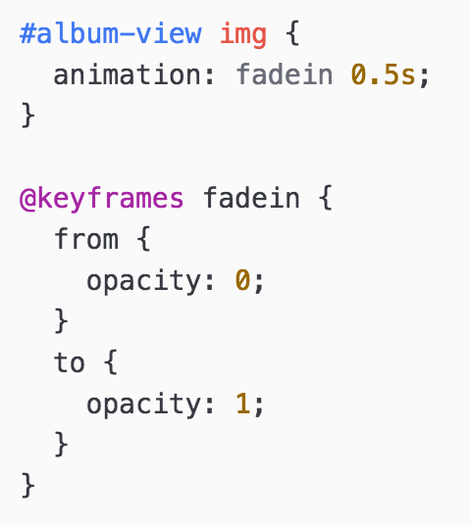
Easier example: Fade in

Slide 59
Finished result: photo-mobile-finished.html

