Slide 1
4102165:
Full Stack Web Development Fundamentals
Spring 2019
簡立仁 Li-Ren Chien
ccumouse@gmail.com

Slide 2
Today's schedule
Today
Intro to Amateur JavaScript
  What is JavaScript?
  Tour of language features
  Basic event handling
Next
DOM: How to interact with your web page
HW1 due
HW2 goes out

Slide 3
How do web pages work again?

Slide 4

You are on
your laptop

Slide 5
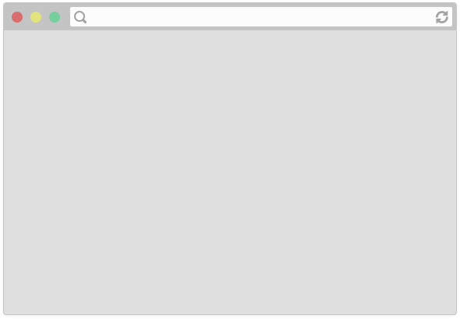
Your laptop is running a web browser, e.g. Chrome

Slide 6
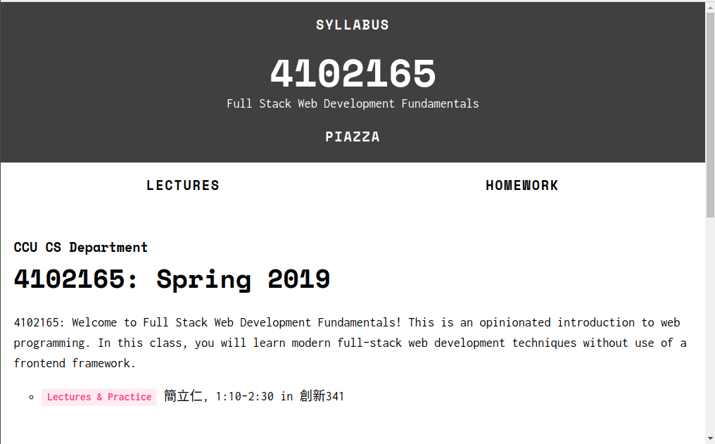
You type a URL in the address bar and hit "enter"
https://fullstackccu.github.io/

Slide 7

(Warning: Somewhat inaccurate,
massive hand-waving begins now.
See this Quora answer for slightly more detailed/accurate handwaving)

Slide 8
Server at
https://fullstackccu.github.io/
Browser sends an HTTP request saying "Please GET me the index.html file at https://fullstackccu.github.io/"
(Routing, etc…)

Slide 9
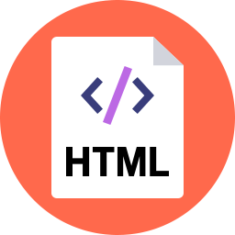
Server at
https://fullstackccu.github.io/
Assuming all goes well, the server responds by sending the HTML file through the internet back to the browser to display.

Slide 10
Server at
https://fullstackccu.github.io/
The HTML will include things like <img src="pup.png" /> and <link src="style.css" .../> which generate more requests for those resources

Slide 11

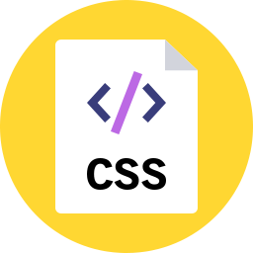
Server at
http://cs193x.stanford.edu
And the server replies with those resources for the browser to render

Slide 12
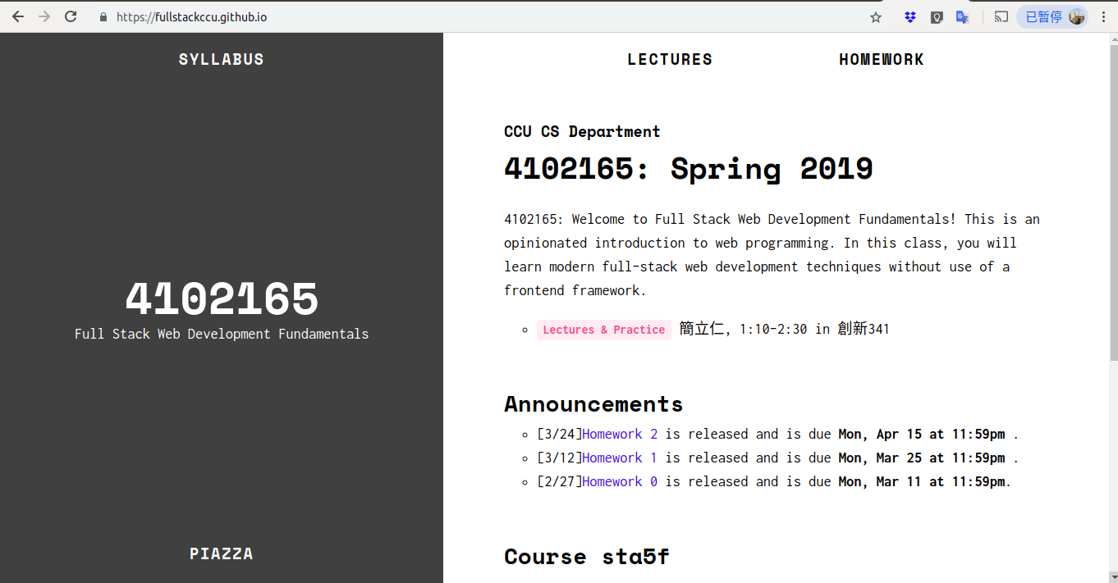
Finally, when all resources are loaded, we see the loaded web page
https://fullstackccu.github.io/

Slide 13
+
produces
Describes the content and structure of the page
Describes the appearance and style of the page
A web page…
that doesn't do anything

Slide 14


What we've learned so far
We've learned how to build web pages that:
Look the way we want them to
Can link to other web pages
Display differently on different screen sizes
But we don't know how build web pages that do anything:
Get user input
Save user input
Show and hide elements when the user
interacts with the page
etc.

Slide 15
What we've learned so far
We've learned how to build web pages that:
Look the way we want them to
Can link to other web pages
Display differently on different screen sizes
But we don't know how build web pages that do anything:
Get user input
Save user input
Show and hide elements when the user
interacts with the page
etc.
Enter JavaScript!

Slide 16
JavaScript

Slide 17

JavaScript
JavaScript is a programming language.
It is currently the only programming language that your browser can execute natively. (There are efforts to change that.)
Therefore if you want to make your web pages do stuff, you must use JavaScript: There are no other options.

Slide 18
JavaScript
Created in 1995 by Brendan Eich
(co-founder of Mozilla; resigned 2014 due to his homophobia)
JavaScript has nothing to do with Java
  Literally named that way for marketing reasons
The first version was written in 10 days
Several fundamental language decisions were made because of company politics and not technical reasons
"I was under marketing orders to make it look like Java but not make it too big for its britches ... [it] needed to be a silly little brother language." (source)

Slide 19
JavaScript
Created in 1995 by Brendan Eich
(co-founder of Mozilla; resigned 2014 due to his homophobia)
JavaScript has nothing to do with Java
  Literally named that way for marketing reasons
The first version was written in 10 days
Several fundamental language decisions were made because of company politics and not technical reasons
In other words:
JavaScript is messy and full of drama…
and our only option.
(though it's gotten much, much better in the last few years)

Slide 20
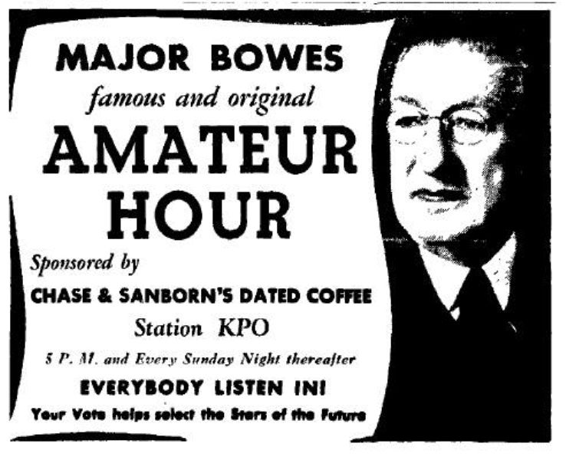
Our JavaScript Strategy
This week: "Amateur JavaScript"
Simple, old-school JavaScript
Mostly not best practice
  Everything in global scope
  No classes / modules
  Will result in a big mess if you code this way for anything but very small projects
(But easy to get started)
Next week(?): Modern JavaScript
More disciplined and based on best practices
Even more "opinionated"

Slide 21
JavaScript
in the browser

Slide 22
Code in web pages
HTML can embed JavaScript files into the web page via the <script> tag.
<!DOCTYPE html>
<html>
<head>
<title>web</title>
<link rel="stylesheet" href="style.css" />
<script src="filename.js"></script>
</head>
<body>
... contents of the page...
</body>
</html>

Slide 23
console.log
You can print log messages in JavaScript by calling console.log():
script.js
console.log('Hello, world!');
This JavaScript's equivalent of Java's System.out.println, print, printf, etc.

Slide 24
How does JavaScript get loaded?

Slide 25
<head>
<title>CS 193X</title>
<link rel="stylesheet" href="style.css" />
<script src="script.js"></script>
</head>
The browser is parsing the HTML file, and gets to a script tag, so it knows it needs to get the script file as well.

Slide 26
<head>
<title>web</title>
<link rel="stylesheet" href="style.css" />
<script src="script.js"></script>
</head>
The browser makes a request to the server for the script.js file, just like it would for a CSS file or an image...

Slide 27
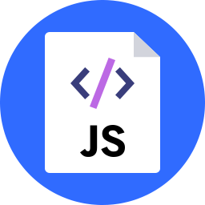
<head>
<title>CS 193X</title>
<link rel="stylesheet" href="style.css" />
<script src="script.js"></script>
</head>
And the server responds with the JavaScript file, just like it would with a CSS file or an image...

Slide 28
<head>
<title>web</title>
<link rel="stylesheet" href="style.css" />
<script src="script.js"></script>
</head>
console.log('Hello, world!');
Now at this point, the JavaScript file will execute "client-side", or in the browser on the user's computer.

Slide 29
JavaScript execution
There is no "main method"
The script file is executed from top to bottom.
There's no compilation by the developer
JavaScript is compiled and executed on the fly by the browser
(Note that this is slightly different than being "interpreted": see just-in-time (JIT) compilation)

Slide 30
first-js.html
<!DOCTYPE html>
<html>
<head>
<meta charset="utf-8">
<title>First JS Example</title>
<script src="script.js"></script>
</head>
<body>
</body>
</html>
script.js
console.log('Hello, world!');

Slide 31
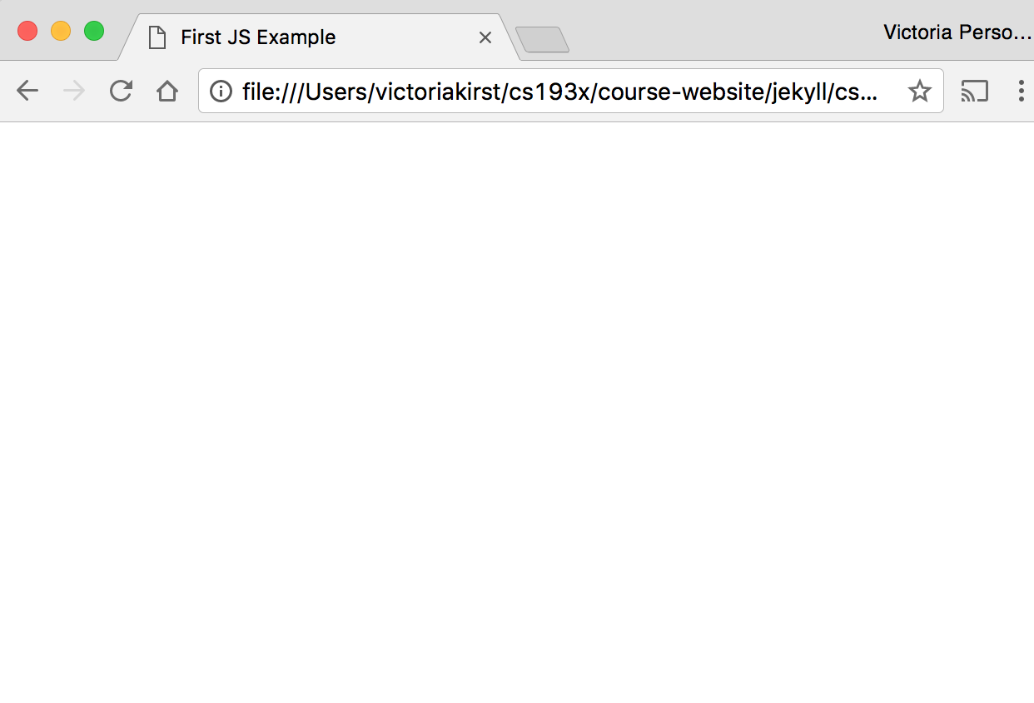
Hey, nothing happened!

Slide 32
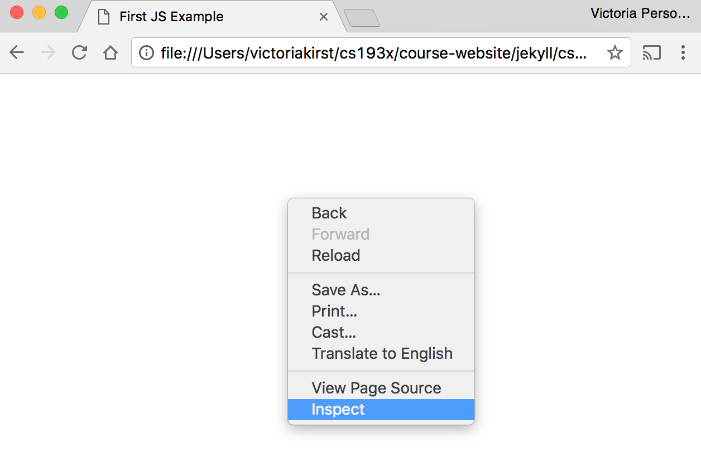
Right-click (or control-click on Mac) and choose "Inspect"

Slide 33
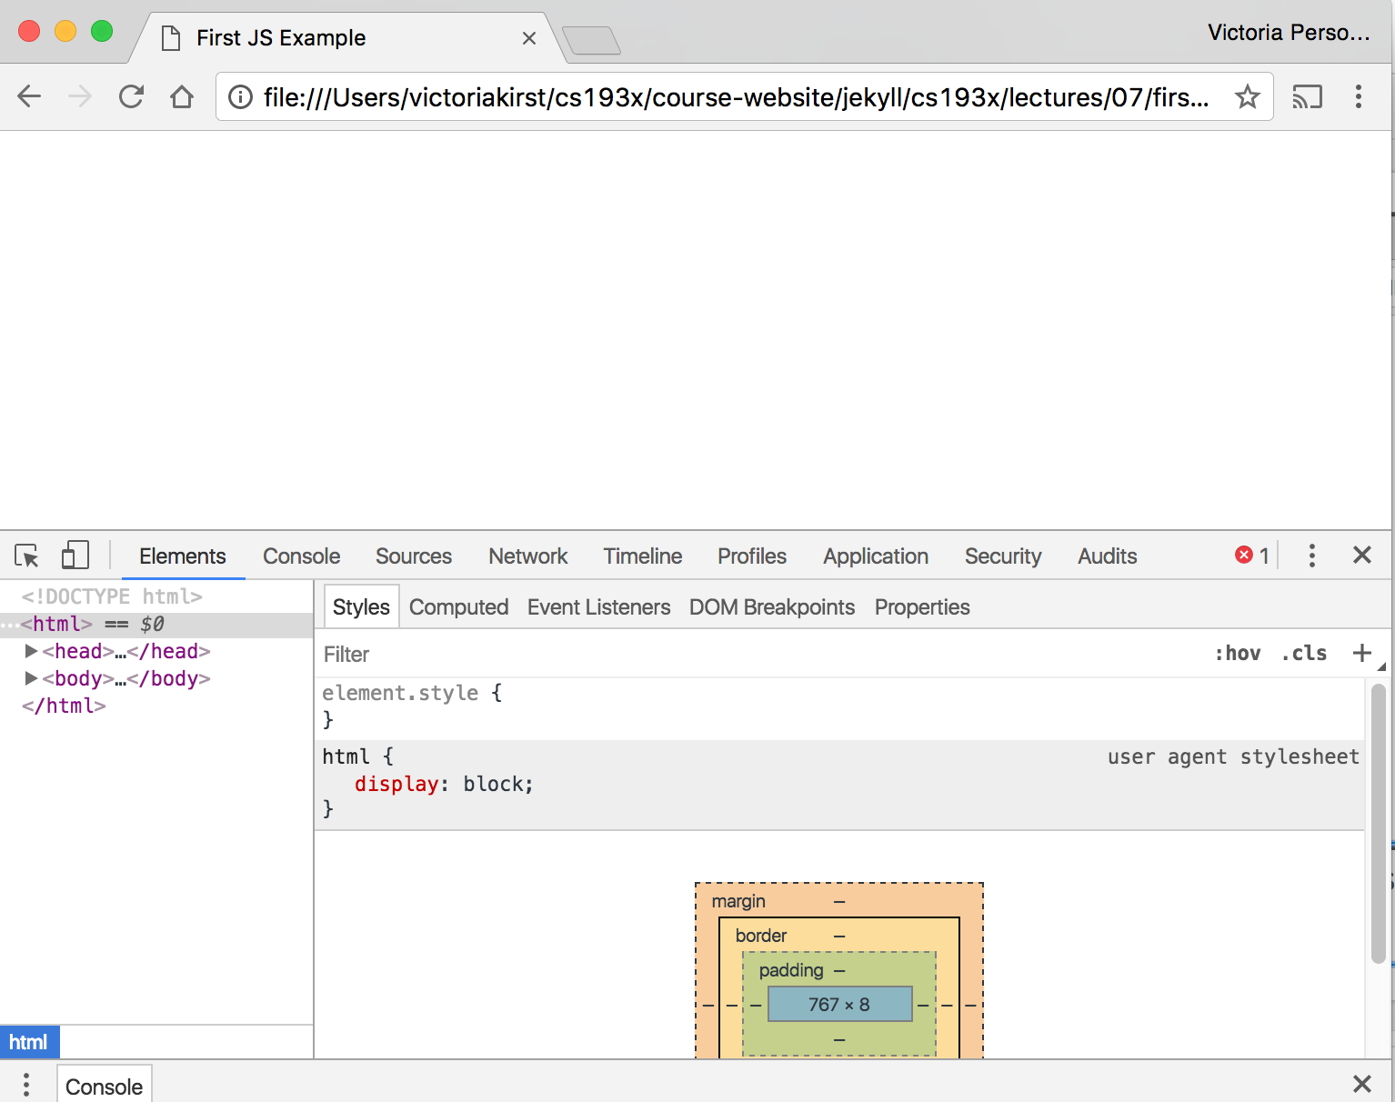
Click "Console" tab

Slide 34
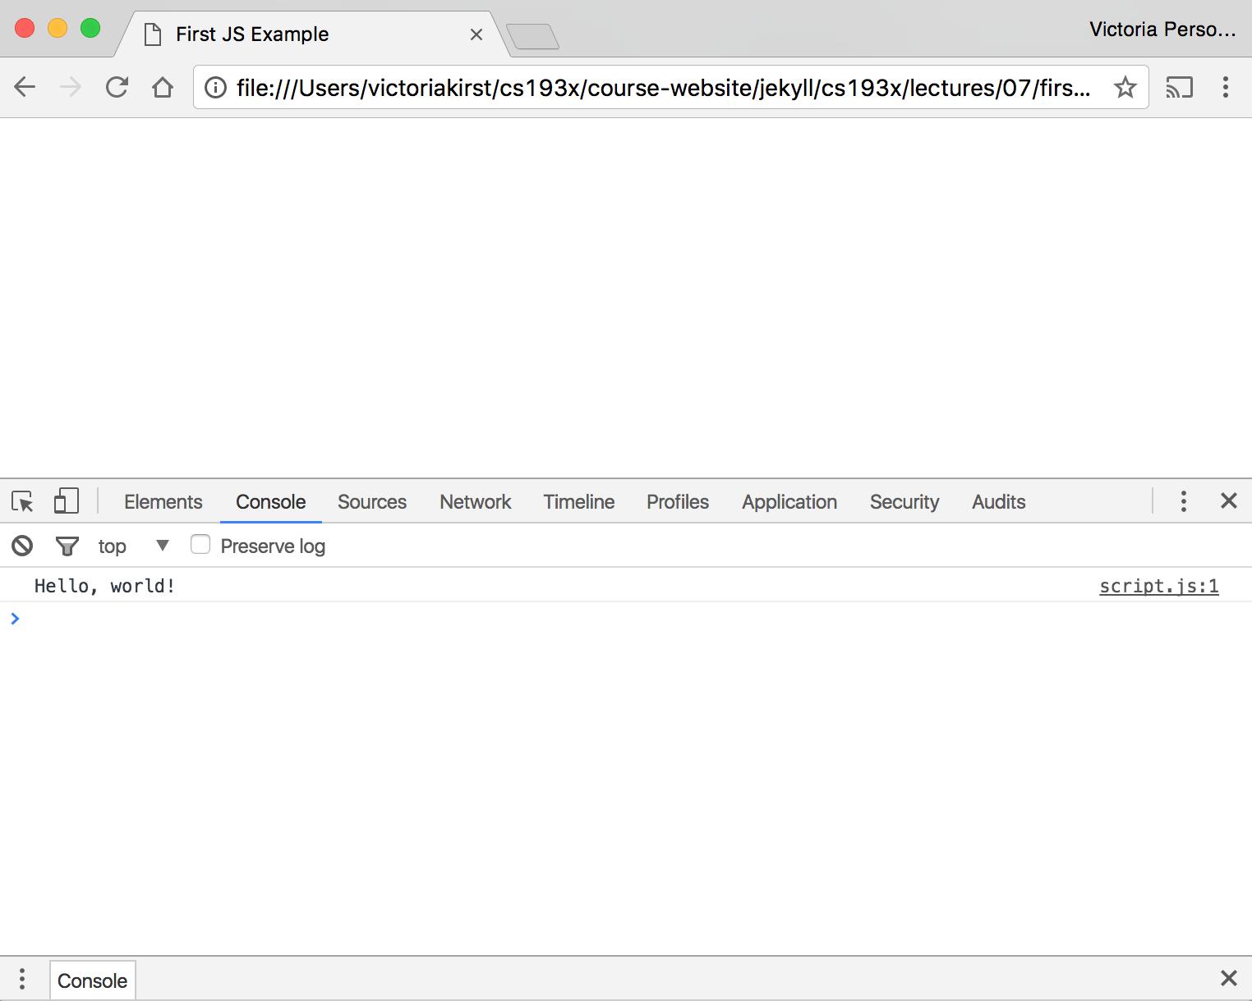

Slide 35
The "Console" tab is also a REPL, or an interactive language shell, so you can type in JavaScript expressions, etc. to test out the language.
We will be using this throughout the quarter!

Slide 36
JavaScript
language features

Slide 37
Same as Java/C++/C-style langs
for-loops:
for (let i = 0; i < 5; i++) { … }
while-loops:
while (notFinished) { … }
comments:
// comment or /* comment */
conditionals (if statements):
if (...) {
...
} else {
...
}

Slide 38
Functions
One way of defining a JavaScript function is with the following syntax:
function name() {
statement;
statement;
...
}

Slide 39
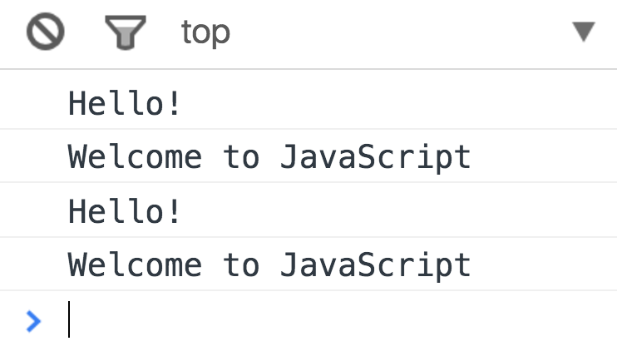
script.js
function hello() {
console.log('Hello!');
console.log('Welcome to JavaScript');
}
hello();
hello();
Console output

Slide 40
script.js
function hello() {
console.log('Hello!');
console.log('Welcome to JavaScript');
}
hello();
hello();
The browser "executes" the function definition first, but that just creates the hello function (and it doesn't run the hello function), similar to a variable declaration.
Console output

Slide 41
script.js
hello();
hello();
function hello() {
console.log('Hello!');
console.log('Welcome to JavaScript');
}
Q: Does this work?

Slide 42
script.js
hello();
hello();
function hello() {
console.log('Hello!');
console.log('Welcome to JavaScript');
}
A: Yes, for this particular syntax.
This works because function declarations are "hoisted" (mdn).
You can think of it as if the definition gets moved to the top of the scope in which it's defined (though that's not what actually happens).
Console output

Slide 43
script.js
hello();
hello();
function hello() {
console.log('Hello!');
console.log('Welcome to JavaScript');
}
Caveats:
There are other ways to define functions that do not get hoisted; we'll visit this once we graduate from Amateur JS
Try not to rely on hoisting when coding. It gets bad.
Console output

Slide 44
Variables: var, let, const
Declare a variable in JS with one of three keywords:
// Function scope variable
var x = 15;
// Block scope variable
let fruit = 'banana';
// Block scope constant; cannot be reassigned
const isHungry = true;
You do not declare the datatype of the variable before using it ("dynamically typed")

Slide 45
Function parameters
function printMessage(message, times) {
for (var i = 0; i < times; i++) {
console.log(message);
}
}
Function parameters are not declared with var, let, or const

Slide 46
Understanding var
function printMessage(message, times) {
for (var i = 0; i < times; i++) {
console.log(message);
}
console.log('Value of i is ' + i);
}
printMessage('hello', 3);
Q: What happens if we try to print "i" at the end of the loop?

Slide 47
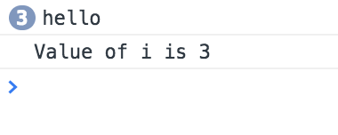
Understanding var
function printMessage(message, times) {
for (var i = 0; i < times; i++) {
console.log(message);
}
console.log('Value of i is ' + i);
}
printMessage('hello', 3);
The value of "i" is readable outside of the for-loop because variables declared with var have function scope.

Slide 48
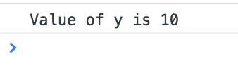
Function scope with var
var x = 10;
if (x > 0) {
var y = 10;
}
console.log('Value of y is ' + y);
Variables declared with "var" have function-level scope and do not go out of scope at the end of blocks; only at the end of functions
Therefore you can refer to the same variable after the block has ended (e.g. after the loop or if-statement in which they are declared)

Slide 49
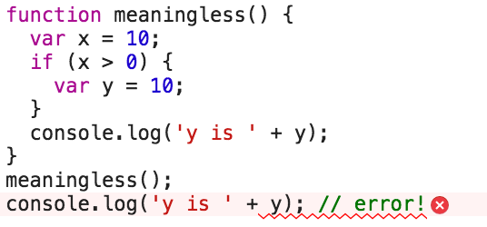
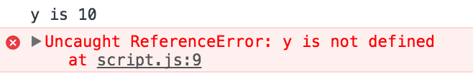
Function scope with var
But you can't refer to a variable outside of the function in which it's declared.

Slide 50
Understanding let
function printMessage(message, times) {
for (let i = 0; i < times; i++) {
console.log(message);
}
console.log('Value of i is ' + i);
}
printMessage('hello', 3);
Q: What happens if we try to print "i" at the end of the loop?

Slide 51
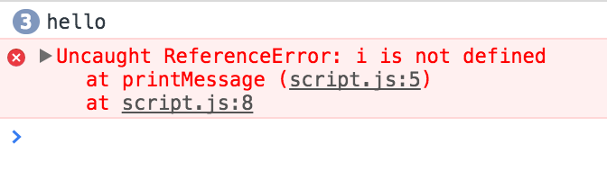
Understanding let
function printMessage(message, times) {
for (let i = 0; i < times; i++) {
console.log(message);
}
console.log('Value of i is ' + i);
}
printMessage('hello', 3);
let has block-scope so this results in an error

Slide 52
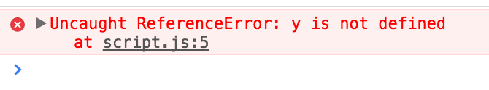
Understanding const
let x = 10;
if (x > 0) {
const y = 10;
}
console.log(y); // error!
Like let, const also has block-scope, so accessing the variable outside the block results in an error

Slide 53
Understanding const
const y = 10;
y = 0; // error!
y++; // error!
const list = [1, 2, 3];
list.push(4); // OK
const declared variables cannot be reassigned.
However, it doesn't provide true const correctness, so you can still modify the underlying object
(In other words, it behaves like Java's final keyword and not C++'s const keyword)

Slide 54
Contrasting with let
let y = 10;
y = 0; // OK
y++; // OK
let list = [1, 2, 3];
list.push(4); // OK
let can be reassigned, which is the difference between const and let

Slide 55
Variables best practices
Use const whenever possible.
If you need a variable to be reassignable, use let.
Don't use var.
  You will see a ton of example code on the internet with var since const and let are relatively new.
  However, const and let are well-supported, so there's no reason not to use them.
(This is also what the Google and AirBnB JavaScript Style Guides recommend.)

Slide 56
Variables best practices
Use const whenever possible.
If you need a variable to be reassignable, use let.
Don't use var.
  You will see a ton of example code on the internet with var since const and let are relatively new.
  However, const and let are well-supported, so there's no reason not to use them.
(This is also what the Google and AirBnB JavaScript Style Guides recommend.)
Aside: The internet has a ton of misinformation about JavaScript!
Including several "accepted" StackOverflow answers, tutorials, etc. Lots of stuff online is years out of date.
Tread carefully.

Slide 57
Types
JS variables do not have types, but the values do.
There are six primitive types (mdn):
Boolean : true and false
Number : everything is a double (no integers)
String: in 'single' or "double-quotes"
Symbol: (skipping this today)
Null: null: a value meaning "this has no value"
Undefined: the value of a variable with no value assigned
There are also Object types, including Array, Date, String (the object wrapper for the primitive type), etc.

Slide 58
Numbers
const homework = 0.45;
const midterm = 0.2;
const final = 0.35;
const score =
homework * 87 + midterm * 90 + final * 95;
console.log(score); // 90.4

Slide 59
Numbers
const homework = 0.45;
const midterm = 0.2;
const final = 0.35;
const score =
homework * 87 + midterm * 90 + final * 95;
console.log(score); // 90.4
All numbers are floating point real numbers. No integer type.
Operators are like Java or C++.
Precedence like Java or C++.
A few special values: NaN (not-a-number), +Infinity, -Infinity
There's a Math class: Math.floor, Math.ceil, etc.

Slide 60
Strings
let snack = 'coo';
snack += 'kies';
snack = snack.toUpperCase();
console.log("I want " + snack);

Slide 61
Strings
let snack = 'coo';
snack += 'kies';
snack = snack.toUpperCase();
console.log("I want " + snack);
Can be defined with single or double quotes
  Many style guides prefer single-quote, but there is no functionality difference
Immutable
No char type: letters are strings of length one
Can use plus for concatenation
Can check size via length property (not function)

Slide 62
Boolean
There are two literal values for boolean: true and false that behave as you would expect
Can use the usual boolean operators: && || !
let isHungry = true;
let isTeenager = age > 12 && age < 20;
if (isHungry && isTeenager) {
pizza++;
}

Slide 63
Boolean
Non-boolean values can be used in control statements, which get converted to their "truthy" or "falsy" value:
  null, undefined, 0, NaN, '', "" evaluate to false
  Everything else evaluates to true
if (username) {
// username is defined
}

Slide 64
Equality
JavaScript's == and != are basically broken: they do an implicit type conversion before the comparison.
'' == '0' // false
'' == 0 // true
0 == '0' // true
NaN == NaN // false
[''] == '' // true
false == undefined // false
false == null // false
null == undefined // true

Slide 65
Equality
Instead of fixing == and != , the ECMAScript standard kept the existing behavior but added === and !==
'' === '0' // false
'' === 0 // false
0 === '0' // false
NaN === NaN // still weirdly false
[''] === '' // false
false === undefined // false
false === null // false
null === undefined // false
Always use === and !== and don't use == or !=

Slide 66
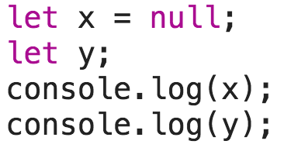
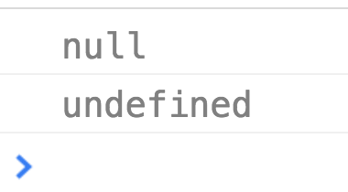
Null and Undefined
What's the difference?
null is a value representing the absence of a value, similar to null in Java and nullptr in C++.
undefined is the value given to a variable that has not been a value.

Slide 67

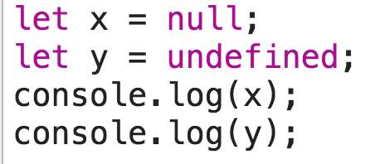
Null and Undefined
What's the difference?
null is a value representing the absence of a value, similar to null in Java and nullptr in C++.
undefined is the value given to a variable that has not been a value.
  … however, you can also set a variable's value to undefined

Slide 68
Arrays
Arrays are Object types used to create lists of data.
// Creates an empty list
let list = [];
let groceries = ['milk', 'cocoa puffs'];
groceries[1] = 'kix';
0-based indexing
Mutable
Can check size via length property (not function)

Slide 69
Events

Slide 70

Event-driven programming
Most JavaScript written in the browser is event-driven:
The code doesn't run right away, but it executes after some event fires.
Example:
Here is a UI element that the user can interact with.
Click Me!

Slide 71
Event-driven programming
Most JavaScript written in the browser is event-driven:
The code doesn't run right away, but it executes after some event fires.
Click Me!
When the user clicks the button...

Slide 72
Event-driven programming
Most JavaScript written in the browser is event-driven:
The code doesn't run right away, but it executes after some event fires.
EVENT!
Click Me!
...the button emits an "event," which is like an announcement that some interesting thing has occurred.

Slide 73
Event-driven programming
Most JavaScript written in the browser is event-driven:
The code doesn't run right away, but it executes after some event fires.
EVENT!
function onClick() {
...
}
Click Me!
Any function listening to that event now executes. This function is called an "event handler."

Slide 74



A few more HTML elements
Buttons:
Single-line text input:
Multi-line text input:

Slide 75
Event-driven programming
Most JavaScript written in the browser is event-driven:
The code doesn't run right away, but it executes after some event fires.
Example:
Here is a UI element that the user can interact with.
Click Me!

Slide 76

Using event listeners
Let's print "Clicked" to the Web Console when the user clicks the given button:
We need to add an event listener to the button...
How do we talk to an element in HTML from JavaScript?

Slide 77
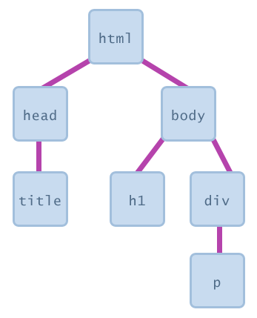
The DOM
Every element on a page is accessible in JavaScript through the DOM: Document Object Model
The DOM is the tree of nodes corresponding to HTML elements on a page.
Can modify, add and remove nodes on the DOM, which will modify, add, or remove the corresponding element on the page.

Slide 78
Getting DOM objects
We can access an HTML element's corresponding DOM object in JavaScript via the querySelector function:
document.querySelector('css selector');
This returns the first element that matches the given CSS selector
// Returns the element with id="button"
let element = document.querySelector('#button');

Slide 79
Adding event listeners
Each DOM object has the following function:
addEventListener(event name, function name);
event name is the string name of the JavaScript event you want to listen to
  Common ones: click, focus, blur, etc
function name is the name of the JavaScript function you want to execute when the event fires

Slide 80
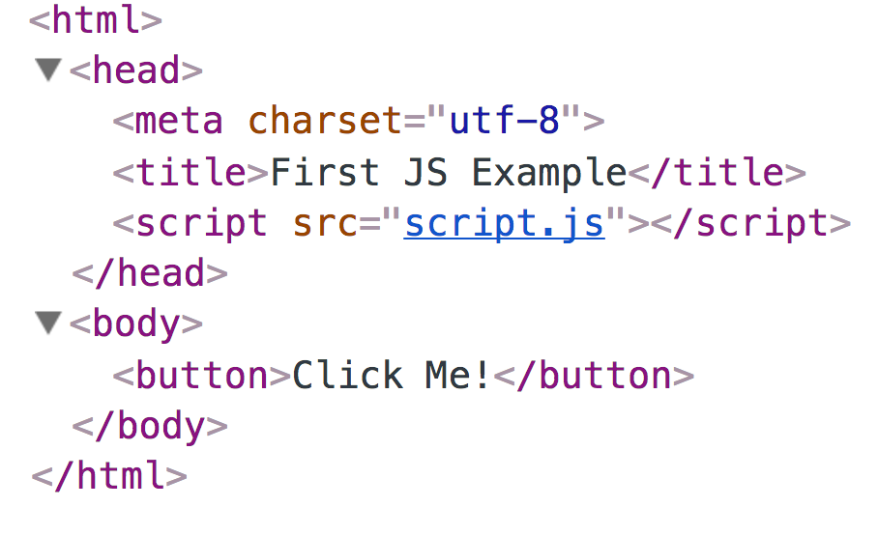
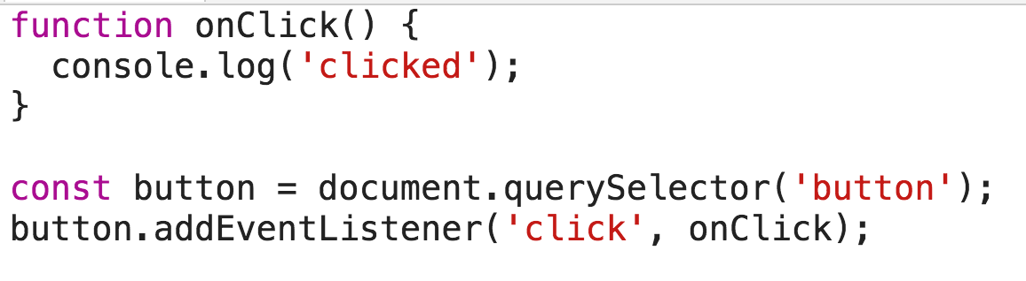

Slide 81
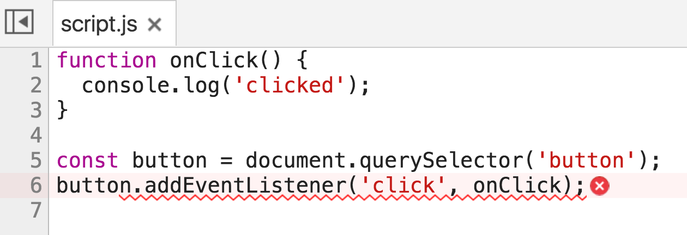
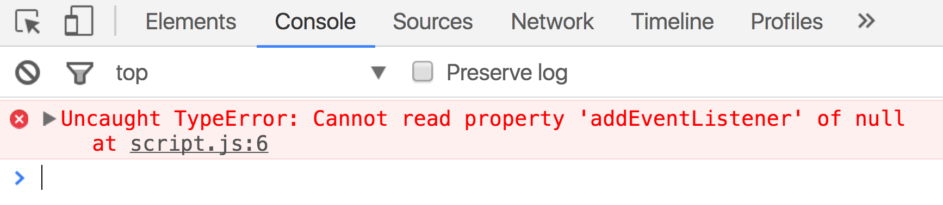
Error! Why?

Slide 82
<head>
<title>web</title>
<link rel="stylesheet" href="style.css" />
<script src="script.js"></script>
</head>

Slide 83
<head>
<title>web</title>
<link rel="stylesheet" href="style.css" />
<script src="script.js"></script>
</head>

Slide 84
<head>
<title>web</title>
<link rel="stylesheet" href="style.css" />
<script src="script.js"></script>
</head>

Slide 85
<head>
<title>web</title>
<link rel="stylesheet" href="style.css" />
<script src="script.js"></script>
</head>
function onClick() {
console.log('clicked');
}
const button = document.querySelector('button');
button.addEventListener('click', onClick);

Slide 86
<head>
<title>web</title>
<link rel="stylesheet" href="style.css" />
<script src="script.js"></script>
</head>
function onClick() {
console.log('clicked');
}
const button = document.querySelector('button');
button.addEventListener('click', onClick);
We are only at the <script> tag, which is at the top of the document… so the <button> isn't available yet.

Slide 87
<head>
<title>web</title>
<link rel="stylesheet" href="style.css" />
<script src="script.js"></script>
</head>
function onClick() {
console.log('clicked');
}
const button = document.querySelector('button');
button.addEventListener('click', onClick);
Therefore querySelector returns null, and we can't call addEventListener on null.

Slide 88
Use defer
You can add the defer attribute onto the script tag so that the JavaScript doesn't execute until after the DOM is loaded (mdn):
<script src="script.js" defer></script>

Slide 89
Use defer
You can add the defer attribute onto the script tag so that the JavaScript doesn't execute until after the DOM is loaded (mdn):
<script src="script.js" defer></script>
Other old-school ways of doing this (don't do these):
Put the <script> tag at the bottom of the page
Listen for the "load" event on the window object
You will see tons of examples on the internet that do this. They are out of date. defer is widely supported and better.

Slide 90
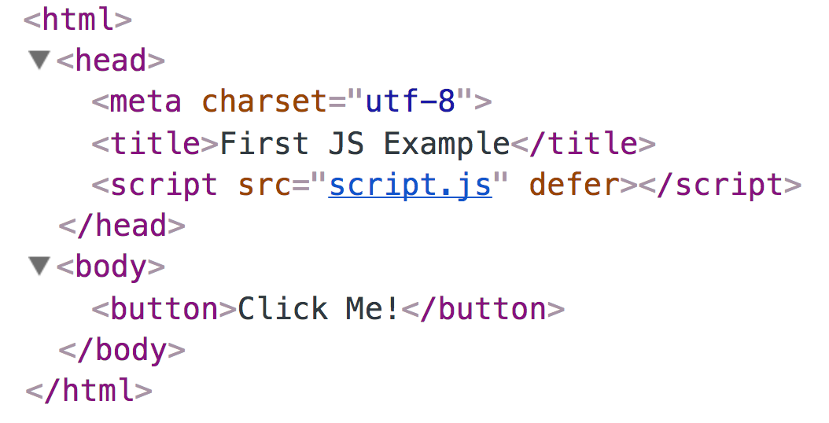
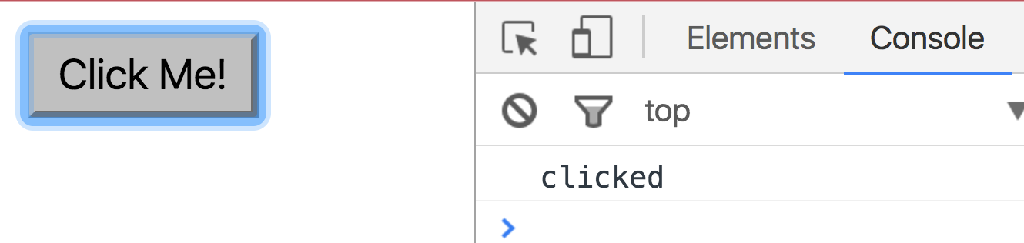

Slide 91
Log messages aren't so interesting...

Slide 92
How do we interact with the page?

Slide 93
DOM object properties
You can access attributes of an HTML element via a property (field) of the DOM object
const image = document.querySelector('img');
image.src = 'new-picture.png';
Some exceptions:
Notably, you can't access the class attribute via object.class

Slide 94
Adding and removing classes
You can control classes applied to an HTML element via classList.add and classList.remove:
const image = document.querySelector('img');
// Adds a CSS class called "active".
image.classList.add('active');
// Removes a CSS class called "hidden".
image.classList.remove('hidden');
(More on classList)

Slide 95
More next time!

